Slide 1

Graphing and Writing Inequalities
Warm Up
Lesson Presentation
Lesson Quiz
Holt Algebra 1
Holt McDougal Algebra 1

Slide 2


Warm Up
Compare. Write <, >, or =.
1. –3 2
3.
<
>
2. 6.5 6.3
>
4. 0.25
=
Tell whether the inequality x < 5 is true or false for the following values of x.
5. x = –10
T
6. x = 5
F
7. x = 4.99
T
8. x =
T

Slide 3
Review Notes: Graphing Inequalities on pg. 40
Complete #1-8 in notes

Slide 4
Textbook pg. 89 #2, 6, 10, 18, 24, 42 on pg. 41 in notebook

Slide 5
Then complete inbox task
Must be completed and turned in at end of period

Slide 6
Objectives
Identify solutions of inequalities with one variable.
Write and graph inequalities with one variable.

Slide 7
Vocabulary
inequality
solution of an inequality

Slide 8
An inequality is a statement that two quantities are not equal. The quantities are compared by using the following signs:
<
>
≤
≥
≠
A < B
A > B
A ≤ B
A ≥ B
A ≠ B
A is less
than B.
A is greater
than B.
A is less
than or
equal to B.
A is greater
than or
equal to B.
A is not
equal to B.
A solution of an inequality is any value of the variable that makes the inequality true.

Slide 9
Example 1: Identifying Solutions of Inequalities
Describe the solutions of x – 6 ≥ 4 in words.
x
–3
0
9.9
10
10.1
12
x – 6
–9
–6
3.9
4
4.1
6
?
?
?
?
?
?
?
x – 6 ≥ 4
–9 4
–6 4
3.9 4
4 4
4.1 4
6 4
≥
≥
≥
≥
≥
≥
Solution?
No
No
No
Yes
Yes
Yes
When the value of x is a number less than 10, the value of x – 6 is less than 4.
When the value of x is 10, the value of x – 6 is equal to 4.
When the value of x is a number greater than 10, the value of x – 6 is greater than 4.
It appears that the solutions of x – 6 ≥ 4 are all real numbers greater than or equal to 10.

Slide 10
Check It Out! Example 1
Describe the solutions of 2p > 8 in words.
p
–3
0
3.9
4
4.1
5
2p
–6
0
7.8
8
8.2
10
?
?
?
?
?
?
?
>
>
>
>
>
–6 8
0 8
7.8 8
8 8
2p > 8
>
8.2 8
10 8
Solution?
No
No
No
No
Yes
Yes
When the value of p is a number less than 4, the value of 2p is less than 8.
When the value of p is 4, the value of 2p is equal to 8
When the value of p is a number greater than 4, the value of 2p is greater than 8.
It appears that the solutions of 2p > 8 are all real numbers greater than 4.

Slide 11

An inequality like 3 + x < 9 has too many solutions to list. You can use a graph on a number line to show all the solutions.
The solutions are shaded and an arrow shows that the solutions continue past those shown on the graph. To show that an endpoint is a solution, draw a solid circle at the number. To show an endpoint is not a solution, draw an empty circle.

Slide 12
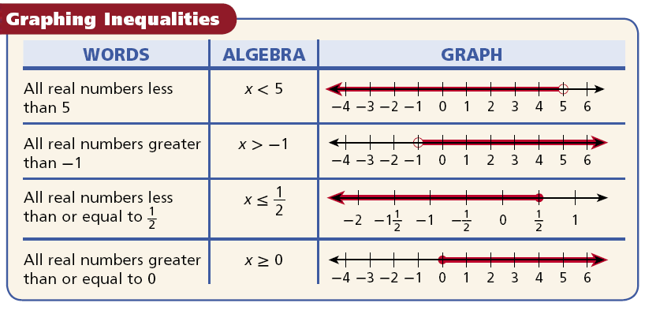

Slide 13
Example 2: Graphing Inequalities
Graph each inequality.
A. m ≥
Draw a solid circle at .
Shade all the numbers greater than and draw an arrow pointing to the right.
–
0
1
2
3
3
B. t < 5(–1 + 3)
Simplify.
t < 5(–1 + 3)
Draw an empty circle at 10.
t < 5(2)
t < 10
Shade all the numbers less than 10 and draw an arrow pointing to the left.
–8
–6
–4
–2
0
2
4
6
8
10
12

Slide 14
Check It Out! Example 2
Graph each inequality.
a. c > 2.5
Draw an empty circle at 2.5.
2.5
Shade in all the numbers greater than 2.5 and draw an arrow pointing to the right.
–4
–3
–2
–1
0
1
2
3
4
5
6
b. 2² – 4 ≥ w
Draw a solid circle at 0.
2² – 4 ≥ w
4 – 4 ≥ w
Shade in all numbers less than 0 and draw an arrow pointing to the left.
0 ≥ w
–4
–3
–2
–1
0
1
2
3
4
5
6
c. m ≤ –3
Draw a solid circle at –3.
–3
Shade in all numbers less than –3 and draw an arrow pointing to the left.
–8
–6
–4
–2
0
2
4
6
8
10
12

Slide 15

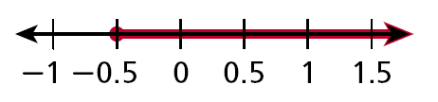
Example 3: Writing an Inequality from a Graph
Write the inequality shown by each graph.
x < 2
Use any variable. The arrow points to the left, so use either < or ≤. The empty circle at 2 means that 2 is not a solution, so use <.
x ≥ –0.5
Use any variable. The arrow points to the right, so use either > or ≥. The solid circle at –0.5 means that –0.5 is a solution, so use ≥.

Slide 16
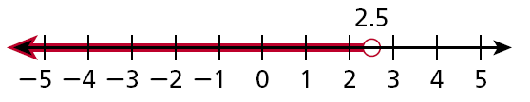
Check It Out! Example 3
Write the inequality shown by the graph.
Use any variable. The arrow points to the left, so use either < or ≤. The empty circle at 2.5 means that 2.5 is not a solution, so use so use <.
x < 2.5

Slide 17
Reading Math
“No more than” means “less than or equal to.”
“At least” means “greater than or equal to”.

Slide 18
Example 4: Application
Ray’s dad told him not to turn on the air conditioner unless the temperature is at least 85°F. Define a variable and write an inequality for the temperatures at which Ray can turn on the air conditioner. Graph the solutions.
Let t represent the temperatures at which Ray can turn on the air conditioner.
Turn on the AC when temperature
is at least
85°F
t
≥
85
t ≥ 85
Draw a solid circle at 85. Shade all numbers greater than 85 and draw an arrow pointing to the right.
70
75
80
85
90

Slide 19
Check It Out! Example 4
A store’s employees earn at least $8.50 per hour. Define a variable and write an inequality for the amount the employees may earn per hour. Graph the solutions.
Let w represent an employee’s wages.
An employee earns
at least
$8.50
w
≥
8.50
w ≥ 8.5
8.5
−2
0
2
4
6
8
10
12
14
16
18

Slide 20


Lesson Quiz: Part I
1. Describe the solutions of 7 < x + 4.
all real numbers greater than 3
2. Graph h ≥ –4.75
–5
–4.75
–4.5
Write the inequality shown by each graph.
3.
x ≥ 3
4.
x < –5.5

Slide 21
Lesson Quiz: Part II
5. A cell phone plan offers free minutes for no more than 250 minutes per month. Define a variable and write an inequality for the possible number of free minutes. Graph the solution.
Let m = number of minutes
0 ≤ m ≤ 250
0
250

