Slide 1

Solving Inequalities by
Adding or Subtracting
Warm Up
Lesson Presentation
Lesson Quiz
Holt Algebra 1
Holt McDougal Algebra 1

Slide 2
Warm Up
Graph each inequality. Write an inequality for each situation.
1. The temperature must be at least –10°F.
2. The temperature must be no more than 90°F.
x ≥ –10
–10
0
10
x ≤ 90
–90
0
90
Solve each equation.
3. x – 4 = 10
14
4. 15 = x + 1.1
13.9

Slide 3
Review Notes: Solving Inequalities by Adding and Subtracting on pg. 42
and Solving Inequalities by Multiplying and Dividing on pg. 44
Complete #1-8 and #1-8 in notes

Slide 4
On pg. 45 in notebook
Pg. 101 #2, 6, 14, 24, 42, 52

Slide 5
No textbook assignment today

Slide 6
Then complete inbox task
Must be completed and turned in at end of period

Slide 7
Objectives
Solve one-step inequalities by using addition.
Solve one-step inequalities by using subtraction.

Slide 8
Solving one-step inequalities is much like solving one-step equations. To solve an inequality, you need to isolate the variable using the properties of inequality and inverse operations.

Slide 9
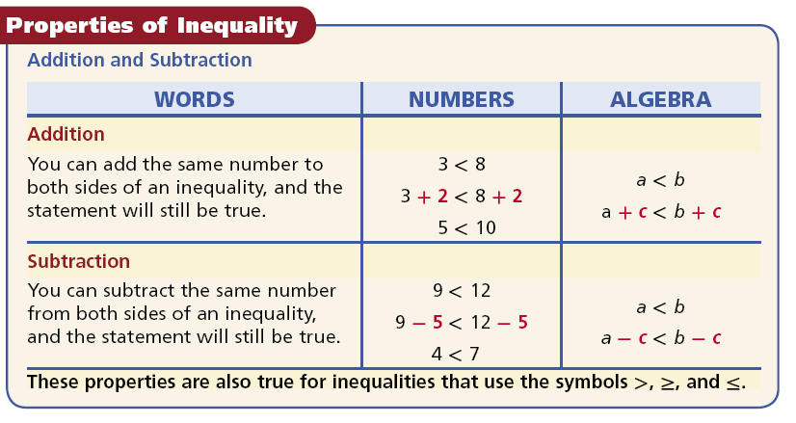

Slide 10
Helpful Hint
Use an inverse operation to “undo” the operation in an inequality. If the inequality contains addition, use subtraction to undo the addition.

Slide 11
Example 1A: Using Addition and Subtraction to Solve
Inequalities
Solve the inequality and graph the solutions.
x + 12 < 20
x + 12 < 20
Since 12 is added to x, subtract 12 from both sides to undo the addition.
–12 –12
x + 0 < 8
x < 8
Draw an empty circle at 8.
–10
–8
–6
–4
–2
0
2
4
6
8
10
Shade all numbers less than 8 and draw an arrow pointing to the left.

Slide 12
Example 1B: Using Addition and Subtraction to Solve
Inequalities
Solve the inequality and graph the solutions.
d – 5 > –7
d – 5 > –7
Since 5 is subtracted from d, add 5 to both sides to undo the subtraction.
+5 +5
d + 0 > –2
d > –2
Draw an empty circle at –2.
–10
–8
–6
–4
–2
0
2
4
6
8
10
Shade all numbers greater than –2 and draw an arrow pointing to the right.

Slide 13
Example 1C: Using Addition and Subtraction to Solve
Inequalities
Solve the inequality and graph the solutions.
0.9 ≥ n – 0.3
0.9 ≥ n – 0.3
Since 0.3 is subtracted from n, add 0.3 to both sides to undo the subtraction.
+0.3 +0.3
1.2 ≥ n – 0
1.2 ≥ n
1.2
Draw a solid circle at 1.2.
•
0
1
2
Shade all numbers less than 1.2 and draw an arrow pointing to the left.

Slide 14




Check It Out! Example 1
Solve each inequality and graph the solutions.
a. s + 1 ≤ 10
Since 1 is added to s, subtract 1 from both sides to undo the addition.
s + 1 ≤ 10
–1 –1
9
s + 0 ≤ 9
–10
–8
–6
–4
–2
0
2
4
6
8
10
s ≤ 9
b. > –3 + t
Since –3 is added to t, add 3 to both sides to undo the addition.
> –3 + t
+3
+3
> 0 + t
–10
–8
–6
–4
–2
0
2
4
6
8
10
t <

Slide 15
Check It Out! Example 1c
Solve the inequality and graph the solutions.
q – 3.5 < 7.5
q – 3.5 < 7.5
Since 3.5 is subtracted from q, add 3.5 to both sides to undo the subtraction.
+ 3.5 +3.5
q – 0 < 11
q < 11
–7
–5
–3
–1
1
3
5
7
9
11
13

Slide 16
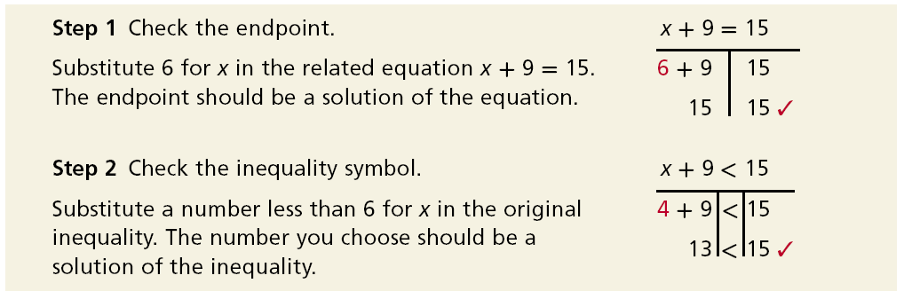
Since there can be an infinite number of solutions to an inequality, it is not possible to check all the solutions. You can check the endpoint and the direction of the inequality symbol.
The solutions of x + 9 < 15 are given by x < 6.

Slide 17


Example 2: Problem-Solving Application
Sami has a gift card. She has already used $14 of the total value, which was $30. Write, solve, and graph an inequality to show how much more she can spend.
1
Understand the problem
The answer will be an inequality and a graph that show all the possible amounts of money that Sami can spend.
List important information:
• Sami can spend up to, or at most $30.
• Sami has already spent $14.

Slide 18

Example 2 Continued
2
Make a Plan
Write an inequality.
Let g represent the remaining amount of money Sami can spend.
Amount remaining
plus
amount used
is at most
$30.
g
+
14
≤
30
g + 14 ≤ 30

Slide 19

Example 2 Continued
3
Solve
g + 14 ≤ 30
Since 14 is added to g, subtract 14 from both sides to undo the addition.
– 14 – 14
g + 0 ≤ 16
g ≤ 16
Draw a solid circle at 0 and16.
0
2
4
6
8
10
12
14
16
18
10
Shade all numbers greater than 0 and less than 16.
The amount spent cannot be negative.

Slide 20

Example 2 Continued
4
Look Back
Check
Check a number less
than 16.
Check the endpoint, 16.
g + 14 = 30
g + 14 ≤ 30
16 + 14 30
6 + 14 ≤ 30
30 30
✓
20 ≤ 30
✓
Sami can spend from $0 to $16.

Slide 21

Check It Out! Example 2
The Recommended Daily Allowance (RDA) of iron for a female in Sarah’s age group (14-18 years) is 15 mg per day. Sarah has consumed 11 mg of iron today. Write and solve an inequality to show how many more milligrams of iron Sarah can consume without exceeding RDA.

Slide 22
Check It Out! Example 2 Continued
1
Understand the problem
The answer will be an inequality and a graph that show all the possible amounts of iron that Sarah can consume to reach the RDA.
List important information:
• The RDA of iron for Sarah is 15 mg.
• So far today she has consumed 11 mg.

Slide 23
Check It Out! Example 2 Continued
2
Make a Plan
Write an inequality.
Let x represent the amount of iron Sarah needs to consume.
Amount taken
plus
amount needed
is at most
15 mg
11
+
x
≤
15
11 + x ≤ 15

Slide 24
Check It Out! Example 2 Continued
3
Solve
11 + x ≤ 15
Since 11 is added to x, subtract 11 from both sides to undo the addition.
–11 –11
x ≤ 4
Draw a solid circle at 4.
Shade all numbers less than 4.
0
1
2
3
4
5
6
7
8
9
10
x ≤ 4. Sarah can consume 4 mg or less of iron without exceeding the RDA.

Slide 25
Check It Out! Example 2 Continued
4
Look Back
Check
Check a number less than 4.
Check the endpoint, 4.
11 + x = 15
11 + 3 ≤ 15
11 + 4 15
11 + 3 ≤ 15
15 15
✓
14 ≤ 15
✓
Sarah can consume 4 mg or less of iron without exceeding the RDA.

Slide 26
Example 3: Application
Mrs. Lawrence wants to buy an antique bracelet at an auction. She is willing to bid no more than $550. So far, the highest bid is $475. Write and solve an inequality to determine the amount Mrs. Lawrence can add to the bid. Check your answer.
Let x represent the amount Mrs. Lawrence can add to the bid.
$475
plus
amount can add
is at most
$550.
475
+
x
≤
550
475 + x ≤ 550

Slide 27
Example 3 Continued
475 + x ≤ 550
–475 – 475
Since 475 is added to x, subtract 475 from both sides to undo the addition.
0 + x ≤ 75
x ≤ 75
Check the endpoint, 75.
Check a number less than 75.
475 + x = 550
475 + x ≤ 550
475 + 75 550
475 + 50 ≤ 550
✓
✓
550 550
525 ≤ 550
Mrs. Lawrence is willing to add $75 or less to the bid.

Slide 28
Check It Out! Example 3
What if…? Josh wants to try to break the school bench press record of 282 pounds. He currently can bench press 250 pounds. Write and solve an inequality to determine how many more pounds Josh needs to lift to break the school record. Check your answer.
Let p represent the number of additional pounds Josh needs to lift.
250 pounds
plus
additional pounds
is greater than
282 pounds.
250
+
p
>
282

Slide 29
Check It Out! Example 3 Continued
250 + p > 282
Since 250 is added to p, subtract 250 from both sides to undo the addition.
–250 –250
p > 32
Check
Check the endpoint, 32.
Check a number greater than 32.
250 + p = 282
250 + p > 282
250 + 32 282
250 + 33 > 282
282 282
✓
✓
283 > 282
Josh must lift more than 32 additional pounds to reach his goal.

Slide 30
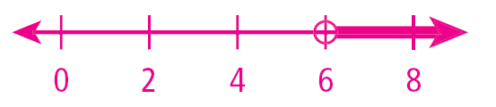
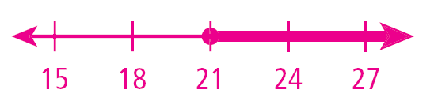
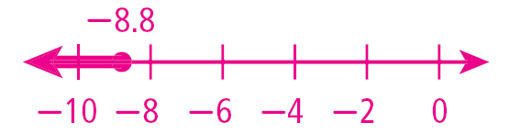
Lesson Quiz: Part I
Solve each inequality and graph the solutions.
1. 13 < x + 7
x > 6
2. –6 + h ≥ 15
h ≥ 21
3. 6.7 + y ≤ –2.1
y ≤ –8.8

Slide 31
Lesson Quiz: Part II
4. A certain restaurant has room for 120 customers. On one night, there are 72 customers dining. Write and solve an inequality to show how many more people can eat at the restaurant.
x + 72 ≤ 120; x ≤ 48, where x is a natural
number

