Slide 1

Congruence and Transformations
Warm Up
Lesson Presentation
Lesson Quiz
Holt Geometry
Holt McDougal Geometry

Slide 2
Warm Up
A figure has vertices A, B, and C. After a transformation, the image of the figure has vertices A′, B′, and C′. Draw the pre-image and the image on graph paper. Then identify the transformation.
A(-3, 1), B(-1, 1), C(-3, 4)
A′(3, 1), B′(5, 1), C′(3, 4)
translation 6 units right
2. A(2, 1), B(5, 1), C(4, 3)
A′(2, -1), B′(5, -1), C′(4, -3)
reflection across x-axis

Slide 3
Review Notes: Congruence and Transformations on pg. 50
Complete #1-6 in notes

Slide 4
Complete pg. 68-69 in workbook
I reminded you to bring your workbooks everyday

Slide 5
Complete your Inbox Task
You may look for examples on this PowerPoint

Slide 6
Objectives
Draw, identify, and describe transformations in the coordinate plane.
Use properties of rigid motions to determine whether figures are congruent and to prove figures congruent.

Slide 7
Vocabulary
dilation
isometry
rigid transformation

Slide 8
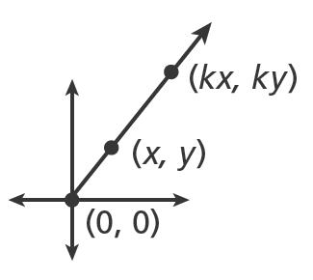
A dilation with scale factor k > 0 and
center (0, 0) maps (x, y) to (kx, ky).

Slide 9
Remember!
In a transformation, the original figure is the pre-image. The resulting figure is the image.

Slide 10
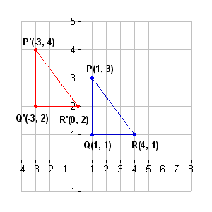
Example 1: Drawing and Identifying Transformations
Apply the transformation M to the polygon with the given vertices. Identify and describe the transformation.
A. M: (x, y) → (x - 4, y + 1)
P(1, 3), Q(1, 1), R(4, 1)
translation 4 units left and 1 unit up

Slide 11
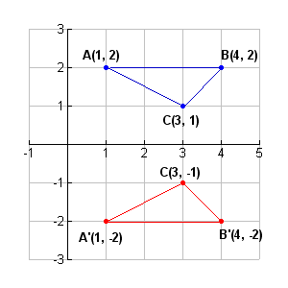
Example 1: Continued
B. M: (x, y) → (x, -y)
A(1, 2), B(4, 2), C(3, 1)
reflection across x-axis

Slide 12
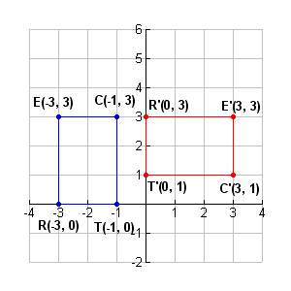
Example 1: Continued
C. M: (x, y) → (y, -x)
R(-3, 0), E(-3, 3), C(-1, 3), T(-1, 0)
90°rotation clockwise with center of rotation (0, 0)

Slide 13
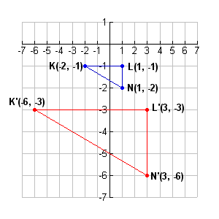
Example 1: Continued
D. M: (x, y) → (3x, 3y)
K(-2, -1), L(1, -1), N(1, -2))
dilation with scale factor 3 and center (0, 0)

Slide 14
Check It Out! Example 1
Apply the transformation M : (x, y) →(3x, 3y) to the polygon with vertices D(1, 3), E(1, -2), and F(3, 0). Name the coordinates of the image points. Identify and describe the transformation.
D’(3, 9), E’(3, -6), F’(9, 0); dilation with scale factor 3

Slide 15
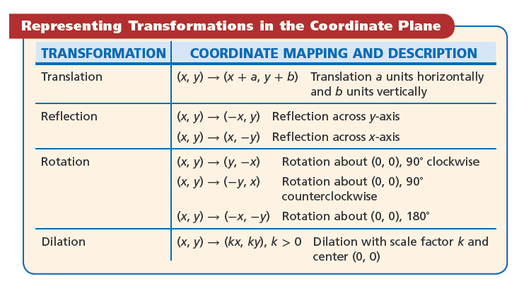

Slide 16
An isometry is a transformation that preserves length, angle measure, and area. Because of these properties, an isometry produces an image that is congruent to the preimage.
A rigid transformation is another name for an isometry.

Slide 17
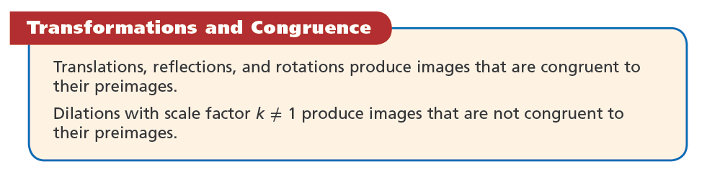

Slide 18
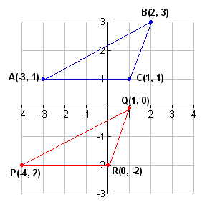
Example 2: Determining Whether Figures are Congruent
Determine whether the polygons with the given vertices are congruent.
A. A(-3, 1), B(2, 3), C(1, 1)
P(-4, -2), Q(1, 0), R(0, -2)
The triangle are congruent; △ ABC can be mapped to △PQR by a translation: (x, y) → (x - 1, y - 3).

Slide 19
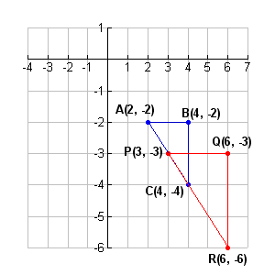
Example 2: Continued
B. A(2, -2), B(4, -2), C(4, -4)
P(3, -3), Q(6, -3), R(6, -6).
The triangles are not congruent; △ ABC can be mapped to △ PQR by a dilation with scale factor k ≠ 1: (x, y) → (1.5x, 1.5y).

Slide 20
Check It Out! Example 2
Determine whether the polygons with the given vertices are congruent. Support your answer by describing a transformation: A(2, -1), B(3, 0), C(2, 3) and P(1, 2), Q(0, 3), R(-3, 2).
The triangles are congruent because ABC can be mapped to PQR by a rotation: (x, y) → (-y, x).

Slide 21
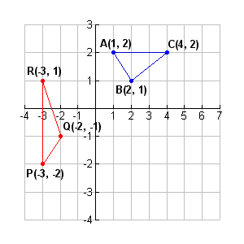
Example 3: Applying Transformations
Prove that the polygons with the given vertices are congruent.
A(1, 2), B(2, 1), C(4, 2)
P(-3, -2), Q(-2, -1), R(-3, 1)
△ ABC can be mapped to △ A′B′C′ by a translation: (x, y) → (x – 3, y + 1); and then △ A′B′C′ can be mapped to △PQR by a rotation: (x, y) → (–y, x).

Slide 22
Check It Out! Example 3
Prove that the polygons with the given vertices are congruent: A(-4, -2), B(-2, 1), C( 2, -2) and P(1, 0), Q(3, -3), R(3, 0).
The triangles are congruent because ABC can be mapped to A’B’C’ by a translation (x, y) → (x + 5, y + 2); and then A’B’C’ can be mapped to ABC by a reflection across the x-axis

Slide 23
Helpful Hint
Translations, reflections, and rotations can be called congruence transformations.

Slide 24
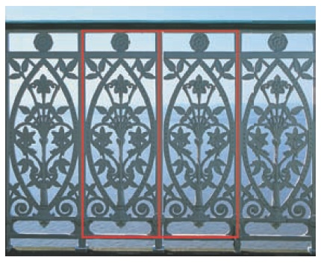
Example 4 : Architecture Application
Is there another transformation that can be used to create this frieze pattern? Explain your answer.

Slide 25
Example 4 : Continued
Repeated reflections can create this frieze pattern; a reflection of any section over a line through either the left or right side of each section.

Slide 26
Check It Out! Example 4
Sketch a frieze pattern that can be produced by using reflections
Possible answer: repeated horizontal reflections

Slide 27
Lesson Quiz : Part-I
Apply the transformation M to the polygon with the given vertices. Identify and describe the transformation.
1. M: (x, y) → (3x, 3y)
A(0, 1), B(2, 1), C(2, -1)
dilation with scale factor 3 and center (0, 0)
2. M: (x, y) → (-y, x)
A(0, 3), B(1, 2), C(4, 5)
90° rotation counterclockwise with center of rotation (0, 0)

Slide 28
Lesson Quiz : Part-II
3. M: (x, y) → (x + 1, y - 2)
A(-2, 1), B(-2, 4), C(0, 3)
translation 1 unit right and 2 units down
4. Determine whether the triangles are congruent. A(1, 1), B(1, -2), C(3, 0) J(2, 2), K(2, -4), L(6, 0)
not ≌; △ ABC can be mapped to △ JKL by a dilation with scale factor k ≠ 1: (x, y) → (2x, 2y).

Slide 29
Lesson Quiz : Part-III
5. Prove that the triangles are congruent. A(1, -2), B(4, -2), C(1, -4) D(-2, 2), E(-5, 2), F(-2, 0)
△ ABC can be mapped to △ A′B′C′ by a translation: (x, y) → (x + 1, y + 4); and then △ A′B′C′ can be mapped to △DEF by a reflection: (x, y) → (-x, y).

