Slide 1

Solving Inequalities by Multiplying or Dividing
Warm Up
Lesson Presentation
Lesson Quiz
Holt Algebra 1
Holt McDougal Algebra 1

Slide 2



Warm Up
Solve each equation.
1. –5a = 30 2.
3.
4.
Graph each inequality.
5. x ≥ –10
6. x < –3

Slide 3




Warm Up
Solve each equation.
1. –5a = 30 2.
–6
–10
3.
4.
Graph each inequality.
5. x ≥ –10
6. x < –3

Slide 4
Objectives
Solve one-step inequalities by using multiplication.
Solve one-step inequalities by using division.

Slide 5
Remember, solving inequalities is similar to solving equations. To solve an inequality that contains multiplication or division, undo the operation by dividing or multiplying both sides of the inequality by the same number.
The following rules show the properties of inequality for multiplying or dividing by a positive number. The rules for multiplying or dividing by a negative number appear later in this lesson.

Slide 6
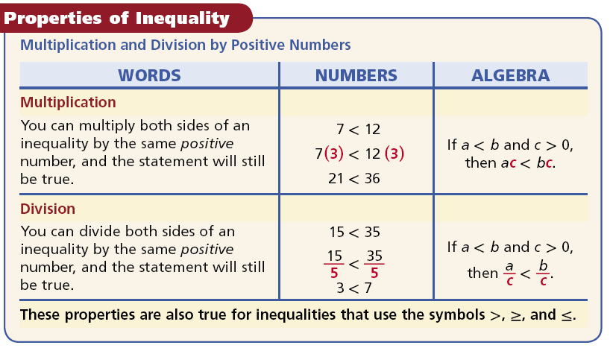

Slide 7


Example 1A: Multiplying or Dividing by a Positive Number
Solve the inequality and graph the solutions.
7x > –42
7x > –42
Since x is multiplied by 7, divide both sides by 7 to undo the multiplication.
>
1x > –6
x > –6
–10
–8
–6
–4
–2
0
2
4
6
8
10

Slide 8


Example 1B: Multiplying or Dividing by a Positive Number
Solve the inequality and graph the solutions.
Since m is divided by 3, multiply both sides by 3 to undo the division.
3(2.4) ≤ 3
7.2 ≤ m
(or m ≥ 7.2)
0
2
4
6
8
10
12
14
16
18
20

Slide 9


Example 1C: Multiplying or Dividing by a Positive Number
Solve the inequality and graph the solutions.
Since r is multiplied by , multiply both sides by the reciprocal of .
r < 16
0
2
4
6
8
10
12
14
16
18
20

Slide 10

Check It Out! Example 1a
Solve the inequality and graph the solutions.
4k > 24
Since k is multiplied by 4, divide both sides by 4.
k > 6
0
2
4
6
8
10
12
14
16
18
20

Slide 11

Check It Out! Example 1b
Solve the inequality and graph the solutions.
–50 ≥ 5q
Since q is multiplied by 5, divide both sides by 5.
–10 ≥ q
–15
–10
–5
0
5
15

Slide 12


Check It Out! Example 1c
Solve the inequality and graph the solutions.
Since g is multiplied by , multiply both sides by the reciprocal of .
g > 36
36
15
20
25
30
35
40

Slide 13
If you multiply or divide both sides of an inequality by a negative number, the resulting inequality is not a true statement. You need to reverse the inequality symbol to make the statement true.

Slide 14
This means there is another set of properties of inequality for multiplying or dividing by a negative number.

Slide 15
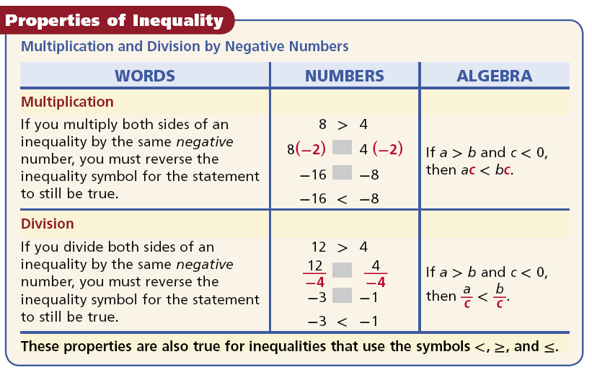

Slide 16
Caution!
Do not change the direction of the inequality symbol just because you see a negative sign. For example, you do not change the symbol when solving 4x < –24.

Slide 17

Example 2A: Multiplying or Dividing by a Negative Number
Solve the inequality and graph the solutions.
–12x > 84
Since x is multiplied by –12, divide both sides by –12. Change > to <.
x < –7
–7
–14
–12
–10
–8
–6
–4
–2
0
2
4
6

Slide 18


Example 2B: Multiplying or Dividing by a Negative Number
Solve the inequality and graph the solutions.
Since x is divided by –3, multiply both sides by –3. Change to .
24 ≥ x
(or x ≤ 24)
10
12
14
16
18
20
22
24
26
28
30

Slide 19

Check It Out! Example 2
Solve each inequality and graph the solutions.
a. 10 ≥ –x
Multiply both sides by –1 to make x positive. Change ≥ to ≤.
–1(10) ≤ –1(–x)
–10 ≤ x
–10
–8
–6
–4
–2
0
2
4
6
8
10
b. 4.25 > –0.25h
Since h is multiplied by –0.25, divide both sides by –0.25. Change > to <.
–17
–17 < h
–20
–16
–12
–8
–4
0
4
8
12
16
20

Slide 20
Example 3: Application
Jill has a $20 gift card to an art supply store where 4 oz tubes of paint are $4.30 each after tax. What are the possible numbers of tubes that Jill can buy?
Let p represent the number of tubes of paint that Jill can buy.
$4.30
times
number of tubes
is at most
$20.00.
4.30
•
p
≤
20.00

Slide 21

Example 3 Continued
4.30p ≤ 20.00
Since p is multiplied by 4.30, divide both sides by 4.30. The symbol does not change.
p ≤ 4.65…
Since Jill can buy only whole numbers of tubes, she can buy 0, 1, 2, 3, or 4 tubes of paint.

Slide 22
Check It Out! Example 3
A pitcher holds 128 ounces of juice. What are the possible numbers of 10-ounce servings that one pitcher can fill?
Let x represent the number of servings of juice the pitcher can contain.
number of servings
10 oz
times
is at most
128 oz
10
•
x
≤
128

Slide 23

Check It Out! Example 3 Continued
10x ≤ 128
Since x is multiplied by 10, divide both sides by 10.
The symbol does not change.
x ≤ 12.8
The pitcher can fill 0, 1, 2, 3, 4, 5, 6, 7, 8, 9, 10, 11, or 12 servings.

Slide 24


Lesson Quiz
Solve each inequality and graph the solutions.
1. 8x < –24
x < –3
2. –5x ≥ 30
x ≤ –6
3.
x > 20
4.
x ≥ 6
5. A soccer coach plans to order more shirts for her team. Each shirt costs $9.85. She has $77 left in her uniform budget. What are the possible number of shirts she can buy?
0, 1, 2, 3, 4, 5, 6, or 7 shirts

Slide 25




Lesson Quiz
Solve each inequality and graph the solutions.
1. 8x < –24
x < –3
2. –5x ≥ 30
x ≤ –6
3.
x > 20
4.
x ≥ 6
5. A soccer coach plans to order more shirts for her team. Each shirt costs $9.85. She has $77 left in her uniform budget. What are the possible number of shirts she can buy?
0, 1, 2, 3, 4, 5, 6, or 7 shirts

