Slide 1

Angle Relationships in Triangles
Warm Up
Lesson Presentation
Lesson Quiz
Holt Geometry
Holt McDougal Geometry

Slide 2
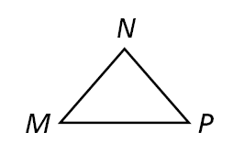
Warm Up
1. Find the measure of exterior ∠DBA of BCD, if m∠DBC = 30°, m∠C= 70°, and m∠D = 80°.
2. What is the complement of an angle with measure 17°?
3. How many lines can be drawn through N parallel to MP? Why?
150°
73°
1; Parallel Post.

Slide 3
Objectives
Find the measures of interior and exterior angles of triangles.
Apply theorems about the interior and exterior angles of triangles.

Slide 4
Vocabulary
auxiliary line
corollary
interior
exterior
interior angle
exterior angle
remote interior angle

Slide 5
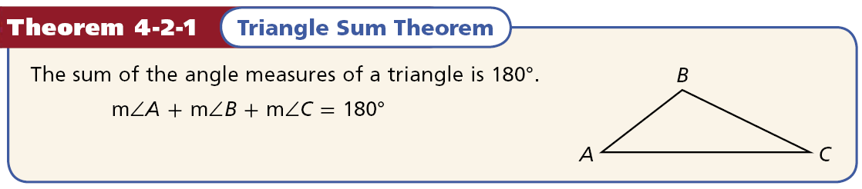

Slide 6
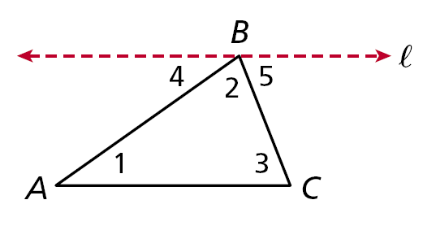
An auxiliary line is a line that is added to a figure to aid in a proof.
An auxiliary line used in the Triangle Sum Theorem

Slide 7
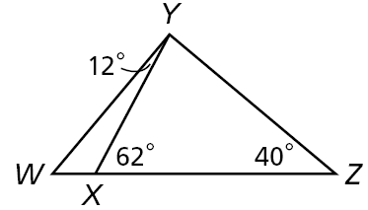
Example 1A: Application
After an accident, the positions of cars are measured by law enforcement to investigate the collision. Use the diagram drawn from the information collected to find m∠XYZ.
m∠XYZ + m∠YZX + m∠ZXY = 180°
Sum. Thm
Substitute 40 for m∠YZX and 62 for m∠ZXY.
m∠XYZ + 40 + 62 = 180
m∠XYZ + 102 = 180
Simplify.
m∠XYZ = 78°
Subtract 102 from both sides.

Slide 8
Example 1B: Application
After an accident, the positions of cars are measured by law enforcement to investigate the collision. Use the diagram drawn from the information collected to find m∠YWZ.
118°
Step 1 Find m∠WXY.
m∠YXZ + m∠WXY = 180°
Lin. Pair Thm. and ∠ Add. Post.
62 + m∠WXY = 180
Substitute 62 for m∠YXZ.
m∠WXY = 118°
Subtract 62 from both sides.

Slide 9
Example 1B: Application Continued
After an accident, the positions of cars are measured by law enforcement to investigate the collision. Use the diagram drawn from the information collected
to find m∠YWZ.
118°
Step 2 Find m∠YWZ.
m∠YWX + m∠WXY + m∠XYW = 180°
Sum. Thm
m∠YWX + 118 + 12 = 180
Substitute 118 for m∠WXY and 12 for m∠XYW.
m∠YWX + 130 = 180
Simplify.
m∠YWX = 50°
Subtract 130 from both sides.

Slide 10
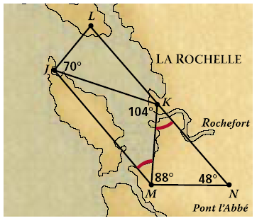
Check It Out! Example 1
Use the diagram to find m∠MJK.
m∠MJK + m∠JKM + m∠KMJ = 180°
Sum. Thm
m∠MJK + 104 + 44= 180
Substitute 104 for m∠JKM and 44 for m∠KMJ.
m∠MJK + 148 = 180
Simplify.
m∠MJK = 32°
Subtract 148 from both sides.

Slide 11
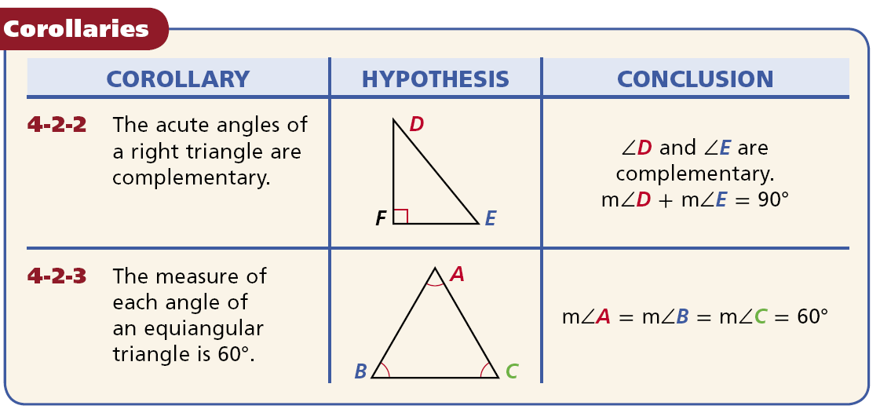
A corollary is a theorem whose proof follows directly from another theorem. Here are two corollaries to the Triangle Sum Theorem.

Slide 12
Example 2: Finding Angle Measures in Right Triangles
One of the acute angles in a right triangle measures 2x°. What is the measure of the other acute angle?
Let the acute angles be ∠A and ∠B, with m∠A = 2x°.
m∠A + m∠B = 90°
Acute ∠s of rt. are comp.
2x + m∠B = 90
Substitute 2x for m∠A.
m∠B = (90 – 2x)°
Subtract 2x from both sides.

Slide 13
Check It Out! Example 2a
The measure of one of the acute angles in a right triangle is 63.7°. What is the measure of the other acute angle?
Let the acute angles be ∠A and ∠B, with m∠A = 63.7°.
m∠A + m∠B = 90°
Acute ∠s of rt. are comp.
63.7 + m∠B = 90
Substitute 63.7 for m∠A.
m∠B = 26.3°
Subtract 63.7 from both sides.

Slide 14
Check It Out! Example 2b
The measure of one of the acute angles in a right triangle is x°. What is the measure of the other acute angle?
Let the acute angles be ∠A and ∠B, with m∠A = x°.
m∠A + m∠B = 90°
Acute ∠s of rt. are comp.
x + m∠B = 90
Substitute x for m∠A.
m∠B = (90 – x)°
Subtract x from both sides.

Slide 15
Check It Out! Example 2c
The measure of one of the acute angles in a right triangle is 48 . What is the measure of the other acute angle?
2° 5
2° 5
Let the acute angles be ∠A and ∠B, with m∠A = 48 .
m∠A + m∠B = 90°
Acute ∠s of rt. are comp.
2 5
2 5
48 + m∠B = 90
Substitute 48 for m∠A.
3° 5
2 5
m∠B = 41
Subtract 48 from both sides.

Slide 16
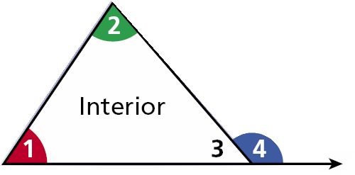
The interior is the set of all points inside the figure. The exterior is the set of all points outside the figure.
Exterior
Interior

Slide 17
An interior angle is formed by two sides of a triangle. An exterior angle is formed by one side of the triangle and extension of an adjacent side.
∠4 is an exterior angle.
Exterior
Interior
∠3 is an interior angle.

Slide 18
Each exterior angle has two remote interior angles. A remote interior angle is an interior angle that is not adjacent to the exterior angle.
∠4 is an exterior angle.
Exterior
The remote interior angles of ∠4 are ∠1 and ∠2.
Interior
∠3 is an interior angle.

Slide 19
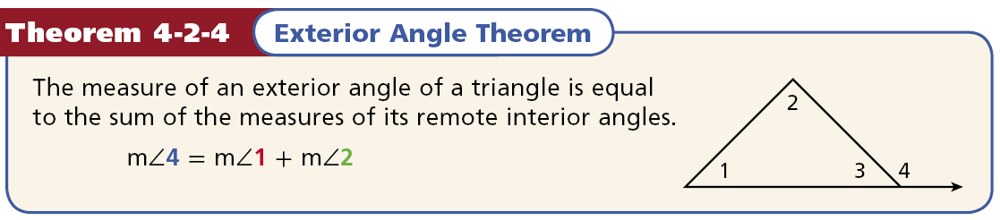

Slide 20
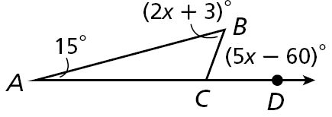
Example 3: Applying the Exterior Angle Theorem
Find m∠B.
m∠A + m∠B = m∠BCD
Ext. ∠ Thm.
15 + 2x + 3 = 5x – 60
Substitute 15 for m∠A, 2x + 3 for m∠B, and 5x – 60 for m∠BCD.
2x + 18 = 5x – 60
Simplify.
Subtract 2x and add 60 to both sides.
78 = 3x
26 = x
Divide by 3.
m∠B = 2x + 3 = 2(26) + 3 = 55°

Slide 21
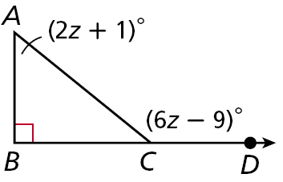
Check It Out! Example 3
Find m∠ACD.
m∠ACD = m∠A + m∠B
Ext. ∠ Thm.
6z – 9 = 2z + 1 + 90
Substitute 6z – 9 for m∠ACD, 2z + 1 for m∠A, and 90 for m∠B.
6z – 9 = 2z + 91
Simplify.
Subtract 2z and add 9 to both sides.
4z = 100
z = 25
Divide by 4.
m∠ACD = 6z – 9 = 6(25) – 9 = 141°

Slide 22
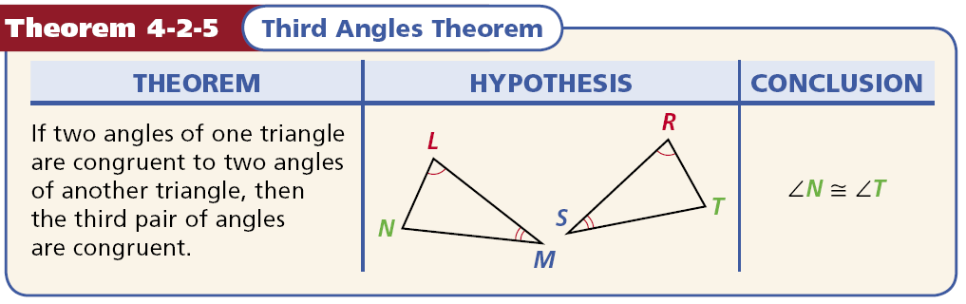

Slide 23
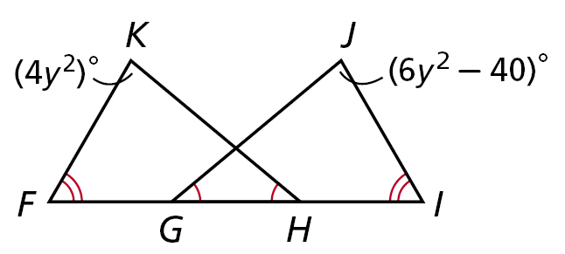
Example 4: Applying the Third Angles Theorem
Find m∠K and m∠J.
∠K ≅ ∠J
Third ∠s Thm.
m∠K = m∠J
Def. of ≅ ∠s.
4y² = 6y² – 40
Substitute 4y² for m∠K and 6y² – 40 for m∠J.
–2y² = –40
Subtract 6y² from both sides.
y² = 20
Divide both sides by -2.
So m∠K = 4y² = 4(20) = 80°.
Since m∠J = m∠K, m∠J = 80°.

Slide 24
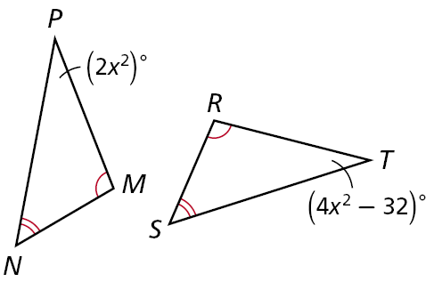
Check It Out! Example 4
Find m∠P and m∠T.
∠P ≅ ∠T
Third ∠s Thm.
m∠P = m∠T
Def. of ≅ ∠s.
2x² = 4x² – 32
Substitute 2x² for m∠P and 4x² – 32 for m∠T.
–2x² = –32
Subtract 4x² from both sides.
x² = 16
Divide both sides by -2.
So m∠P = 2x² = 2(16) = 32°.
Since m∠P = m∠T, m∠T = 32°.

Slide 25
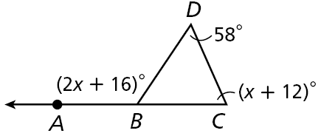
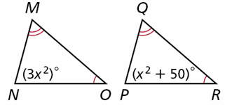
Lesson Quiz: Part I
1. The measure of one of the acute angles in a right triangle is 56 °. What is the measure of the other acute angle?
2. Find m∠ABD. 3. Find m∠N and m∠P.
2 3
1 3
33 °
124°
75°; 75°

Slide 26
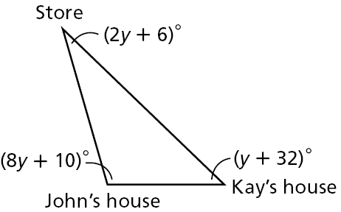
Lesson Quiz: Part II
4. The diagram is a map showing John's house, Kay's house, and the grocery store. What is the angle the two houses make with the store?
30°

