Slide 1

Solving Compound Inequalities
Warm Up
Lesson Presentation
Lesson Quiz
Holt Algebra 1
Holt McDougal Algebra 1

Slide 2

Warm Up
Evaluate each expression for x = 1 and y =–3.
1. x – 4y 2. –2x + y
Write each expression in slope-intercept form.
3. y – x = 1
4. 2x + 3y = 6
5. 0 = 5y + 5x
13
–5
y = x + 1
y = x + 2
y = –x

Slide 3
Review notes on pg. 58 in notebook
complete #1-7 on that page

Slide 4
In workbook complete pages 89 and 94

Slide 5
Complete Inbox Task

Slide 6
Objectives
Solve compound inequalities with one variable.
Graph solution sets of compound inequalities with one variable.

Slide 7
Vocabulary
compound inequality
intersection
union

Slide 8
The inequalities you have seen so far are simple inequalities. When two simple inequalities are combined into one statement by the words AND or OR, the result is called a compound inequality.

Slide 9
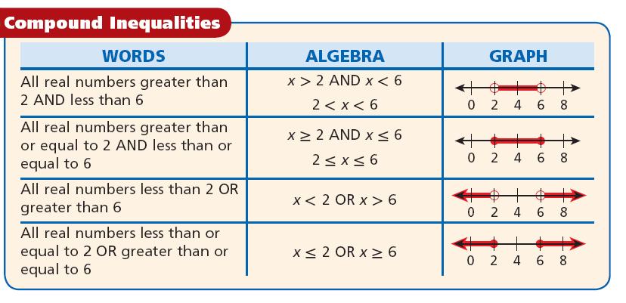

Slide 10
Example 1: Chemistry Application
The pH level of a popular shampoo is between 6.0 and 6.5 inclusive. Write a compound inequality to show the pH levels of this shampoo. Graph the solutions.
Let p be the pH level of the shampoo.
6.0
is less than or equal to
pH level
is less than or equal to
6.5
6.0 ≤ p ≤ 6.5
6.0 ≤ p ≤ 6.5
5.9
6.0
6.1
6.2
6.3
6.4
6.5

Slide 11
Check It Out! Example 1
The free chlorine in a pool should be between 1.0 and 3.0 parts per million inclusive. Write a compound inequality to show the levels that are within this range. Graph the solutions.
Let c be the chlorine level of the pool.
1.0
is less than or equal to
chlorine
is less than or equal to
3.0
1.0 ≤ c ≤ 3.0
1.0 ≤ c ≤ 3.0
0
1
2
3
4
5
6

Slide 12
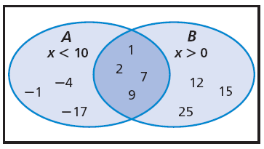
In this diagram, oval A represents some integer solutions of x < 10 and oval B represents some integer solutions of x > 0. The overlapping region represents numbers that belong in both ovals. Those numbers are solutions of both x < 10 and x > 0.

Slide 13
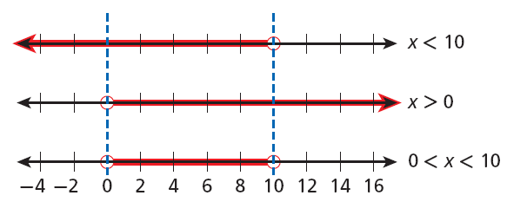
You can graph the solutions of a compound inequality involving AND by using the idea of an overlapping region. The overlapping region is called the intersection and shows the numbers that are solutions of both inequalities.

Slide 14
Example 2A: Solving Compound Inequalities Involving AND
Solve the compound inequality and graph the solutions.
–5 < x + 1 < 2
Since 1 is added to x, subtract 1 from each part of the inequality.
–5 < x + 1 < 2
–1 – 1 – 1
–6 < x < 1
Graph –6 < x.
Graph x < 1.
Graph the intersection by finding where the two graphs overlap.
–10
–8
–6
–4
–2
0
2
4
6
8
10

Slide 15

Example 2B: Solving Compound Inequalities Involving AND
Solve the compound inequality and graph the solutions.
8 < 3x – 1 ≤ 11
8 < 3x – 1 ≤ 11
Since 1 is subtracted from 3x, add 1 to each part of the inequality.
+1 +1 +1
9 < 3x ≤ 12
Since x is multiplied by 3, divide each part of the inequality by 3 to undo the multiplication.
3 < x ≤ 4

Slide 16
Example 2B Continued
Graph 3 < x.
Graph x ≤ 4.
Graph the intersection by finding where the two graphs overlap.
–4
–3
–2
–1
0
1
2
3
4
5
–5

Slide 17
Check It Out! Example 2a
Solve the compound inequality and graph the solutions.
–9 < x – 10 < –5
Since 10 is subtracted from x, add 10 to each part of the inequality.
–9 < x – 10 < –5
+10 +10 +10
1 < x < 5
Graph 1 < x.
Graph x < 5.
Graph the intersection by finding where the two graphs overlap.
–5
–3
–2
0
1
2
3
4
5
–4
–1

Slide 18

Check It Out! Example 2b
Solve the compound inequality and graph the solutions.
–4 ≤ 3n + 5 < 11
–4 ≤ 3n + 5 < 11
Since 5 is added to 3n, subtract 5 from each part of the inequality.
–5 – 5 – 5
–9 ≤ 3n < 6
Since n is multiplied by 3, divide each part of the inequality by 3 to undo the multiplication.
–3 ≤ n < 2
Graph –3 ≤ n.
Graph n < 2.
Graph the intersection by finding where the two graphs overlap.
–5
–3
–2
0
1
2
3
4
5
–4
–1

Slide 19
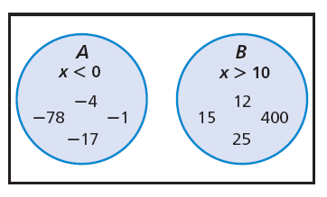
In this diagram, circle A represents some integer solutions of x < 0, and circle B represents some integer solutions of x > 10. The combined shaded regions represent numbers that are solutions of either x < 0 or x >10.

Slide 20
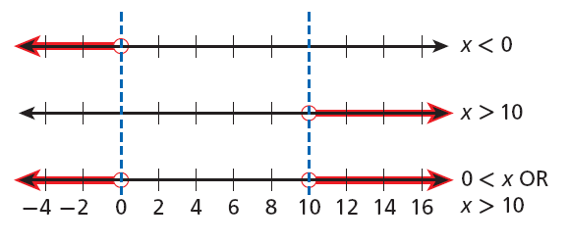
You can graph the solutions of a compound inequality involving OR by using the idea of combining regions. The combine regions are called the union and show the numbers that are solutions of either inequality.
>

Slide 21
Example 3A: Solving Compound Inequalities Involving OR
Solve the inequality and graph the solutions.
8 + t ≥ 7 OR 8 + t < 2
8 + t ≥ 7 OR 8 + t < 2
Solve each simple inequality.
–8 –8 –8 −8
t ≥ –1 OR t < –6
Graph t ≥ –1.
Graph t < –6.
Graph the union by combining the regions.
–10
–8
–6
–4
–2
0
2
4
6
8
10

Slide 22

Example 3B: Solving Compound Inequalities Involving OR
Solve the inequality and graph the solutions.
4x ≤ 20 OR 3x > 21
4x ≤ 20 OR 3x > 21
Solve each simple inequality.
x ≤ 5 OR x > 7
Graph x ≤ 5.
Graph x > 7.
Graph the union by combining the regions.
–10
–8
–6
–4
–2
0
2
4
6
8
10

Slide 23
Check It Out! Example 3a
Solve the compound inequality and graph the solutions.
2 +r < 12 OR r + 5 > 19
2 +r < 12 OR r + 5 > 19
Solve each simple inequality.
–2 –2 –5 –5
r < 10 OR r > 14
Graph r < 10.
Graph r > 14.
Graph the union by combining the regions.
–4
–2
0
2
4
6
8
10
12
14
16

Slide 24


Check It Out! Example 3b
Solve the compound inequality and graph the solutions.
7x ≥ 21 OR 2x < –2
7x ≥ 21 OR 2x < –2
Solve each simple inequality.
x ≥ 3 OR x < –1
Graph x ≥ 3.
Graph x < −1.
Graph the union by combining the regions.
–5
–3
–2
0
1
2
3
4
5
–4
–1

Slide 25
Every solution of a compound inequality involving AND must be a solution of both parts of the compound inequality. If no numbers are solutions of both simple inequalities, then the compound inequality has no solutions.
The solutions of a compound inequality involving OR are not always two separate sets of numbers. There may be numbers that are solutions of both parts of the compound inequality.

Slide 26

Example 4A: Writing a Compound Inequality from a Graph
Write the compound inequality shown by the graph.
The shaded portion of the graph is not between two values, so the compound inequality involves OR.
On the left, the graph shows an arrow pointing left, so use
either < or ≤. The solid circle at –8 means –8 is a solution so use ≤.
x ≤ –8
On the right, the graph shows an arrow pointing right, so use either > or ≥. The empty circle at 0 means that 0 is not a solution, so use >.
x > 0
The compound inequality is x ≤ –8 OR x > 0.

Slide 27

Example 4B: Writing a Compound Inequality from a Graph
Write the compound inequality shown by the graph.
The shaded portion of the graph is between the values –2 and 5, so the compound inequality involves AND.
The shaded values are on the right of –2, so use > or ≥. The empty circle at –2 means –2 is not a solution, so use >.
m > –2
The shaded values are to the left of 5, so use < or ≤. The empty circle at 5 means that 5 is not a solution so use <.
m < 5
The compound inequality is m > –2 AND m < 5 (or -2 < m < 5).

Slide 28

Check It Out! Example 4a
Write the compound inequality shown by the graph.
The shaded portion of the graph is between the values –9 and –2, so the compound inequality involves AND.
The shaded values are on the right of –9, so use > or ≥. The empty circle at –9 means –9 is not a solution, so use >.
x > –9
The shaded values are to the left of –2, so use < or ≤. The empty circle at –2 means that –2 is not a solution so use <.
x < –2
The compound inequality is –9 < x AND x < –2
(or –9 < x < –2).

Slide 29

Check It Out! Example 4b
Write the compound inequality shown by the graph.
The shaded portion of the graph is not between two values, so the compound inequality involves OR.
On the left, the graph shows an arrow pointing left, so use
either < or ≤. The solid circle at –3 means –3 is a solution, so use ≤.
x ≤ –3
On the right, the graph shows an arrow pointing right, so use either > or ≥. The solid circle at 2 means that 2 is a solution, so use ≥.
x ≥ 2
The compound inequality is x ≤ –3 OR x ≥ 2.

Slide 30

Lesson Quiz: Part I
1. The target heart rate during exercise for a 15 year-old is between 154 and 174 beats per minute inclusive. Write a compound inequality to show the heart rates that are within the target range. Graph the solutions.
154 ≤ h ≤ 174

Slide 31


Lesson Quiz: Part II
Solve each compound inequality and graph the solutions.
2. 2 ≤ 2w + 4 ≤ 12
–1 ≤ w ≤ 4
3. 3 + r > −2 OR 3 + r < −7
r > –5 OR r < –10

Slide 32


Lesson Quiz: Part III
Write the compound inequality shown by each graph.
4.
x < −7 OR x ≥ 0
5.
−2 ≤ a < 4

