Slide 1

Triangle Congruence: SSS and SAS
Warm Up
Lesson Presentation
Lesson Quiz
Holt Geometry
Holt McDougal Geometry

Slide 2
Warm Up
1. Name the angle formed by AB and AC.
2. Name the three sides of ΔABC.
3. ∆QRS ≅ ∆LMN. Name all pairs of congruent corresponding parts.
Possible answer: ∠A
AB, AC, BC
QR ≅ LM, RS ≅ MN, QS ≅ LN, ∠Q ≅ ∠L, ∠R ≅ ∠M, ∠S ≅ ∠N

Slide 3
Objectives
Apply SSS and SAS to construct triangles and solve problems.
Prove triangles congruent by using SSS and SAS.

Slide 4
Vocabulary
triangle rigidity
included angle

Slide 5
In Lesson 4-3, you proved triangles congruent by showing that all six pairs of corresponding parts were congruent.
The property of triangle rigidity gives you a shortcut for proving two triangles congruent. It states that if the side lengths of a triangle are given, the triangle can have only one shape.

Slide 6
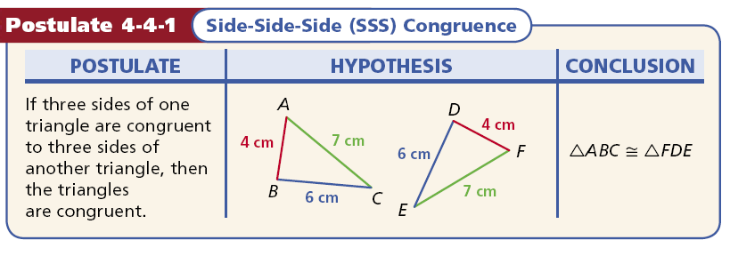
For example, you only need to know that two triangles have three pairs of congruent corresponding sides. This can be expressed as the following postulate.

Slide 7
Remember!
Adjacent triangles share a side, so you can apply the Reflexive Property to get a pair of congruent parts.

Slide 8
Example 1: Using SSS to Prove Triangle Congruence
Use SSS to explain why ∆ABC ≅ ∆DBC.
It is given that AC ≅ DC and that AB ≅ DB. By the Reflexive Property of Congruence, BC ≅ BC. Therefore ∆ABC ≅ ∆DBC by SSS.

Slide 9
Check It Out! Example 1
Use SSS to explain why
∆ABC ≅ ∆CDA.
It is given that AB ≅ CD and BC ≅ DA.
By the Reflexive Property of Congruence, AC ≅ CA.
So ∆ABC ≅ ∆CDA by SSS.

Slide 10
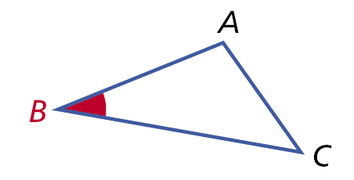
An included angle is an angle formed by two adjacent sides of a polygon.
∠B is the included angle between sides AB and BC.

Slide 11
It can also be shown that only two pairs of congruent corresponding sides are needed to prove the congruence of two triangles if the included angles are also congruent.

Slide 12
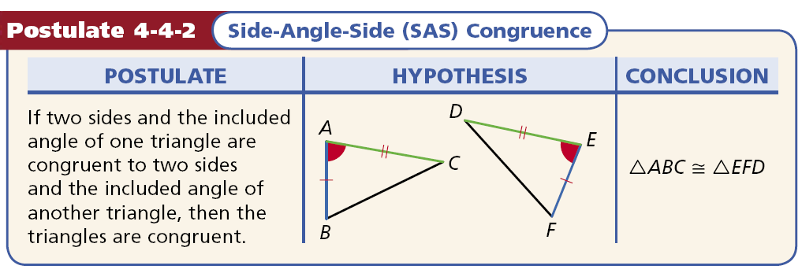

Slide 13
Caution
The letters SAS are written in that order because the congruent angles must be between pairs of congruent corresponding sides.

Slide 14
Example 2: Engineering Application
The diagram shows part of the support structure for a tower. Use SAS to explain why ∆XYZ ≅ ∆VWZ.
It is given that XZ ≅ VZ and that YZ ≅ WZ. By the Vertical ∠s Theorem. ∠XZY ≅ ∠VZW. Therefore ∆XYZ ≅ ∆VWZ by SAS.

Slide 15
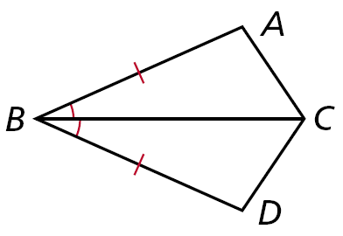
Check It Out! Example 2
Use SAS to explain why ∆ABC ≅ ∆DBC.
It is given that BA ≅ BD and ∠ABC ≅ ∠DBC. By the Reflexive Property of ≅, BC ≅ BC. So ∆ABC ≅ ∆DBC by SAS.

Slide 16
The SAS Postulate guarantees that if you are given the lengths of two sides and the measure of the included angles, you can construct one and only one triangle.

Slide 17
Example 3A: Verifying Triangle Congruence
Show that the triangles are congruent for the given value of the variable.
∆MNO ≅ ∆PQR, when x = 5.
PQ | = x + 2
 | = 5 + 2 = 7
QR | = x = 5
PR | = 3x – 9
 | = 3(5) – 9 = 6
PQ ≅ MN, QR ≅ NO, PR ≅ MO
∆MNO ≅ ∆PQR by SSS.

Slide 18
Example 3B: Verifying Triangle Congruence
Show that the triangles are congruent for the given value of the variable.
∆STU ≅ ∆VWX, when y = 4.
ST | = 2y + 3
 | = 2(4) + 3 = 11
TU | = y + 3
 | = 4 + 3 = 7
m∠T | = 20y + 12
 | = 20(4)+12 = 92°
ST ≅ VW, TU ≅ WX, and ∠T ≅ ∠W.
∆STU ≅ ∆VWX by SAS.

Slide 19
Check It Out! Example 3
Show that ∆ADB ≅ ∆CDB, t = 4.
DA | = 3t + 1
 | = 3(4) + 1 = 13
DC | = 4t – 3
 | = 4(4) – 3 = 13
m∠D | = 2t²
 | = 2(16)= 32°
∠ADB ≅ ∠CDB Def. of ≅.
DB ≅ DB Reflexive Prop. of ≅.
∆ADB ≅ ∆CDB by SAS.

Slide 20
Example 4: Proving Triangles Congruent
Given: BC ║ AD, BC ≅ AD
Prove: ∆ABD ≅ ∆CDB
Statements
Reasons
1. BC || AD
1. Given
2. ∠CBD ≅ ∠ABD
2. Alt. Int. ∠s Thm.
3. BC ≅ AD
3. Given
4. BD ≅ BD
4. Reflex. Prop. of ≅
5. ∆ABD ≅ ∆ CDB
5. SAS Steps 3, 2, 4

Slide 21
Check It Out! Example 4
Given: QP bisects ∠RQS. QR ≅ QS
Prove: ∆RQP ≅ ∆SQP
Statements
Reasons
1. QR ≅ QS
1. Given
2. QP bisects ∠RQS
2. Given
3. ∠RQP ≅ ∠SQP
3. Def. of bisector
4. QP ≅ QP
4. Reflex. Prop. of ≅
5. ∆RQP ≅ ∆SQP
5. SAS Steps 1, 3, 4

Slide 22
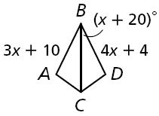
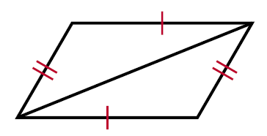
Lesson Quiz: Part I
1. Show that ∆ABC ≅ ∆DBC, when x = 6.
26°
∠ABC ≅ ∠DBC
BC ≅ BC
AB ≅ DB
So ∆ABC ≅ ∆DBC by SAS
Which postulate, if any, can be used to prove the triangles congruent?
2.
3.
none
SSS

Slide 23
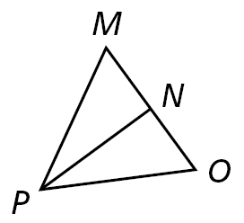
Lesson Quiz: Part II
4. Given: PN bisects MO, PN ⊥ MO
Prove: ∆MNP ≅ ∆ONP
Statements
Reasons
1. PN bisects MO
2. MN ≅ ON
3. PN ≅ PN
4. PN ⊥ MO
5. ∠PNM and ∠PNO are rt. ∠s
6. ∠PNM ≅ ∠PNO
7. ∆MNP ≅ ∆ONP
1. Given
2. Def. of bisect
3. Reflex. Prop. of ≅
4. Given
5. Def. of ⊥
6. Rt. ∠ ≅ Thm.
7. SAS Steps 2, 6, 3

