Slide 1

Triangle Congruence: ASA, AAS, and HL
Warm Up
Lesson Presentation
Lesson Quiz
Holt Geometry
Holt McDougal Geometry

Slide 2
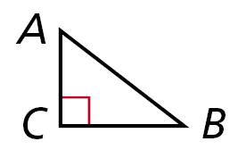
Warm Up
1. What are sides AC and BC called? Side AB?
2. Which side is in between ∠A and ∠C?
3. Given ΔDEF and ΔGHI, if ∠D ≅ ∠G and ∠E ≅ ∠H, why is ∠F ≅ ∠I?
legs; hypotenuse
AC
Third ∠s Thm.

Slide 3
Review notes on pg. 58 in notebook
complete #1-7 on that page

Slide 4
In workbook complete pages 89 and 94

Slide 5
Complete Inbox Task

Slide 6
Objectives
Apply ASA, AAS, and HL to construct triangles and to solve problems.
Prove triangles congruent by using ASA, AAS, and HL.

Slide 7
Vocabulary
included side

Slide 8
Participants in an orienteering race use a map and a compass to find their way to checkpoints along an unfamiliar course.
Directions are given by bearings, which are based on compass headings. For example, to travel along the bearing S 43° E, you face south and then turn 43° to the east.

Slide 9
An included side is the common side of two consecutive angles in a polygon. The following postulate uses the idea of an included side.

Slide 11

Example 1: Problem Solving Application
A mailman has to collect mail from mailboxes at A and B and drop it off at the post office at C. Does the table give enough information to determine the location of the mailboxes and the post office?

Slide 12

1
Understand the Problem
The answer is whether the information in the table can be used to find the position of points A, B, and C.
List the important information: The bearing from A to B is N 65° E. From B to C is N 24° W, and from C to A is S 20° W. The distance from A to B is 8 mi.

Slide 13

2
Make a Plan
Draw the mailman’s route using vertical lines to show north-south directions. Then use these parallel lines and the alternate interior angles to help find angle measures of ΔABC.

Slide 14

3
Solve
m∠CAB = 65° – 20° = 45°
m∠CAB = 180° – (24° + 65°) = 91°
You know the measures of m∠CAB and m∠CBA and the length of the included side AB. Therefore by ASA, a unique triangle ABC is determined.

Slide 15

4
Look Back
One and only one triangle can be made using the information in the table, so the table does give enough information to determine the location of the mailboxes and the post office.

Slide 16
Check It Out! Example 1
What if……? If 7.6km is the distance from B to C, is there enough information to determine the location of all the checkpoints? Explain.
7.6km
Yes; the Δ is uniquely determined by AAS.

Slide 17
Example 2: Applying ASA Congruence
Determine if you can use ASA to prove the triangles congruent. Explain.
Two congruent angle pairs are give, but the included sides are not given as congruent. Therefore ASA cannot be used to prove the triangles congruent.

Slide 18
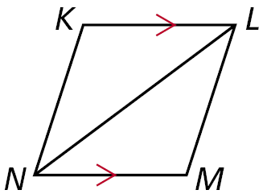
Check It Out! Example 2
Determine if you can use ASA to prove ΔNKL ≅ ΔLMN. Explain.
By the Alternate Interior Angles Theorem. ∠KLN ≅ ∠MNL. NL ≅ LN by the Reflexive Property. No other congruence relationships can be determined, so ASA cannot be applied.

Slide 19
You can use the Third Angles Theorem to prove another congruence relationship based on ASA. This theorem is Angle-Angle-Side (AAS).

Slide 20
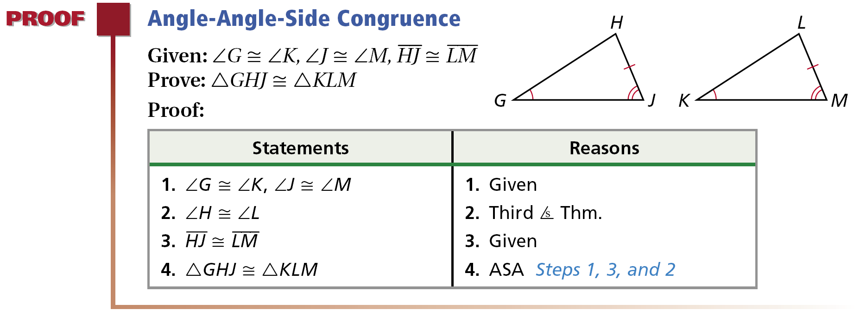

Slide 21
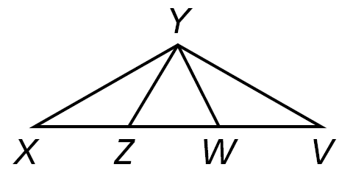
Example 3: Using AAS to Prove Triangles Congruent
Use AAS to prove the triangles congruent.
Given: ∠X ≅ ∠V, ∠YZW ≅ ∠YWZ, XY ≅ VY
Prove: Δ XYZ ≅ ΔVYW

Slide 22
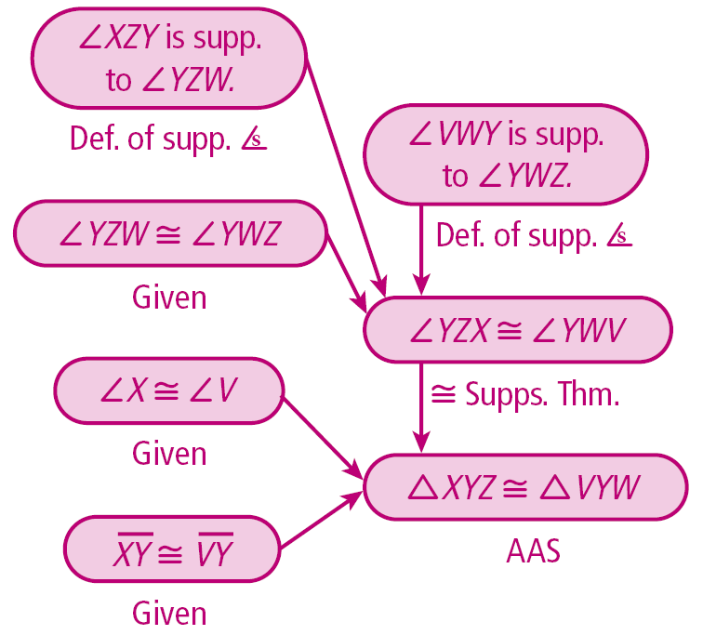

Slide 23
Check It Out! Example 3
Use AAS to prove the triangles congruent.
Given: JL bisects ∠KLM, ∠K ≅ ∠M
Prove: ΔJKL ≅ ΔJML

Slide 26
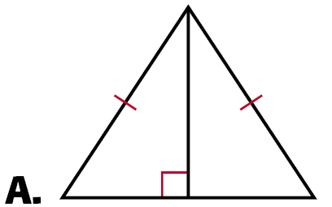
Example 4A: Applying HL Congruence
Determine if you can use the HL Congruence Theorem to prove the triangles congruent. If not, tell what else you need to know.
According to the diagram, the triangles are right triangles that share one leg.
It is given that the hypotenuses are congruent, therefore the triangles are congruent by HL.

Slide 27
Example 4B: Applying HL Congruence
This conclusion cannot be proved by HL. According to the diagram, the triangles are right triangles and one pair of legs is congruent. You do not know that one hypotenuse is congruent to the other.

Slide 28
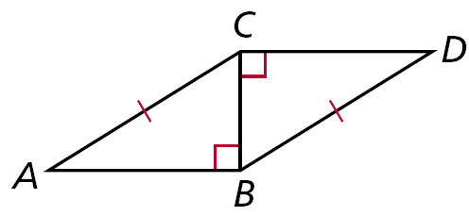
Check It Out! Example 4
Determine if you can use the HL Congruence Theorem to prove ΔABC ≅ ΔDCB. If not, tell what else you need to know.
Yes; it is given that AC ≅ DB. BC ≅ CB by the Reflexive Property of Congruence. Since ∠ABC and ∠DCB are right angles, ΔABC and ΔDCB are right triangles. ΔABC ≅ DCB by HL.

Slide 29
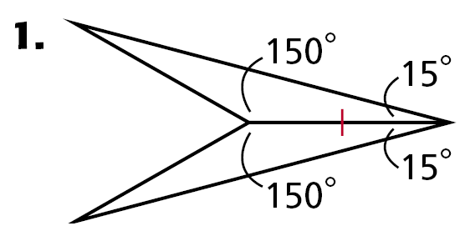
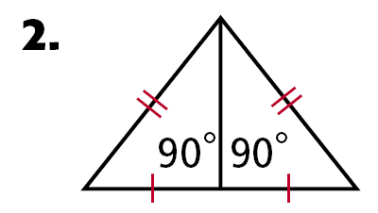
Exit Ticket 1
Identify the postulate or theorem that proves the triangles congruent.
HL
ASA
SAS or SSS
Draw t

Slide 30
Exit Ticket 1
Identify the postulate or theorem that proves the triangles congruent.
4. Draw two triangles that are congruent by SAS

Slide 31
Lesson Quiz: Part II
4. Given: ∠FAB ≅ ∠GED, ∠ABC ≅ ∠ DCE, AC ≅ EC
Prove: ΔABC ≅ ΔEDC

Slide 32
Lesson Quiz: Part II Continued
Statements
Reasons
1. ∠FAB ≅ ∠GED
1. Given
2. ∠BAC is a supp. of ∠FAB; ∠DEC is a supp. of ∠GED.
2. Def. of supp. ∠s
3. ∠BAC ≅ ∠DEC
3. ≅ Supp. Thm.
4. ∠ACB ≅ ∠DCE; AC ≅ EC
4. Given
5. ΔABC ≅ ΔEDC
5. ASA Steps 3,4

