Slide 1

Solving Systems by Graphing
Warm Up
Lesson Presentation
Lesson Quiz
Holt McDougal Algebra 1
Holt Algebra 1

Slide 2

Warm Up
Evaluate each expression for x = 1 and y =–3.
1. x – 4y 2. –2x + y
Write each expression in slope-intercept form.
3. y – x = 1
4. 2x + 3y = 6
5. 0 = 5y + 5x
13
–5
y = x + 1
y = x + 2
y = –x

Slide 3
Objectives
Identify solutions of linear equations in two variables.
Solve systems of linear equations in two variables by graphing.

Slide 4
Vocabulary
systems of linear equations
solution of a system of linear equations

Slide 5
A system of linear equations is a set of two or more linear equations containing two or more variables. A solution of a system of linear equations with two variables is an ordered pair that satisfies each equation in the system. So, if an ordered pair is a solution, it will make both equations true.

Slide 6



Example 1A: Identifying Solutions of Systems
Tell whether the ordered pair is a solution of the given system.
(5, 2);
3x – y = 13
3x – y =13
Substitute 5 for x and 2 for y in each equation in the system.
0
3(5) – 2 13
2 – 2 0
15 – 2 13
0 0
✓
13 13
✓
The ordered pair (5, 2) makes both equations true.
(5, 2) is the solution of the system.

Slide 7
Helpful Hint
If an ordered pair does not satisfy the first equation in the system, there is no reason to check the other equations.

Slide 8
Example 1B: Identifying Solutions of Systems
Tell whether the ordered pair is a solution of the given system.
x + 3y = 4
(–2, 2);
–x + y = 2
x + 3y = 4
–x + y = 2
Substitute –2 for x and 2 for y in each equation in the system.
–2 + 3(2) 4
–(–2) + 2 2
–2 + 6 4
4 2
4 4
✓
The ordered pair (–2, 2) makes one equation true but not the other.
(–2, 2) is not a solution of the system.

Slide 9
Check It Out! Example 1a
Tell whether the ordered pair is a solution of the given system.
(1, 3);
2x + y = 5
–2x + y = 1
2x + y = 5
–2x + y = 1
Substitute 1 for x and 3 for y in each equation in the system.
2(1) + 3 5
–2(1) + 3 1
2 + 3 5
–2 + 3 1
✓
✓
5 5
1 1
The ordered pair (1, 3) makes both equations true.
(1, 3) is the solution of the system.

Slide 10
Check It Out! Example 1b
Tell whether the ordered pair is a solution of the given system.
(2, –1);
x – 2y = 4
3x + y = 6
x – 2y = 4
3x + y = 6
Substitute 2 for x and –1 for y in each equation in the system.
2 – 2(–1) 4
3(2) + (–1) 6
2 + 2 4
6 – 1 6
4 4
✓
5 6
The ordered pair (2, –1) makes one equation true, but not the other.
(2, –1) is not a solution of the system.

Slide 11
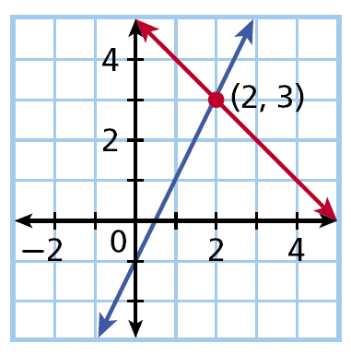
All solutions of a linear equation are on its graph. To find a solution of a system of linear equations, you need a point that each line has in common. In other words, you need their point of intersection.
y = 2x – 1
y = –x + 5
The point (2, 3) is where the two lines intersect and is a solution of both equations, so (2, 3) is the solution of the systems.

Slide 12
Helpful Hint
Sometimes it is difficult to tell exactly where the lines cross when you solve by graphing. It is good to confirm your answer by substituting it into both equations.

Slide 13
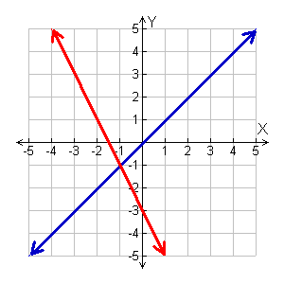
Example 2A: Solving a System by Graphing
Solve the system by graphing. Check your answer.
y = x
y = –2x – 3
Graph the system.
The solution appears to be at (–1, –1).
Check
Substitute (–1, –1) into the system.
y = x
y = x
y = –2x – 3
(–1) (–1)
(–1) –2(–1) –3
•
(–1, –1)
✓
–1 2 – 3
–1 –1
✓
y = –2x – 3
–1 – 1
The solution is (–1, –1).

Slide 14


Example 2B: Solving a System by Graphing
Solve the system by graphing. Check your answer.
y = x – 6
Graph using a calculator and then use the intercept command.
y + x = –1
Rewrite the second equation in slope-intercept form.
y = x – 6
y + x = –1
− x − x
y =

Slide 15








Example 2B Continued
Solve the system by graphing. Check your answer.
Check Substitute into the system.
y = x – 6
y = x – 6
– 6
+ – 1
–1
✓
–1
✓
–1 – 1
The solution is .

Slide 16
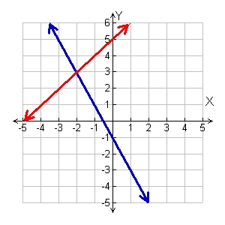
Check It Out! Example 2a
Solve the system by graphing. Check your answer.
y = –2x – 1
Graph the system.
y = x + 5
The solution appears to be (–2, 3).
Check Substitute (–2, 3) into the system.
y = x + 5
y = –2x – 1
y = x + 5
3 –2(–2) – 1
3 –2 + 5
y = –2x – 1
✓
3 4 – 1
3 3
✓
3 3
The solution is (–2, 3).

Slide 17


Check It Out! Example 2b
Solve the system by graphing. Check your answer.
Graph using a calculator and then use the intercept command.
2x + y = 4
Rewrite the second equation in slope-intercept form.
2x + y = 4
2x + y = 4
–2x – 2x
y = –2x + 4

Slide 18

Check It Out! Example 2b Continued
Solve the system by graphing. Check your answer.
2x + y = 4
Check Substitute (3, –2) into the system.
2x + y = 4
2x + y = 4
2(3) + (–2) 4
–2 (3) – 3
6 – 2 4
–2 1 – 3
4 4
✓
–2 –2
✓
The solution is (3, –2).

Slide 19

Example 3: Problem-Solving Application
Wren and Jenni are reading the same book. Wren is on page 14 and reads 2 pages every night. Jenni is on page 6 and reads 3 pages every night. After how many nights will they have read the same number of pages? How many pages will that be?

Slide 20

Example 3 Continued
1
Understand the Problem
The answer will be the number of nights it takes for the number of pages read to be the same for both girls.
List the important information:
Wren on page 14 Reads 2 pages a night
Jenni on page 6 Reads 3 pages a night

Slide 21

Example 3 Continued
2
Make a Plan
Write a system of equations, one equation to represent the number of pages read by each girl. Let x be the number of nights and y be the total pages read.
Total
pages
number read
every
night
already read.
is
plus
Wren
y
=
2
• x
+
14
Jenni
y
=
3
• x
+
6

Slide 22

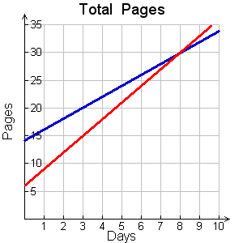
Example 3 Continued
3
Solve
Graph y = 2x + 14 and y = 3x + 6. The lines appear to intersect at (8, 30). So, the number of pages read will be the same at 8 nights with a total of 30 pages.
•
(8, 30)
Nights

Slide 23

Example 3 Continued
4
Look Back
Check (8, 30) using both equations.
Number of days for Wren to read 30 pages.
✓
2(8) + 14 = 16 + 14 = 30
Number of days for Jenni to read 30 pages.
✓
3(8) + 6 = 24 + 6 = 30

Slide 24
Check It Out! Example 3
Video club A charges $10 for membership and $3 per movie rental. Video club B charges $15 for membership and $2 per movie rental. For how many movie rentals will the cost be the same at both video clubs? What is that cost?

Slide 25
Check It Out! Example 3 Continued
1
Understand the Problem
The answer will be the number of movies rented for which the cost will be the same at both clubs.
List the important information:
Rental price: Club A $3 Club B $2
Membership: Club A $10 Club B $15

Slide 26
Check It Out! Example 3 Continued
2
Make a Plan
Write a system of equations, one equation to represent the cost of Club A and one for Club B. Let x be the number of movies rented and y the total cost.
Total
cost
member-
ship fee.
for each
rental
is
price
plus
Club A
y
=
3
• x
+
10
Club B
y
=
2
• x
+
15

Slide 27
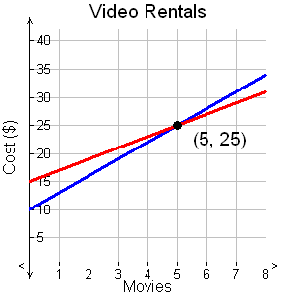
Check It Out! Example 3 Continued
3
Solve
Graph y = 3x + 10 and y = 2x + 15. The lines appear to intersect at (5, 25). So, the cost will be the same for 5 rentals and the total cost will be $25.

Slide 28
Check It Out! Example 3 Continued
4
Look Back
Check (5, 25) using both equations.
Number of movie rentals for Club A to reach $25:
✓
3(5) + 10 = 15 + 10 = 25
Number of movie rentals for Club B to reach $25:
✓
2(5) + 15 = 10 + 15 = 25

Slide 29




Exit Ticket 2
Tell whether the ordered pair is a solution of the given system.
1. (–3, 1);
2. (2, –4);

Slide 30
Lesson Quiz: Part I
Tell whether the ordered pair is a solution of the given system.
1. (–3, 1);
2. (2, –4);
no
yes

Slide 31
Lesson Quiz: Part II
Solve the system by graphing.
3.
4. Joy has 5 collectable stamps and will buy 2 more each month. Ronald has 25 collectable stamps and will sell 3 each month. After how many months will they have the same number of stamps? How many will that be?
y = 2x - 1
(2, )
y = -x + 5
4 months
13 stamps

