Slide 1

Triangle Congruence: CPCTC
Warm Up
Lesson Presentation
Lesson Quiz
Holt Geometry
Holt McDougal Geometry

Slide 2
Warm Up
1. If ∆ABC ≅ ∆DEF, then ∠A ≅ ? and BC ≅ ? .
2. What is the distance between (3, 4) and (–1, 5)?
3. If ∠1 ≅ ∠2, why is a||b?
4. List methods used to prove two triangles congruent.
∠D
EF
√17
Converse of Alternate Interior Angles Theorem
SSS, SAS, ASA, AAS, HL

Slide 3
Objective
Use CPCTC to prove parts of triangles are congruent.

Slide 4
Vocabulary
CPCTC

Slide 5
CPCTC is an abbreviation for the phrase “Corresponding Parts of Congruent Triangles are Congruent.” It can be used as a justification in a proof after you have proven two triangles congruent.

Slide 6
Remember!
SSS, SAS, ASA, AAS, and HL use corresponding parts to prove triangles congruent. CPCTC uses congruent triangles to prove corresponding parts congruent.

Slide 7
Example 1: Engineering Application
A and B are on the edges of a ravine. What is AB?
One angle pair is congruent, because they are vertical angles. Two pairs of sides are congruent, because their lengths are equal.
Therefore the two triangles are congruent by
SAS. By CPCTC, the third side pair is congruent,
so AB = 18 mi.

Slide 8
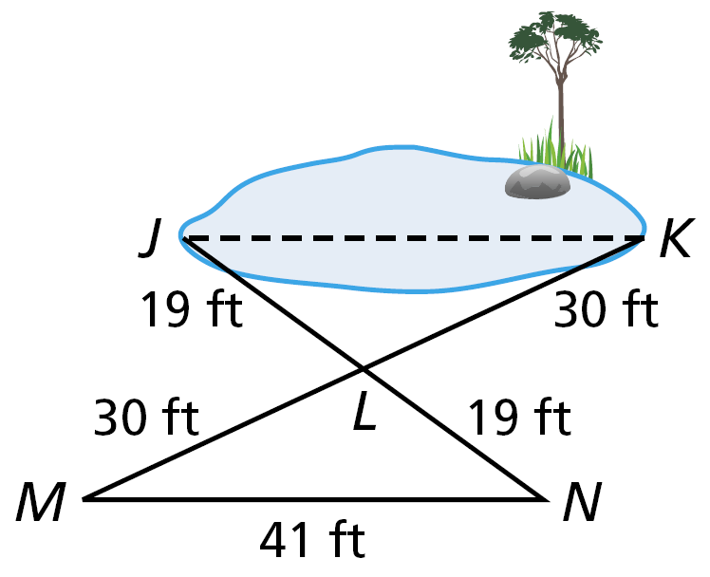
Check It Out! Example 1
A landscape architect sets up the triangles shown in the figure to find the distance JK across a pond. What is JK?
One angle pair is congruent, because they are vertical angles.
Two pairs of sides are congruent, because their lengths are equal. Therefore the two triangles are congruent by SAS. By CPCTC, the third side pair is congruent, so JK = 41 ft.

Slide 9
Example 2: Proving Corresponding Parts Congruent
Given: YW bisects XZ, XY ≅ YZ.
Prove: ∠XYW ≅ ∠ZYW
Z

Slide 10
Example 2 Continued
ZW
WY

Slide 11
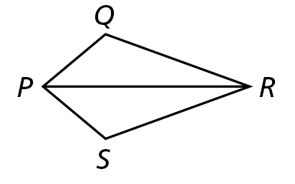
Check It Out! Example 2
Given: PR bisects ∠QPS and ∠QRS.
Prove: PQ ≅ PS

Slide 12
Check It Out! Example 2 Continued
PR bisects ∠QPS
and ∠QRS
∠QRP ≅ ∠SRP
∠QPR ≅ ∠SPR
RP ≅ PR
Given
Reflex. Prop. of ≅
Def. of ∠ bisector
∆PQR ≅ ∆PSR
ASA
PQ ≅ PS
CPCTC

Slide 13
Helpful Hint
Work backward when planning a proof. To show that ED || GF, look for a pair of angles that are congruent.
Then look for triangles that contain these angles.

Slide 14
Example 3: Using CPCTC in a Proof
Given: NO || MP, ∠N ≅ ∠P
Prove: MN || OP

Slide 15
Example 3 Continued
Statements
Reasons
1. ∠N ≅ ∠P; NO || MP
1. Given
2. ∠NOM ≅ ∠PMO
2. Alt. Int. ∠s Thm.
3. MO ≅ MO
3. Reflex. Prop. of ≅
4. ∆MNO ≅ ∆OPM
4. AAS
5. ∠NMO ≅ ∠POM
5. CPCTC
6. MN || OP
6. Conv. Of Alt. Int. ∠s Thm.

Slide 16
Check It Out! Example 3
Given: J is the midpoint of KM and NL.
Prove: KL || MN

Slide 17
Check It Out! Example 3 Continued
Statements
Reasons
1. J is the midpoint of KM and NL.
1. Given
2. KJ ≅ MJ, NJ ≅ LJ
2. Def. of mdpt.
3. ∠KJL ≅ ∠MJN
3. Vert. ∠s Thm.
4. ∆KJL ≅ ∆MJN
4. SAS Steps 2, 3
5. ∠LKJ ≅ ∠NMJ
5. CPCTC
6. KL || MN
6. Conv. Of Alt. Int. ∠s Thm.

Slide 18
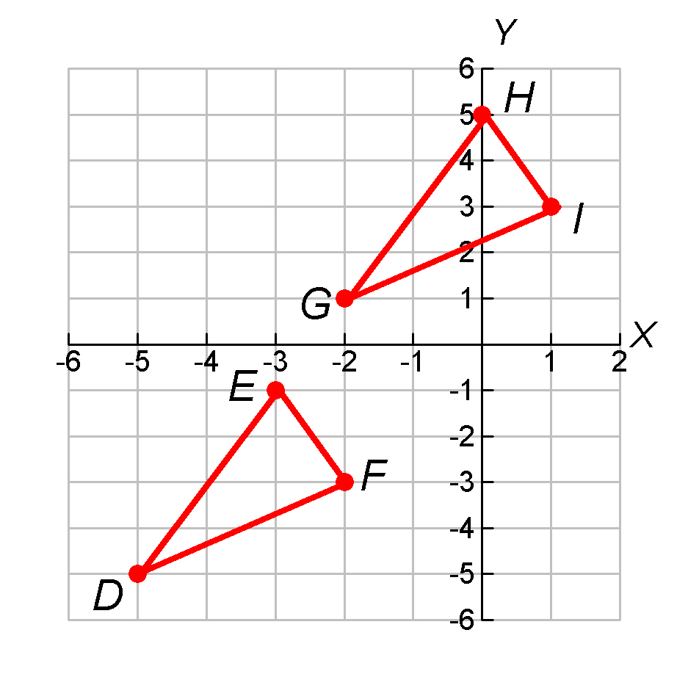
Example 4: Using CPCTC In the Coordinate Plane
Given: D(–5, –5), E(–3, –1), F(–2, –3), G(–2, 1), H(0, 5), and I(1, 3)
Prove: ∠DEF ≅ ∠GHI
Step 1 Plot the points on a coordinate plane.

Slide 19
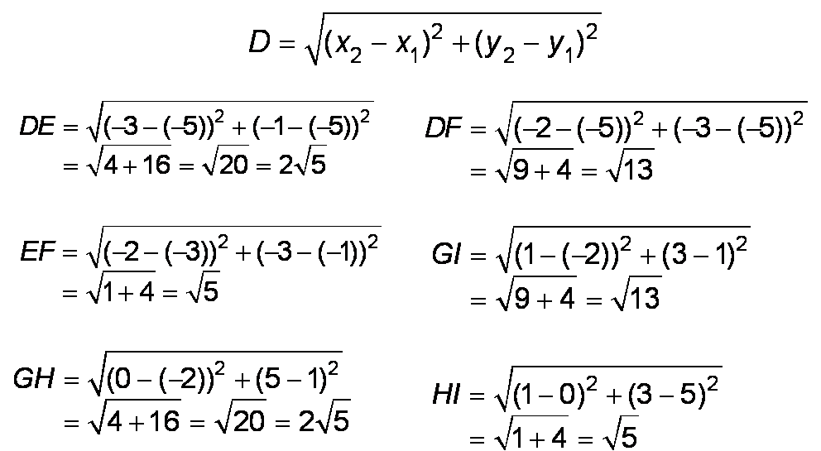
Step 2 Use the Distance Formula to find the lengths of the sides of each triangle.

Slide 20
So DE ≅ GH, EF ≅ HI, and DF ≅ GI.
Therefore ∆DEF ≅ ∆GHI by SSS, and ∠DEF ≅ ∠GHI by CPCTC.

Slide 21
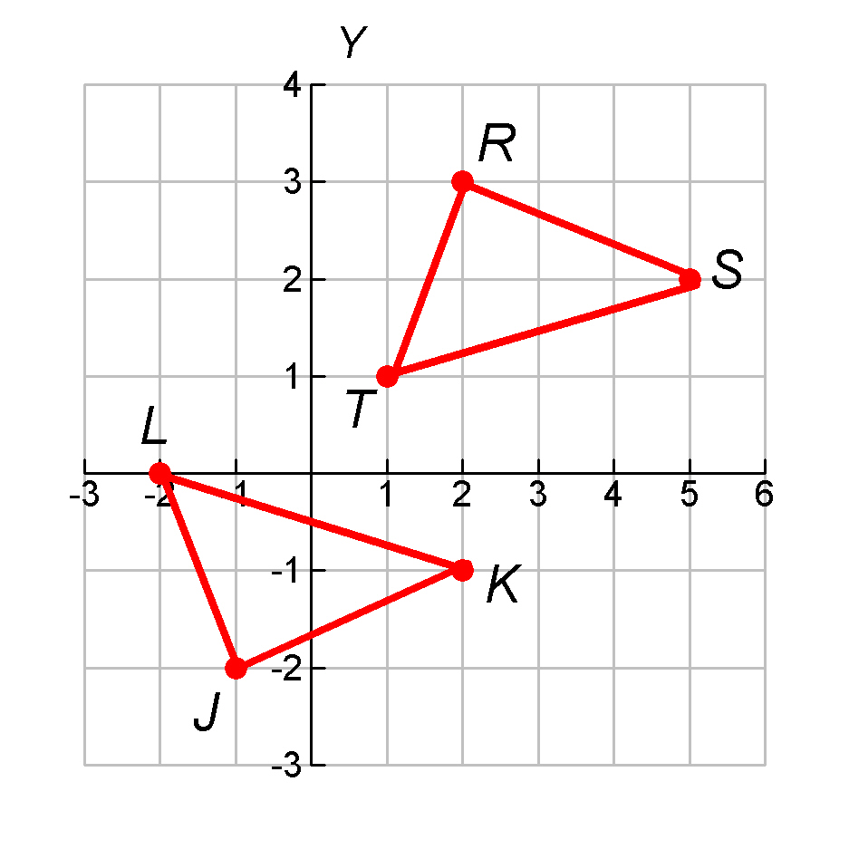
Check It Out! Example 4
Given: J(–1, –2), K(2, –1), L(–2, 0), R(2, 3), S(5, 2), T(1, 1)
Prove: ∠JKL ≅ ∠RST
Step 1 Plot the points on a coordinate plane.

Slide 22
Check It Out! Example 4
Step 2 Use the Distance Formula to find the lengths of the sides of each triangle.
RT = JL = √5, RS = JK = √10, and ST = KL = √17.
So ∆JKL ≅ ∆RST by SSS. ∠JKL ≅ ∠RST by CPCTC.

Slide 23
Lesson Quiz: Part I
1. Given: Isosceles ∆PQR, base QR, PA ≅ PB
Prove: AR ≅ BQ

Slide 24
Lesson Quiz: Part I Continued
Statements
Reasons
1. Isosc. ∆PQR, base QR
1. Given
2. PQ = PR
2. Def. of Isosc. ∆
3. PA = PB
3. Given
4. ∠P ≅ ∠P
4. Reflex. Prop. of ≅
5. ∆QPB ≅ ∆RPA
5. SAS Steps 2, 4, 3
6. AR = BQ
6. CPCTC

Slide 25
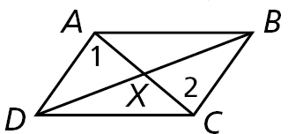
Lesson Quiz: Part II
2. Given: X is the midpoint of AC . ∠1 ≅ ∠2
Prove: X is the midpoint of BD.

Slide 26
Lesson Quiz: Part II Continued
Statements
Reasons
1. X is mdpt. of AC. ∠1 ≅ ∠2
1. Given
2. AX = CX
2. Def. of mdpt.
3. AX ≅ CX
3. Def of ≅
4. ∠AXD ≅ ∠CXB
4. Vert. ∠s Thm.
5. ∆AXD ≅ ∆CXB
5. ASA Steps 1, 4, 5
6. DX ≅ BX
6. CPCTC
7. DX = BX
7. Def. of ≅
8. X is mdpt. of BD.
8. Def. of mdpt.

Slide 27
Lesson Quiz: Part III
3. Use the given set of points to prove
∆DEF ≅ ∆GHJ: D(–4, 4), E(–2, 1), F(–6, 1), G(3, 1), H(5, –2), J(1, –2).
DE = GH = √13, DF = GJ = √13,
EF = HJ = 4, and ∆DEF ≅ ∆GHJ by SSS.

