Slide 1

Solving Systems by Elimination
Warm Up
Lesson Presentation
Lesson Quiz
Holt McDougal Algebra 1
Holt Algebra 1

Slide 2
Warm Up
Simplify each expression.
1. 3x + 2y – 5x – 2y
2. 5(x – y) + 2x + 5y
3. 4y + 6x – 3(y + 2x)
4. 2y – 4x – 2(4y – 2x)
–2x
7x
y
–6y
Write the least common multiple.
5.
3 and 6
6
6.
4 and 10
20
7.
6 and 8
24
8.
2 and 5
10

Slide 3
Objectives
Solve systems of linear equations in two variables by elimination.
Compare and choose an appropriate method for solving systems of linear equations.

Slide 4

Another method for solving systems of equations is elimination. Like substitution, the goal of elimination is to get one equation that has only one variable.
Remember that an equation stays balanced if you add equal amounts to both sides.
Consider the system . Since
5x + 2y = 1, you can add 5x + 2y to one side of the first equation and 1 to the other side and the balance is maintained.

Slide 5
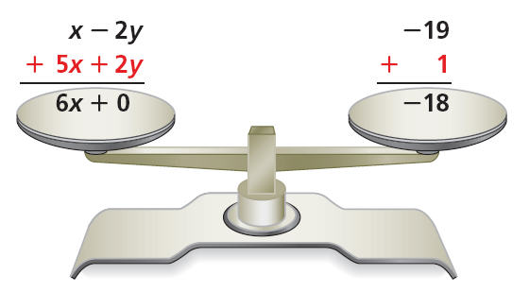
Since –2y and 2y have opposite coefficients, you can eliminate the y by adding the two equations. The result is one equation that has only one variable:
6x = –18.
When you use the elimination method to solve a system of linear equations, align all like terms in the equations. Then determine whether any like terms can be eliminated because they have opposite coefficients.

Slide 6
Solving Systems of Equations by Elimination
Step 1
Write the system so that like terms are aligned.
Eliminate one of the variables and solve for the other variable.
Step 2
Substitute the value of the variable into one of the original equations and solve for the other variable.
Step 3
Write the answers from Steps 2 and 3 as an ordered pair, (x, y), and check.
Step 4

Slide 7
Later in this lesson you will learn how to multiply one or more equations by a number in order to produce opposites that can be eliminated.

Slide 8
Example 1: Elimination Using Addition
3x – 4y = 10
Solve by elimination.
x + 4y = –2
Step 1
3x – 4y = 10
Align like terms. −4y and +4y are opposites.
x + 4y = –2
Step 2
4x + 0 = 8
Add the equations to eliminate y.
4x = 8
Simplify and solve for x.
4x = 8
Divide both sides by 4.
4 4
x = 2

Slide 9
Example 1 Continued
Step 3
x + 4y = –2
Write one of the original equations.
2 + 4y = –2
Substitute 2 for x.
–2 –2
Subtract 2 from both sides.
4y = –4
4y –4
Divide both sides by 4.
4 4
y = –1
Step 4 (2, –1)
Write the solution as an ordered pair.

Slide 10

Check It Out! Example 1
y + 3x = –2
Solve by elimination.
2y – 3x = 14
Align like terms. 3x and −3x are opposites.
Step 1
y + 3x = –2
2y – 3x = 14
Add the equations to eliminate x.
Step 2
3y + 0 = 12
3y = 12
Simplify and solve for y.
Divide both sides by 3.
y = 4

Slide 11
Check It Out! Example 1 Continued
Step 3 y + 3x = –2
Write one of the original equations.
4 + 3x = –2
Substitute 4 for y.
–4 –4
Subtract 4 from both sides.
3x = –6
3x = –6
Divide both sides by 3.
3 3
x = –2
Write the solution as an ordered pair.
Step 4
(–2, 4)

Slide 12
When two equations each contain the same term, you can subtract one equation from the other to solve the system. To subtract an equation, add the opposite of each term.

Slide 13
Example 2: Elimination Using Subtraction
2x + y = –5
Solve by elimination.
2x – 5y = 13
Step 1
2x + y = –5
Both equations contain 2x. Add the opposite of each term in the second equation.
–(2x – 5y = 13)
2x + y = –5
–2x + 5y = –13
Step 2
0 + 6y = –18
Eliminate x.
6y = –18
Simplify and solve for y.
y = –3

Slide 14
Example 2 Continued
Step 3
2x + y = –5
Write one of the original equations.
2x + (–3) = –5
Substitute –3 for y.
2x – 3 = –5
+3 +3
Add 3 to both sides.
2x = –2
Simplify and solve for x.
x = –1
Step 4
(–1, –3)
Write the solution as an ordered pair.

Slide 15
Remember!
Remember to check by substituting your answer into both original equations.

Slide 16
Check It Out! Example 2
3x + 3y = 15
Solve by elimination.
–2x + 3y = –5
Step 1
3x + 3y = 15
Both equations contain 3y. Add the opposite of each term in the second equation.
–(–2x + 3y = –5)
3x + 3y = 15
+ 2x – 3y = +5
Step 2
5x + 0 = 20
Eliminate y.
5x = 20
Simplify and solve for x.
x = 4

Slide 17
Check It Out! Example 2 Continued
Write one of the original equations.
Step 3
3x + 3y = 15
3(4) + 3y = 15
Substitute 4 for x.
12 + 3y = 15
Subtract 12 from both sides.
–12 –12
3y = 3
Simplify and solve for y.
y = 1
Step 4
(4, 1)
Write the solution as an ordered pair.

Slide 18
In some cases, you will first need to multiply one or both of the equations by a number so that one variable has opposite coefficients.

Slide 19
Example 3A: Elimination Using Multiplication First
Solve the system by elimination.
x + 2y = 11
–3x + y = –5
Step 1
x + 2y = 11
Multiply each term in the second equation by –2 to get opposite y-coefficients.
–2(–3x + y = –5)
x + 2y = 11
+(6x –2y = +10)
Add the new equation to the first equation to eliminate y.
7x + 0 = 21
Step 2
7x = 21
Solve for x.
x = 3

Slide 20
Example 3A Continued
Write one of the original equations.
Step 3
x + 2y = 11
3 + 2y = 11
Substitute 3 for x.
–3 –3
Subtract 3 from both sides.
2y = 8
Solve for y.
y = 4
Step 4
(3, 4)
Write the solution as an ordered pair.

Slide 21
Example 3B: Elimination Using Multiplication First
Solve the system by elimination.
–5x + 2y = 32
2x + 3y = 10
Multiply the first equation by 2 and the second equation by 5 to get opposite x-coefficients
Step 1
2(–5x + 2y = 32)
5(2x + 3y = 10)
–10x + 4y = 64
+(10x + 15y = 50)
Add the new equations to
eliminate x.
Step 2
19y = 114
y = 6
Solve for y.

Slide 22
Example 3B Continued
Step 3
2x + 3y = 10
Write one of the original equations.
2x + 3(6) = 10
Substitute 6 for y.
2x + 18 = 10
–18 –18
Subtract 18 from both sides.
2x = –8
x = –4
Solve for x.
Step 4
(–4, 6)
Write the solution as an ordered pair.

Slide 23
Check It Out! Example 3a
Solve the system by elimination.
3x + 2y = 6
–x + y = –2
Multiply each term in the second equation by 3 to get opposite x-coefficients.
Step 1
3x + 2y = 6
3(–x + y = –2)
3x + 2y = 6
+(–3x + 3y = –6)
Add the new equation to the first equation.
0 + 5y = 0
Step 2
5y = 0
Simplify and solve for y.
y = 0

Slide 24
Check It Out! Example 3a Continued
Write one of the original equations.
Step 3
–x + y = –2
–x + 3(0) = –2
Substitute 0 for y.
–x + 0 = –2
Solve for x.
–x = –2
x = 2
Step 4
(2, 0)
Write the solution as an ordered pair.

Slide 25
Check It Out! Example 3b
Solve the system by elimination.
2x + 5y = 26
–3x – 4y = –25
Multiply the first equation by 3 and the second equation by 2 to get opposite x-coefficients
Step 1
3(2x + 5y = 26)
+(2)(–3x – 4y = –25)
6x + 15y = 78
+(–6x – 8y = –50)
Add the new equations to
eliminate x.
Step 2
0 + 7y = 28
y = 4
Solve for y.

Slide 26
Check It Out! Example 3b Continued
Write one of the original equations.
Step 3
2x + 5y = 26
2x + 5(4) = 26
Substitute 4 for y.
2x + 20 = 26
Subtract 20 from both sides.
–20 –20
2X = 6
Solve for x.
x = 3
Step 4
(3, 4)
Write the solution as an ordered pair.

Slide 27
Example 4: Application
Paige has $7.75 to buy 12 sheets of felt and card stock for her scrapbook. The felt costs $0.50 per sheet, and the card stock costs $0.75 per sheet. How many sheets of each can Paige buy?
Write a system. Use f for the number of felt sheets and c for the number of card stock sheets.
0.50f + 0.75c = 7.75
The cost of felt and card stock totals $7.75.
f + c = 12
The total number of sheets is 12.

Slide 28
Example 4 Continued
Step 1
0.50f + 0.75c = 7.75
Multiply the second equation by –0.50 to get opposite f-coefficients.
+ (–0.50)(f + c) = 12
0.50f + 0.75c = 7.75
Add this equation to the first equation to eliminate f.
+ (–0.50f – 0.50c = –6)
Step 2
0.25c = 1.75
c = 7
Solve for c.
Step 3
f + c = 12
Write one of the original equations.
f + 7 = 12
Substitute 7 for c.
–7 –7
Subtract 7 from both sides.
f = 5

Slide 29
Example 4 Continued
Step 4
(7, 5)
Write the solution as an ordered pair.
Paige can buy 7 sheets of card stock and 5 sheets of felt.

Slide 30
Check It Out! Example 4
What if…? Sally spent $14.85 to buy 13 flowers. She bought lilies, which cost $1.25 each, and tulips, which cost $0.90 each. How many of each flower did Sally buy?
Write a system. Use l for the number of lilies and t for the number of tulips.
1.25l + 0.90t = 14.85
The cost of lilies and tulips totals $14.85.
l + t = 13
The total number of flowers is 13.

Slide 31
Check It Out! Example 4 Continued
Step 1
1.25l + .90t = 14.85
Multiply the second equation by –0.90 to get opposite t-coefficients.
+ (–.90)(l + t) = 13
1.25l + 0.90t = 14.85
+ (–0.90l – 0.90t = –11.70)
Add this equation to the first equation to eliminate t.
0.35l = 3.15
Step 2
Solve for l.
l = 9

Slide 32
Check It Out! Example 4 Continued
Step 3
l + t = 13
Write one of the original equations.
9 + t = 13
Substitute 9 for l.
–9 –9
Subtract 9 from both sides.
t = 4
Step 4
(9, 4)
Write the solution as an ordered pair.
Sally bought 9 lilies and 4 tulips.

Slide 33
All systems can be solved in more than one way. For some systems, some methods may be better than others.

Slide 34
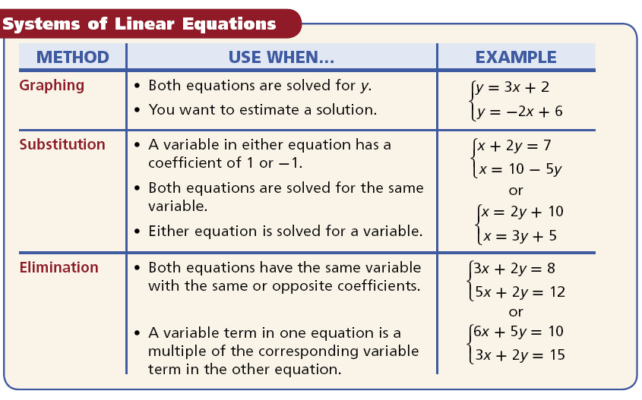

Slide 35
Lesson Quiz
Solve each system by elimination.
1.
2.
3.
2x + y = 25
(11, 3)
3y = 2x – 13
–3x + 4y = –18
x = –2y – 4
(2, –3)
–2x + 3y = –15
(–3, –7)
3x + 2y = –23
4. Harlan has $44 to buy 7 pairs of socks. Athletic socks cost $5 per pair. Dress socks cost $8 per pair. How many pairs of each can Harlan buy?
4 pairs of athletic socks and 3 pairs of dress socks

