Slide 1

Solving Special Systems
Warm Up
Lesson Presentation
Lesson Quiz
Holt McDougal Algebra 1
Holt Algebra 1

Slide 2
Warm Up
Solve each equation.
1. 2x + 3 = 2x + 4
2. 2(x + 1) = 2x + 2
3. Solve 2y – 6x = 10 for y
no solution
infinitely many solutions
y =3x + 5
Solve by using any method.
4.
y = 3x + 2
5.
x – y = 8
(1, 5)
(6, –2)
2x + y = 7
x + y = 4

Slide 3
Objectives
Solve special systems of linear equations in two variables.
Classify systems of linear equations and determine the number of solutions.

Slide 4
Vocabulary
inconsistent system
consistent system
independent system
dependent system

Slide 5
In Lesson 6-1, you saw that when two lines intersect at a point, there is exactly one solution to the system. Systems with at least one solution are called consistent.
When the two lines in a system do not intersect they are parallel lines. There are no ordered pairs that satisfy both equations, so there is no solution. A system that has no solution is an inconsistent system.

Slide 6
Example 1: Systems with No Solution
y = x – 4
Show that has no solution.
–x + y = 3
Method 1 Compare slopes and y-intercepts.
y = x – 4 y = 1x – 4
Write both equations in slope-intercept form.
–x + y = 3 y = 1x + 3
The lines are parallel because they have the same slope and different y-intercepts.
This system has no solution.

Slide 7
Example 1 Continued
y = x – 4
Show that has no solution.
–x + y = 3
Method 2 Solve the system algebraically. Use the substitution method because the first equation is solved for y.
–x + (x – 4) = 3
Substitute x – 4 for y in the second equation, and solve.
–4 = 3
✗
False.
This system has no solution.

Slide 8
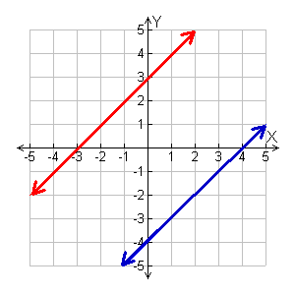
Example 1 Continued
y = x – 4
Show that has no solution.
–x + y = 3
Check Graph the system.
– x + y = 3
The lines appear are parallel.
y = x – 4

Slide 9
Check It Out! Example 1
y = –2x + 5
Show that has no solution.
2x + y = 1
Method 1 Compare slopes and y-intercepts.
y = –2x + 5 y = –2x + 5
Write both equations in slope-intercept form.
2x + y = 1 y = –2x + 1
The lines are parallel because they have the same slope and different y-intercepts.
This system has no solution.

Slide 10
Check It Out! Example 1 Continued
y = –2x + 5
Show that has no solution.
2x + y = 1
Method 2 Solve the system algebraically. Use the substitution method because the first equation is solved for y.
2x + (–2x + 5) = 1
Substitute –2x + 5 for y in the second equation, and solve.
5 = 1
✗
False.
This system has no solution.

Slide 11
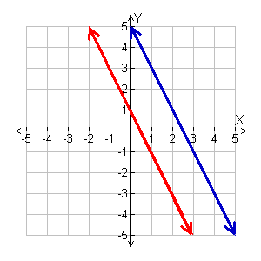
Check It Out! Example 1 Continued
y = –2x + 5
Show that has no solution.
2x + y = 1
Check Graph the system.
y = –2x + 5
y = – 2x + 1
The lines are parallel.

Slide 12
If two linear equations in a system have the same graph, the graphs are coincident lines, or the same line. There are infinitely many solutions of the system because every point on the line represents a solution of both equations.

Slide 13
Example 2A: Systems with Infinitely Many Solutions
y = 3x + 2
Show that has infinitely
many solutions.
3x – y + 2= 0
Method 1 Compare slopes and y-intercepts.
y = 3x + 2 y = 3x + 2
Write both equations in slope-intercept form. The lines have the same slope and the same y-intercept.
3x – y + 2= 0 y = 3x + 2
If this system were graphed, the graphs would be the same line. There are infinitely many solutions.

Slide 14
Example 2A Continued
y = 3x + 2
Show that has infinitely
many solutions.
3x – y + 2= 0
Method 2 Solve the system algebraically. Use the elimination method.
y = 3x + 2 y − 3x = 2
Write equations to line up like terms.
3x − y + 2= 0 −y + 3x = −2
Add the equations.
✓
0 = 0
True. The equation is an identity.
There are infinitely many solutions.

Slide 15
Caution!
0 = 0 is a true statement. It does not mean the system has zero solutions or no solution.

Slide 16
Check It Out! Example 2
y = x – 3
Show that has infinitely
many solutions.
x – y – 3 = 0
Method 1 Compare slopes and y-intercepts.
y = x – 3 y = 1x – 3
Write both equations in slope-intercept form. The lines have the same slope and the same y-intercept.
x – y – 3 = 0 y = 1x – 3
If this system were graphed, the graphs would be the same line. There are infinitely many solutions.

Slide 17
Check It Out! Example 2 Continued
y = x – 3
Show that has infinitely
many solutions.
x – y – 3 = 0
Method 2 Solve the system algebraically. Use the elimination method.
y = x – 3 y = x – 3
Write equations to line up like terms.
x – y – 3 = 0 –y = –x + 3
Add the equations.
✓
0 = 0
True. The equation is an identity.
There are infinitely many solutions.

Slide 18
Consistent systems can either be independent or dependent.
An independent system has exactly one solution. The graph of an independent system consists of two intersecting lines.
A dependent system has infinitely many solutions. The graph of a dependent system consists of two coincident lines.

Slide 19
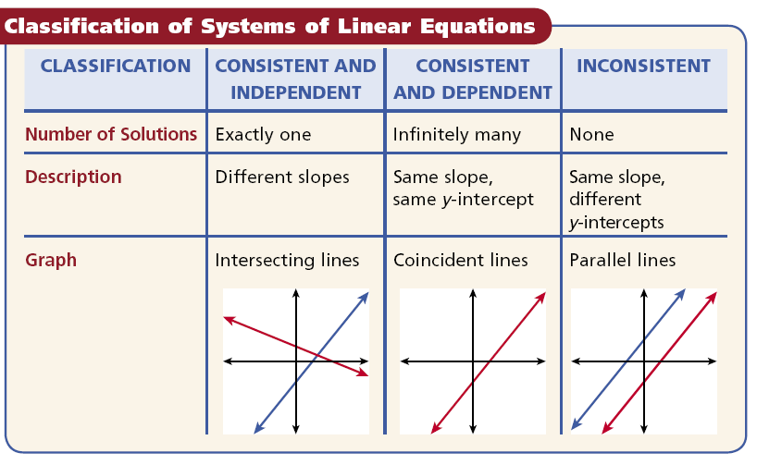

Slide 20


Example 3A: Classifying Systems of Linear Equations
Classify the system. Give the number of solutions.
3y = x + 3
Solve
x + y = 1
3y = x + 3 y = x + 1
Write both equations in slope-intercept form.
x + y = 1
y = x + 1
The lines have the same slope and the same y-intercepts. They are the same.
The system is consistent and dependent. It has infinitely many solutions.

Slide 21
Example 3B: Classifying Systems of Linear equations
Classify the system. Give the number of solutions.
x + y = 5
Solve
4 + y = –x
x + y = 5 y = –1x + 5
Write both equations in slope-intercept form.
4 + y = –x y = –1x – 4
The lines have the same slope and different y-intercepts. They are parallel.
The system is inconsistent. It has no solutions.

Slide 22
Example 3C: Classifying Systems of Linear equations
Classify the system. Give the number of solutions.
y = 4(x + 1)
Solve
y – 3 = x
y = 4(x + 1) y = 4x + 4
Write both equations in slope-intercept form.
y – 3 = x y = 1x + 3
The lines have different slopes. They intersect.
The system is consistent and independent. It has one solution.

Slide 23

Check It Out! Example 3a
Classify the system. Give the number of solutions.
x + 2y = –4
Solve
–2(y + 2) = x
x + 2y = –4
y = x – 2
Write both equations in slope-intercept form.
–2(y + 2) = x
y = x – 2
The lines have the same slope and the same y-intercepts. They are the same.
The system is consistent and dependent. It has infinitely many solutions.

Slide 24
Check It Out! Example 3b
Classify the system. Give the number of solutions.
y = –2(x – 1)
Solve
y = –x + 3
y = –2(x – 1)
y = –2x + 2
Write both equations in slope-intercept form.
y = –x + 3
y = –1x + 3
The lines have different slopes. They intersect.
The system is consistent and independent. It has one solution.

Slide 25
Check It Out! Example 3c
Classify the system. Give the number of solutions.
2x – 3y = 6
Solve
y = x
Write both equations in slope-intercept form.
2x – 3y = 6
y = x – 2
y = x
y = x
The lines have the same slope and different y-intercepts. They are parallel.
The system is inconsistent. It has no solutions.

Slide 26
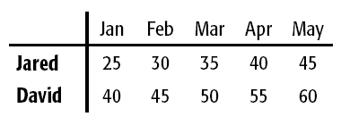
Example 4: Application
Jared and David both started a savings account in January. If the pattern of savings in the table continues, when will the amount in Jared’s account equal the amount in David’s account?
Use the table to write a system of linear equations. Let y represent the savings total and x represent the number of months.

Slide 27
Example 4 Continued
Total saved
start
amount
amount
saved
for each
month.
is
plus
Jared
y
=
$25
+
$5
x
David
y
=
$40
+
$5
x
y = 5x + 25
Both equations are in the slope-intercept form.
y = 5x + 40
y = 5x + 25
The lines have the same slope but different y-intercepts.
y = 5x + 40
The graphs of the two equations are parallel lines, so there is no solution. If the patterns continue, the amount in Jared’s account will never be equal to the amount in David’s account.

Slide 28
Check It Out! Example 4
Matt has $100 in a checking account and deposits $20 per month. Ben has $80 in a checking account and deposits $30 per month. Will the accounts ever have the same balance? Explain.
Write a system of linear equations. Let y represent the account total and x represent the number of months.
y = 20x + 100
Both equations are in slope-intercept form.
y = 30x + 80
y = 20x + 100
The lines have different slopes..
y = 30x + 80
The accounts will have the same balance. The graphs of the two equations have different slopes so they intersect.

Slide 29

Lesson Quiz: Part I
Solve and classify each system.
1.
2.
3.
y = 5x – 1
infinitely many solutions; consistent, dependent
5x – y – 1 = 0
y = 4 + x
no solution; inconsistent
–x + y = 1
y = 3(x + 1)
consistent, independent
y = x – 2

Slide 30
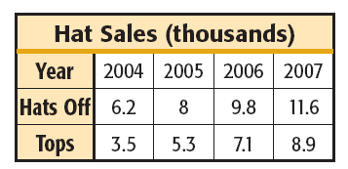
Lesson Quiz: Part II
4. If the pattern in the table continues, when will the sales for Hats Off equal sales for Tops?
never

