Slide 1

Bisectors in Triangles
Warm Up
Lesson Presentation
Lesson Quiz
Holt McDougal Geometry
Holt Geometry

Slide 2


Warm Up
1. Draw a triangle and construct the bisector of one angle.
2. JK is perpendicular to ML at its midpoint K. List the congruent segments.

Slide 3
Objectives
Prove and apply properties of perpendicular bisectors of a triangle.
Prove and apply properties of angle bisectors of a triangle.

Slide 4
Vocabulary
concurrent
point of concurrency
circumcenter of a triangle
circumscribed
incenter of a triangle
inscribed

Slide 5
Since a triangle has three sides, it has three perpendicular bisectors. When you construct the perpendicular bisectors, you find that they have an interesting property.

Slide 6
Helpful Hint
The perpendicular bisector of a side of a triangle does not always pass through the opposite vertex.

Slide 7
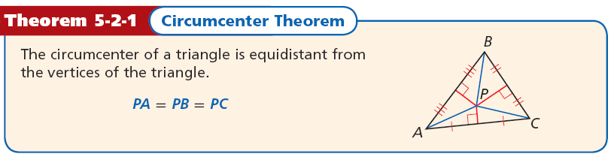
When three or more lines intersect at one point, the lines are said to be concurrent. The point of concurrency is the point where they intersect. In the construction, you saw that the three perpendicular bisectors of a triangle are concurrent. This point of concurrency is the circumcenter of the triangle.

Slide 8
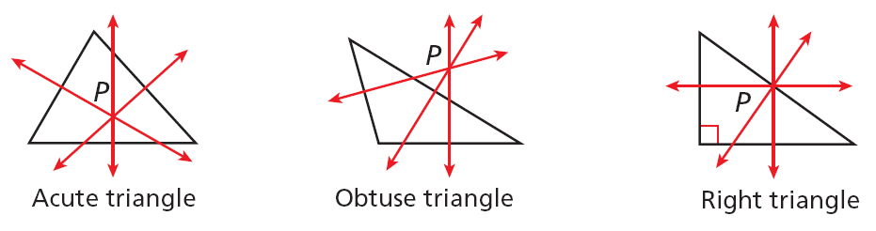
The circumcenter can be inside the triangle, outside the triangle, or on the triangle.

Slide 9
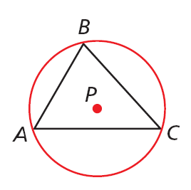
The circumcenter of ΔABC is the center of its circumscribed circle. A circle that contains all the vertices of a polygon is circumscribed about the polygon.

Slide 10
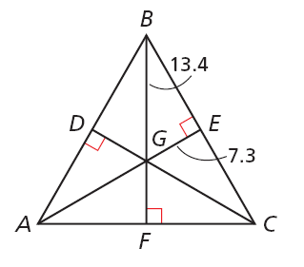
Example 1: Using Properties of Perpendicular Bisectors
DG, EG, and FG are the perpendicular bisectors of ∆ABC. Find GC.
G is the circumcenter of ∆ABC. By the Circumcenter Theorem, G is equidistant from the vertices of
∆ABC.
GC = CB
Circumcenter Thm.
GC = 13.4
Substitute 13.4 for GB.

Slide 11
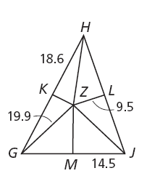
Check It Out! Example 1a
Use the diagram. Find GM.
MZ is a perpendicular bisector of ∆GHJ.
GM = MJ
Circumcenter Thm.
GM = 14.5
Substitute 14.5 for MJ.

Slide 12
Check It Out! Example 1b
Use the diagram. Find GK.
KZ is a perpendicular bisector of ∆GHJ.
GK = KH
Circumcenter Thm.
GK = 18.6
Substitute 18.6 for KH.

Slide 13
Check It Out! Example 1c
Use the diagram. Find JZ.
Z is the circumcenter of ∆GHJ. By the Circumcenter Theorem, Z is equidistant from the vertices of
∆GHJ.
JZ = GZ
Circumcenter Thm.
JZ = 19.9
Substitute 19.9 for GZ.

Slide 14
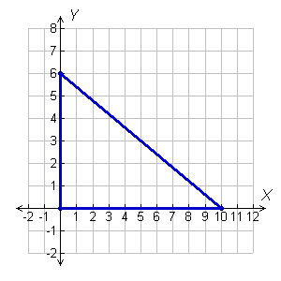
Example 2: Finding the Circumcenter of a Triangle
Find the circumcenter of ∆HJK with vertices H(0, 0), J(10, 0), and K(0, 6).
Step 1 Graph the triangle.

Slide 15
Example 2 Continued
Step 2 Find equations for two perpendicular bisectors.
Since two sides of the triangle lie along the axes, use the graph to find the perpendicular bisectors of these two sides. The perpendicular bisector of HJ is x = 5, and the perpendicular bisector of HK is y = 3.

Slide 16
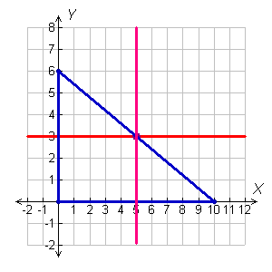
Example 2 Continued
Step 3 Find the intersection of the two equations.
The lines x = 5 and y = 3 intersect at (5, 3), the circumcenter of ∆HJK.

Slide 17
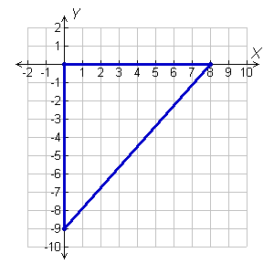
Check It Out! Example 2
Find the circumcenter of ∆GOH with vertices G(0, –9), O(0, 0), and H(8, 0) .
Step 1 Graph the triangle.

Slide 18
Check It Out! Example 2 Continued
Step 2 Find equations for two perpendicular bisectors.
Since two sides of the triangle lie along the axes, use the graph to find the perpendicular bisectors of these two sides. The perpendicular bisector of GO is y = –4.5, and the perpendicular bisector of OH is
x = 4.

Slide 19
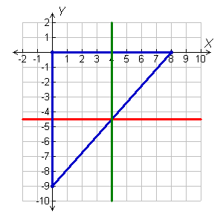
Check It Out! Example 2 Continued
Step 3 Find the intersection of the two equations.
The lines x = 4 and y = –4.5 intersect at (4, –4.5), the circumcenter of ∆GOH.

Slide 20
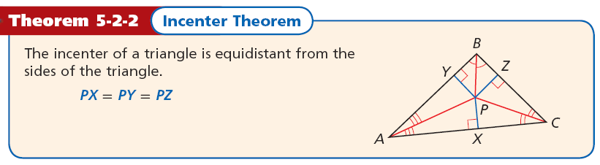
A triangle has three angles, so it has three angle bisectors. The angle bisectors of a triangle are also concurrent. This point of concurrency is the incenter of the triangle .

Slide 21
Remember!
The distance between a point and a line is the length of the perpendicular segment from the
point to the line.

Slide 22
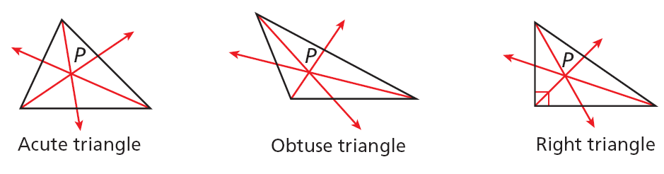
Unlike the circumcenter, the incenter is always inside the triangle.

Slide 23
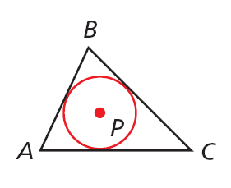
The incenter is the center of the triangle’s inscribed circle. A circle inscribed in a polygon intersects each line that contains a side of the polygon at exactly one point.

Slide 24
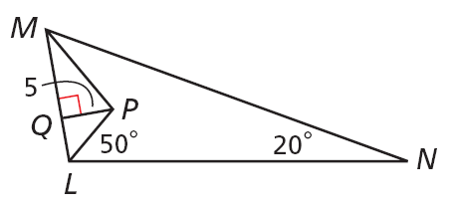
Example 3A: Using Properties of Angle Bisectors
MP and LP are angle bisectors of ∆LMN. Find the distance from P to MN.
P is the incenter of ∆LMN. By the Incenter Theorem, P is equidistant from the sides of ∆LMN.
The distance from P to LM is 5. So the distance from P to MN is also 5.

Slide 25


Example 3B: Using Properties of Angle Bisectors
MP and LP are angle bisectors of ∆LMN. Find m∠PMN.
m∠MLN = 2m∠PLN
PL is the bisector of ∠MLN.
m∠MLN = 2(50°) = 100°
Substitute 50° for m∠PLN.
m∠MLN + m∠LNM + m∠LMN = 180°
Δ Sum Thm.
100 + 20 + m∠LMN = 180
Substitute the given values.
m∠LMN = 60°
Subtract 120° from both sides.
PM is the bisector of ∠LMN.
Substitute 60° for m∠LMN.

Slide 26
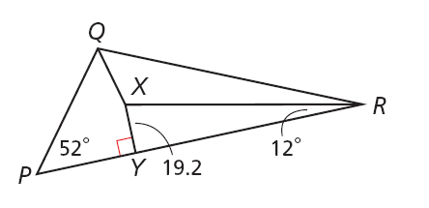
Check It Out! Example 3a
QX and RX are angle bisectors of ΔPQR. Find the distance from X to PQ.
X is the incenter of ∆PQR. By the Incenter Theorem, X is equidistant from the sides of ∆PQR.
The distance from X to PR is 19.2. So the distance from X to PQ is also 19.2.

Slide 27



Check It Out! Example 3b
QX and RX are angle bisectors of ∆PQR. Find m∠PQX.
m∠QRY= 2m∠XRY
XR is the bisector of ∠QRY.
m∠QRY= 2(12°) = 24°
Substitute 12° for m∠XRY.
m∠PQR + m∠QRP + m∠RPQ = 180°
∆ Sum Thm.
m∠PQR + 24 + 52 = 180
Substitute the given values.
Subtract 76° from both sides.
m∠PQR = 104°
QX is the bisector of ∠PQR.
Substitute 104° for m∠PQR.

Slide 28
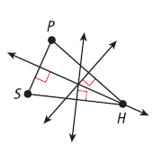
Example 4: Community Application
A city planner wants to build a new library between a school, a post office, and a hospital. Draw a sketch to show where the library should be placed so it is the same distance from all three buildings.
Let the three towns be vertices of a triangle. By the Circumcenter Theorem, the circumcenter of the triangle is equidistant from the vertices.
Draw the triangle formed by the three buildings. To find the circumcenter, find the perpendicular bisectors of each side. The position for the library is the circumcenter.

Slide 29
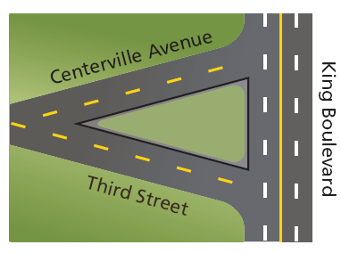
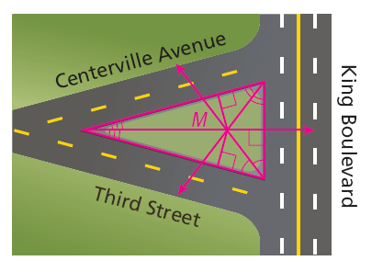
Check It Out! Example 4
A city plans to build a firefighters’ monument in the park between three streets. Draw a sketch to show where the city should place the monument so that it is the same distance from all three streets. Justify your sketch.
By the Incenter Thm., the incenter of a ∆ is equidistant from the sides of the ∆. Draw the ∆ formed by the streets and draw the ∠ bisectors to find the incenter, point M. The city should place the monument at point M.

Slide 30
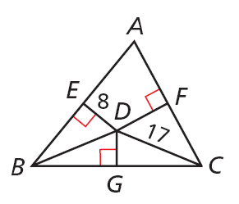
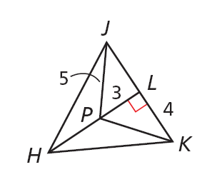
Lesson Quiz: Part I
1. ED, FD, and GD are the perpendicular bisectors of ∆ABC. Find BD.
17
2. JP, KP, and HP are angle bisectors of ∆HJK. Find the distance from P to HK.
3

Slide 31
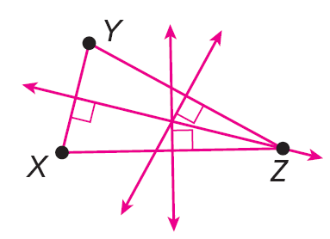
Lesson Quiz: Part II
3. Lee’s job requires him to travel to X, Y, and Z. Draw a sketch to show where he should buy a home so it is the same distance from all three
places.

