Slide 1

Solving Linear Inequalities
Warm Up
Lesson Presentation
Lesson Quiz
Holt McDougal Algebra 1
Holt Algebra 1

Slide 2
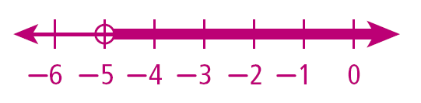
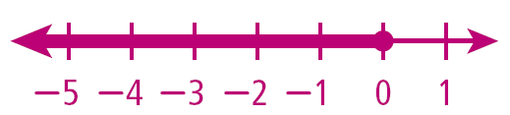
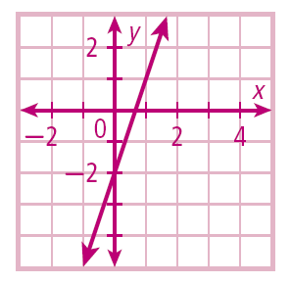
Warm Up
Graph each inequality.
1. x > –5 2. y ≤ 0
3. Write –6x + 2y = –4
in slope-intercept form,
and graph.
y = 3x – 2

Slide 3
Objective
Graph and solve linear inequalities in two variables.

Slide 4
Vocabulary
linear inequality
solution of a linear inequality

Slide 5
A linear inequality is similar to a linear equation, but the equal sign is replaced with an inequality symbol. A solution of a linear inequality is any ordered pair that makes the inequality true.

Slide 6
Example 1A: Identifying Solutions of Inequalities
Tell whether the ordered pair is a solution of the inequality.
(–2, 4); y < 2x + 1
y < 2x + 1
4 2(–2) + 1
Substitute (–2, 4) for (x, y).
4 –4 + 1
✗
4 –3
<
(–2, 4) is not a solution.

Slide 7
Example 1B: Identifying Solutions of Inequalities
Tell whether the ordered pair is a solution of the inequality.
(3, 1); y > x – 4
y > x − 4
1 3 – 4
Substitute (3, 1) for (x, y).
>
✓
1 – 1
(3, 1) is a solution.

Slide 8
Check It Out! Example 1
Tell whether the ordered pair is a solution of the inequality.
a. (4, 5); y < x + 1
b. (1, 1); y > x – 7
y < x + 1
Substitute (4, 5) for (x, y).
y > x – 7
Substitute (1, 1) for (x, y).
5 4 + 1
1 1 – 7
✗
5 5
<
1 –6
>
✓
(4, 5) is not a solution.
(1, 1) is a solution.

Slide 9
A linear inequality describes a region of a coordinate plane called a half-plane. All points in the region are solutions of the linear inequality. The boundary line of the region is the graph of the related equation.

Slide 10
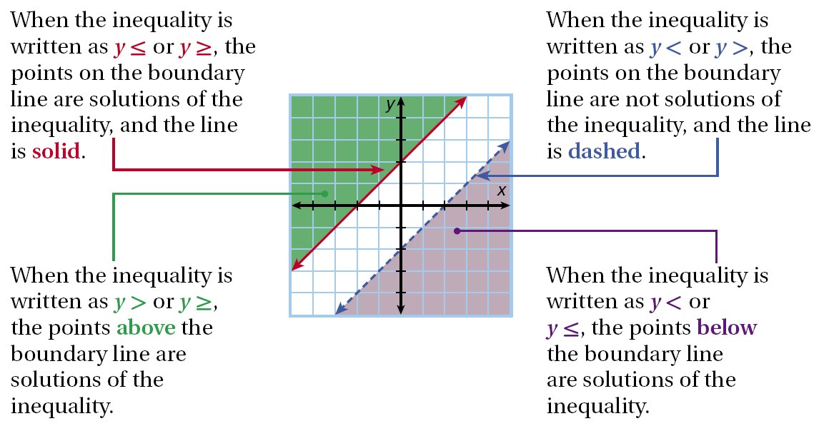

Slide 11

Graphing Linear Inequalities
Step 1
Solve the inequality for y (slope-intercept form).
Graph the boundary line. Use a solid line for ≤ or ≥. Use a dashed line for < or >.
Step 2
Shade the half-plane above the line for y > or ≥. Shade the half-plane below the line for y < or y ≤. Check your answer.
Step 3

Slide 12
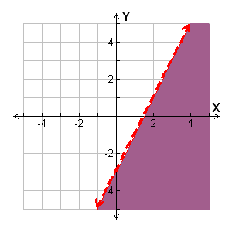
Example 2A: Graphing Linear Inequalities in Two Variables
Graph the solutions of the linear inequality.
y ≤ 2x – 3
Step 1 The inequality is already solved for y.
Step 2 Graph the boundary line y = 2x – 3. Use a solid line for ≤.
Step 3 The inequality is ≤, so shade below the line.

Slide 13
Example 2A Continued
Graph the solutions of the linear inequality.
y ≤ 2x – 3
Substitute (0, 0) for (x, y) because it is not on the boundary line.
Check y ≤ 2x – 3
0 2(0) – 3
A false statement means that the half-plane containing (0, 0) should NOT be shaded. (0, 0) is not one of the solutions, so the graph is shaded correctly.
✗
0 –3
≤

Slide 14
Helpful Hint
The point (0, 0) is a good test point to use if it does not lie on the boundary line.

Slide 15
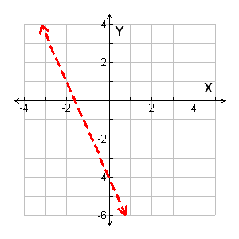

Example 2B: Graphing Linear Inequalities in Two Variables
Graph the solutions of the linear inequality.
5x + 2y > –8
Step 1 Solve the inequality for y.
5x + 2y > –8
–5x –5x
2y > –5x – 8
y > x – 4
Step 2 Graph the boundary line Use a dashed line for >.
y = x – 4.

Slide 16
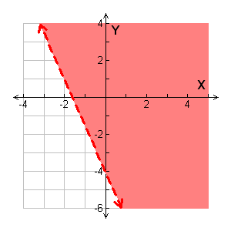
Example 2B Continued
Graph the solutions of the linear inequality.
5x + 2y > –8
Step 3 The inequality is >, so shade above the line.

Slide 17
Example 2B Continued
Graph the solutions of the linear inequality.
5x + 2y > –8
Substitute ( 0, 0) for (x, y) because it is not on the boundary line.
Check
y > x – 4
0 (0) – 4
0 –4
The point (0, 0) satisfies the inequality, so the graph is correctly shaded.
✓
0 –4
>

Slide 18
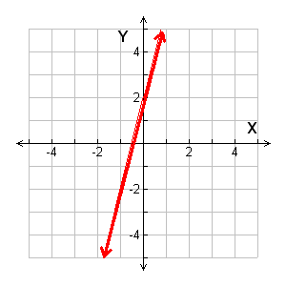
Example 2C: Graphing Linear Inequalities in two Variables
Graph the solutions of the linear inequality.
4x – y + 2 ≤ 0
Step 1 Solve the inequality for y.
4x – y + 2 ≤ 0
–y ≤ –4x – 2
–1
–1
y ≥ 4x + 2
Step 2 Graph the boundary line y ≥= 4x + 2. Use a solid line for ≥.

Slide 19
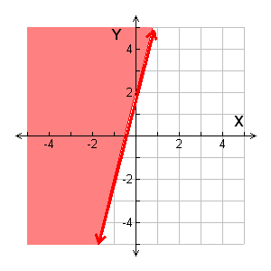
Example 2C Continued
Graph the solutions of the linear inequality.
4x – y + 2 ≤ 0
Step 3 The inequality is ≥, so shade above the line.

Slide 20
Example 2C Continued
Check
y ≥ 4x + 2
3 4(–3)+ 2
3 –12 + 2
✓
3 ≥ –10
Substitute ( –3, 3) for (x, y) because it is not on the boundary line.
The point (–3, 3) satisfies the inequality, so the graph is correctly shaded.

Slide 21
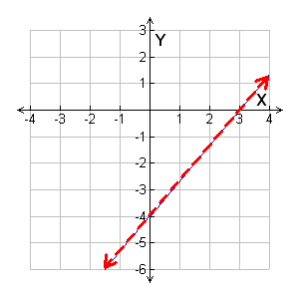


Check It Out! Example 2a
Graph the solutions of the linear inequality.
4x – 3y > 12
Step 1 Solve the inequality for y.
4x – 3y > 12
–4x –4x
–3y > –4x + 12
y < – 4
Step 2 Graph the boundary line y = – 4. Use a dashed line for <.

Slide 22
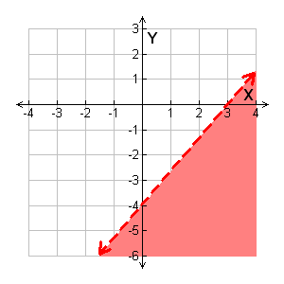
Check It Out! Example 2a Continued
Graph the solutions of the linear inequality.
4x – 3y > 12
Step 3 The inequality is <, so shade below the line.

Slide 23

Check It Out! Example 2a Continued
Graph the solutions of the linear inequality.
4x – 3y > 12
Check
y < – 4
–6 (1) – 4
–6 – 4
✓
–6 <
Substitute ( 1, –6) for (x, y) because it is not on the boundary line.
The point (1, –6) satisfies the inequality, so the graph is correctly shaded.

Slide 24
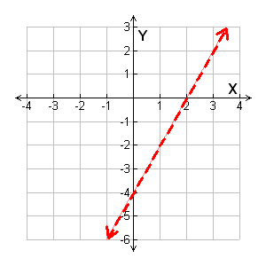
Check It Out! Example 2b
Graph the solutions of the linear inequality.
2x – y – 4 > 0
Step 1 Solve the inequality for y.
2x – y – 4 > 0
– y > –2x + 4
y < 2x – 4
Step 2 Graph the boundary line
y = 2x – 4. Use a dashed line for <.

Slide 25
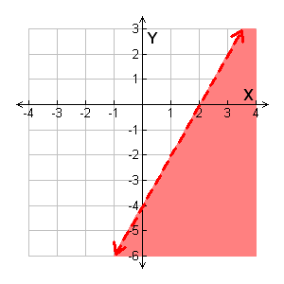
Check It Out! Example 2b Continued
Graph the solutions of the linear inequality.
2x – y – 4 > 0
Step 3 The inequality is <, so shade below the line.

Slide 26
Check It Out! Example 2b Continued
Graph the solutions of the linear inequality.
2x – y – 4 > 0
Check
y < 2x – 4
–3 2(3) – 4
–3 6 – 4
✓
–3 < 2
Substitute (3, –3) for (x, y) because it is not on the boundary line.
The point (3, –3) satisfies the inequality, so the graph is correctly shaded.

Slide 27

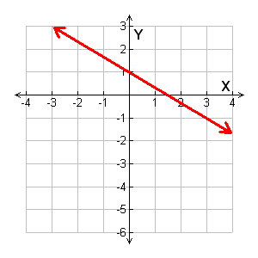
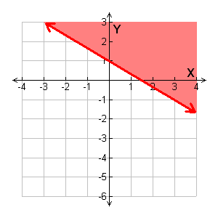

Check It Out! Example 2c
Graph the solutions of the linear inequality.
Step 1 The inequality is already solved for y.
Step 2 Graph the boundary line . Use a solid line for ≥.
=
Step 3 The inequality is ≥, so shade above the line.

Slide 28

Check It Out! Example 2c Continued
Graph the solutions of the linear inequality.
Substitute (0, 0) for (x, y) because it is not on the boundary line.
Check
y ≥ x + 1
0 (0) + 1
0 0 + 1
✗
0 ≥ 1
A false statement means that the half-plane containing (0, 0) should NOT be shaded. (0, 0) is not one of the solutions, so the graph is shaded correctly.

Slide 29
Example 3: Application
Ada has at most 285 beads to make jewelry. A necklace requires 40 beads, and a bracelet requires 15 beads.
Write a linear inequality to describe the situation.
Let x represent the number of necklaces and y the number of bracelets.
Write an inequality. Use ≤ for “at most.”

Slide 30


Example 3a Continued
Necklace
beads
bracelet
beads
285
beads.
is at
most
plus
40x
+
15y
≤
285
Solve the inequality for y.
40x + 15y ≤ 285
–40x –40x
Subtract 40x from both sides.
15y ≤ –40x + 285
Divide both sides by 15.

Slide 31
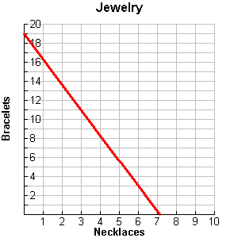
Example 3b
b. Graph the solutions.
Step 1 Since Ada cannot make a negative amount of jewelry, the system is graphed only in Quadrant I. Graph the boundary line . Use a solid line for ≤.
=

Slide 32
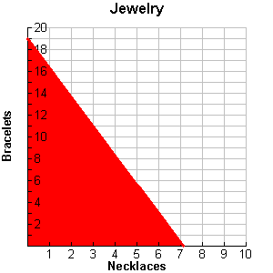
Example 3b Continued
b. Graph the solutions.
Step 2 Shade below the line. Ada can only make whole numbers of jewelry. All points on or below the line with whole number coordinates are the different combinations of bracelets and necklaces that Ada can make.

Slide 33
Example 3c
c. Give two combinations of necklaces and bracelets that Ada could make.
Two different combinations of jewelry that Ada could make with 285 beads could be 2 necklaces and 8 bracelets or 5 necklaces and 3 bracelets.
(2, 8)
•
•
(5, 3)

Slide 34
Check It Out! Example 3
What if…? Dirk is going to bring two types of olives to the Honor Society induction and can spend no more than $6. Green olives cost $2 per pound and black olives cost $2.50 per pound.
a. Write a linear inequality to describe the situation.
b. Graph the solutions.
c. Give two combinations of olives that Dirk could buy.

Slide 35
Check It Out! Example 3 Continued
Let x represent the number of pounds of green olives and let y represent the number of pounds of black olives.
Write an inequality. Use ≤ for “no more than.”
is no more than
Green
olives
black
olives
total
cost.
plus
2x
+
2.50y
≤
6
Solve the inequality for y.
2x + 2.50y ≤ 6
–2x –2x
Subtract 2x from both sides.
2.50y ≤ –2x + 6
2.50y ≤ –2x + 6
Divide both sides by 2.50.
2.50
2.50

Slide 36
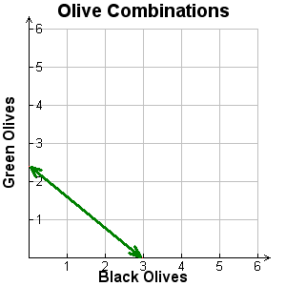
Check It Out! Example 3 Continued
y ≤ –0.80x + 2.4
b. Graph the solutions.
Step 1 Since Dirk cannot buy negative amounts of olive, the system is graphed only in Quadrant I. Graph the boundary line for y = –0.80x + 2.4. Use a solid line for≤.
Black Olives
Green Olives

Slide 37
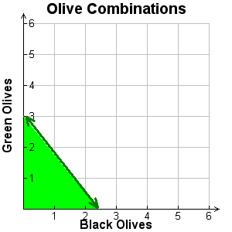
Check It Out! Example 3 Continued
c. Give two combinations of olives that Dirk could buy.
Two different combinations of olives that Dirk could purchase with $6 could be 1 pound of green olives and 1 pound of black olives or 0.5 pound of green olives and 2 pounds of black olives.
Black Olives
(0.5, 2)
•
(1, 1)
•
Green Olives

Slide 38
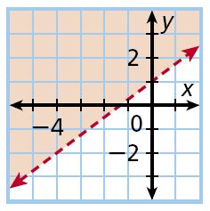


Example 4A: Writing an Inequality from a Graph
Write an inequality to represent the graph.
y-intercept: 1; slope:
Write an equation in slope-intercept form.
The graph is shaded above a dashed boundary line.
Replace = with > to write the inequality

Slide 39
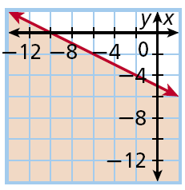



Example 4B: Writing an Inequality from a Graph
Write an inequality to represent the graph.
y-intercept: –5 slope:
Write an equation in slope-intercept form.
The graph is shaded below a solid boundary line.
Replace = with ≤ to write the inequality

Slide 40
Check It Out! Example 4a
Write an inequality to represent the graph.
y-intercept: 0 slope: –1
Write an equation in slope-intercept form.
y = mx + b y = –1x
The graph is shaded below a dashed boundary line.
Replace = with < to write the inequality y < –x.

Slide 41
Check It Out! Example 4b
Write an inequality to represent the graph.
y-intercept: –3 slope: –2
Write an equation in slope-intercept form.
y = mx + b y = –2x – 3
The graph is shaded above a solid boundary line.
Replace = with ≥ to write the inequality y ≥ –2x – 3.

Slide 42
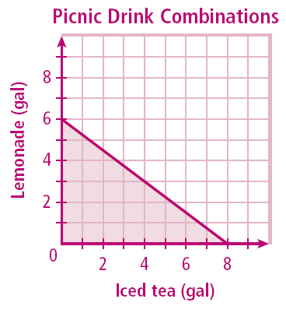
Lesson Quiz: Part I
1. You can spend at most $12.00 for drinks at a picnic. Iced tea costs $1.50 a gallon, and lemonade costs $2.00 per gallon. Write an inequality to describe the situation. Graph the solutions, describe reasonable solutions, and then give two possible combinations of drinks you could buy.
1.50x + 2.00y ≤ 12.00

Slide 43
Lesson Quiz: Part I
1.50x + 2.00y ≤ 12.00
Only whole number solutions are reasonable. Possible answer:
(2 gal tea, 3 gal lemonade) and
(4 gal tea, 1 gal lemonde)

Slide 44
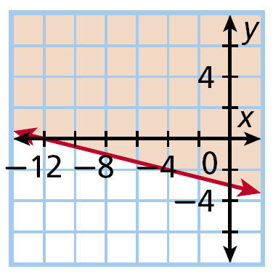

Lesson Quiz: Part II
2. Write an inequality to represent the graph.

