Slide 1

Solving Systems of
Linear Inequalities
Warm Up
Lesson Presentation
Lesson Quiz
Holt McDougal Algebra 1
Holt Algebra 1

Slide 2

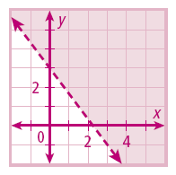
Warm Up
Solve each inequality for y.
1. 8x + y < 6
2. 3x – 2y > 10
3. Graph the solutions of 4x + 3y > 9.
y < –8x + 6

Slide 3
Warnings
Detentions
Beyond
Darren
Mario
Tahmia
Coryn
Tyrell
Charles

Slide 4
Objective
Graph and solve systems of linear inequalities in two variables.

Slide 5
Vocabulary
system of linear inequalities
solution of a system of linear inequalities

Slide 6
A system of linear inequalities is a set of two or more linear inequalities containing two or more variables. The solutions of a system of linear inequalities are all the ordered pairs that satisfy all the linear inequalities in the system.

Slide 7
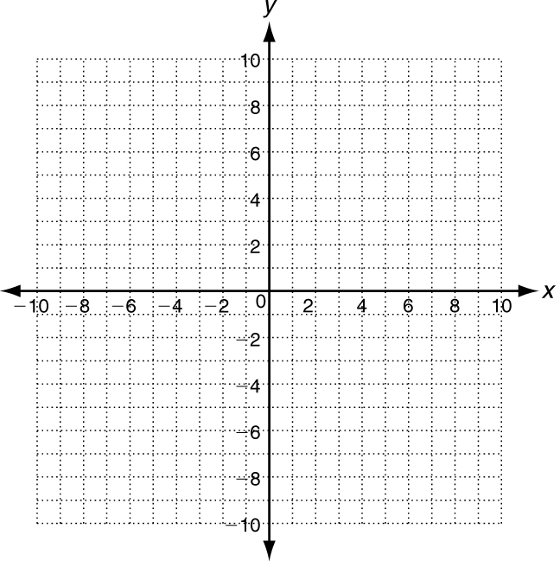

Slide 8
Example 1A: Identifying Solutions of Systems of Linear Inequalities
Tell whether the ordered pair is a solution of the given system.
y ≤ –3x + 1
(–1, –3);
y < 2x + 2
(–1, –3)
(–1, –3)
y ≤ –3x + 1
y < 2x + 2
–3 –3(–1) + 1
–3 2(–1) + 2
–3 3 + 1
–3 –2 + 2
✓
✓
–3 4
≤
–3 0
<
(–1, –3) is a solution to the system because it satisfies both inequalities.

Slide 9
Example 1B: Identifying Solutions of Systems of Linear Inequalities
Tell whether the ordered pair is a solution of the given system.
y < –2x – 1
(–1, 5);
y ≥ x + 3
(–1, 5)
(–1, 5)
y < –2x – 1
y ≥ x + 3
5 –2(–1) – 1
5 –1 + 3
5 2 – 1
≥
✓
5 2
✗
5 1
<
(–1, 5) is not a solution to the system because it does not satisfy both inequalities.

Slide 10
Remember!
An ordered pair must be a solution of all inequalities to be a solution of the system.

Slide 11
Check It Out! Example 1a
Tell whether the ordered pair is a solution of the given system.
y < –3x + 2
(0, 1);
y ≥ x – 1
(0, 1)
(0, 1)
y < –3x + 2
y ≥ x – 1
1 –3(0) + 2
1 0 – 1
1 0 + 2
✓
1 –1
≥
✓
1 2
<
(0, 1) is a solution to the system because it satisfies both inequalities.

Slide 12
Check It Out! Example 1b
Tell whether the ordered pair is a solution of the given system.
y > –x + 1
(0, 0);
y > x – 1
(0, 0)
(0, 0)
y > –x + 1
y > x – 1
0 –1(0) + 1
0 0 – 1
✓
0 0 + 1
0 –1
≥
✗
0 1
>
(0, 0) is not a solution to the system because it does not satisfy both inequalities.

Slide 13
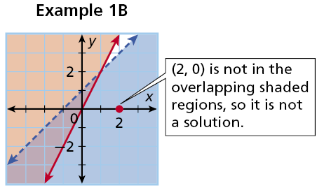
To show all the solutions of a system of linear inequalities, graph the solutions of each inequality. The solutions of the system are represented by the overlapping shaded regions. Below are graphs of Examples 1A and 1B on p. 435.

Slide 14
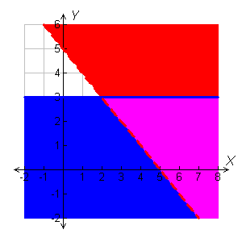
Example 2A: Solving a System of Linear Inequalities by Graphing
Graph the system of linear inequalities. Give two ordered pairs that are solutions and two that are not solutions.
•
y ≤ 3
(2, 6)
(–1, 4)
y > –x + 5
•
•
Graph the system.
(6, 3)
(8, 1)
•
y ≤ 3
y > –x + 5
(8, 1) and (6, 3) are solutions.
(–1, 4) and (2, 6) are not solutions.

Slide 15

Example 2B: Solving a System of Linear Inequalities by Graphing
Graph the system of linear inequalities. Give two ordered pairs that are solutions and two that are not solutions.
–3x + 2y ≥ 2
y < 4x + 3
–3x + 2y ≥ 2
Solve the first inequality for y.
2y ≥ 3x + 2

Slide 16

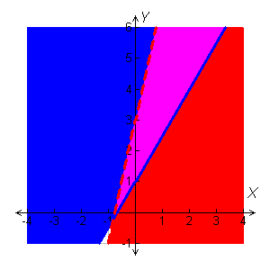
Example 2B Continued
Graph the system.
•
(2, 6)
y < 4x + 3
(–4, 5)
•
(2, 6) and (1, 3) are solutions.
•
(1, 3)
(0, 0) and (–4, 5) are not solutions.
(0, 0)
•

Slide 17
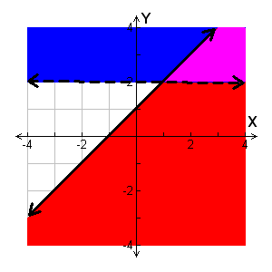
Check It Out! Example 2a
Graph the system of linear inequalities. Give two ordered pairs that are solutions and two that are not solutions.
y ≤ x + 1
(4, 4)
•
y > 2
•
(3, 3)
(–3, 1)
Graph the system.
•
y ≤ x + 1
y > 2
(–1, –4)
(3, 3) and (4, 4) are solutions.
•
(–3, 1) and (–1, –4) are not solutions.

Slide 18

Check It Out! Example 2b
Graph the system of linear inequalities. Give two ordered pairs that are solutions and two that are not solutions.
y > x – 7
3x + 6y ≤ 12
3x + 6y ≤ 12
Solve the second inequality for y.
6y ≤ –3x + 12
y ≤ x + 2

Slide 19
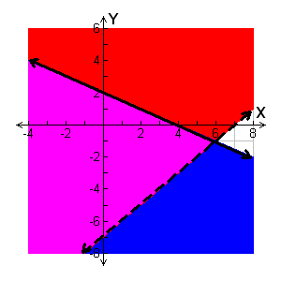
Check It Out! Example 2b Continued
Graph the system.
y > x − 7
y ≤ – x + 2
(4, 4)
•
(0, 0) and (3, –2) are solutions.
•
(0, 0)
•
(4, 4) and (1, –6) are not solutions.
(3, –2)
•
(1, –6)

Slide 20
In Lesson 6-4, you saw that in systems of linear equations, if the lines are parallel, there are no solutions. With systems of linear inequalities, that is not always true.

Slide 21
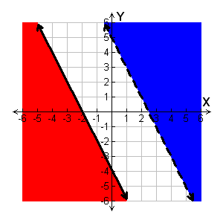
Example 3A: Graphing Systems with Parallel Boundary Lines
Graph the system of linear inequalities.
Describe the solutions.
y ≤ –2x – 4
y > –2x + 5
This system has no solutions.

Slide 22
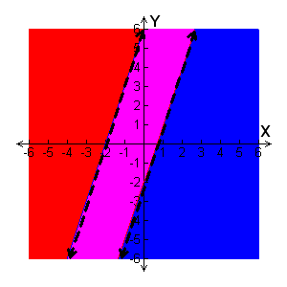
Example 3B: Graphing Systems with Parallel Boundary Lines
Graph the system of linear inequalities. Describe the solutions.
y < 3x + 6
y > 3x – 2
The solutions are all points between the parallel lines but not on the dashed lines.

Slide 23
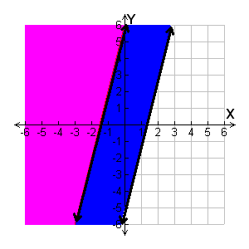
Example 3C: Graphing Systems with Parallel Boundary Lines
Graph the system of linear inequalities. Describe the solutions.
y ≥ 4x + 6
y ≥ 4x – 5
The solutions are the same as the solutions of y ≥ 4x + 6.

Slide 24
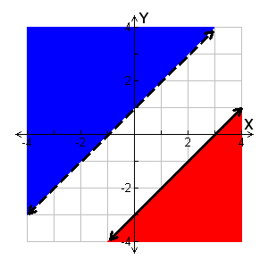
Check It Out! Example 3a
Graph the system of linear inequalities. Describe the solutions.
y > x + 1
y ≤ x – 3
This system has no solutions.

Slide 25
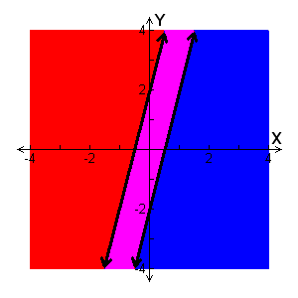
Check It Out! Example 3b
Graph the system of linear inequalities. Describe the solutions.
y ≥ 4x – 2
y ≤ 4x + 2
The solutions are all points between the parallel lines including the solid lines.

Slide 26
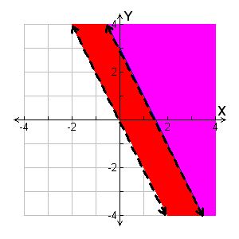
Check It Out! Example 3c
Graph the system of linear inequalities. Describe the solutions.
y > –2x + 3
y > –2x
The solutions are the same as the solutions of y > –2x + 3.

Slide 27
Example 4: Application
In one week, Ed can mow at most 9 times and rake at most 7 times. He charges $20 for mowing and $10 for raking. He needs to make more than $125 in one week. Show and describe all the possible combinations of mowing and raking that Ed can do to meet his goal. List two possible combinations.
Earnings per Job ($)
Mowing
20
Raking
10

Slide 28
Example 4 Continued
Step 1 Write a system of inequalities.
Let x represent the number of mowing jobs and y represent the number of raking jobs.
x ≤ 9
He can do at most 9 mowing jobs.
y ≤ 7
He can do at most 7 raking jobs.
20x + 10y > 125
He wants to earn more than $125.

Slide 29
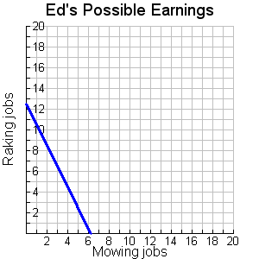
Example 4 Continued
Step 2 Graph the system.
The graph should be in only the first quadrant because the number of jobs cannot be negative.
Solutions

Slide 30
Example 4 Continued
Step 3 Describe all possible combinations.
All possible combinations represented by ordered pairs of whole numbers in the solution region will meet Ed’s requirement of mowing, raking, and earning more than $125 in one week. Answers must be whole numbers because he cannot work a portion of a job.
Step 4 List the two possible combinations.
Two possible combinations are:
7 mowing and 4 raking jobs
8 mowing and 1 raking jobs

Slide 31
Caution
An ordered pair solution of the system need not have whole numbers, but answers to many application problems may be restricted to whole numbers.

Slide 32
Check It Out! Example 4
At her party, Alice is serving pepper jack cheese and cheddar cheese. She wants to have at least 2 pounds of each. Alice wants to spend at most $20 on cheese. Show and describe all possible combinations of the two cheeses Alice could buy. List two possible combinations.
Price per Pound ($)
Pepper Jack
4
Cheddar
2

Slide 33
Check It Out! Example 4 Continued
Step 1 Write a system of inequalities.
Let x represent the pounds of pepper jack
and y represent the pounds of cheddar.
x ≥ 2
She wants at least 2 pounds of pepper jack.
y ≥ 2
She wants at least 2 pounds of cheddar.
4x + 2y ≤ 20
She wants to spend no more than $20.

Slide 34
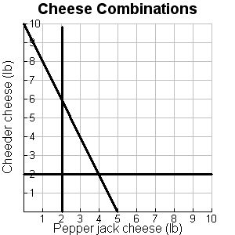
Check It Out! Example 4 Continued
Step 2 Graph the system.
The graph should be in only the first quadrant because the amount of cheese cannot be negative.
Solutions

Slide 35
Step 3 Describe all possible combinations.
All possible combinations within the gray region will meet Alice’s requirement of at most $20 for cheese and no less than 2 pounds of either type of cheese. Answers need not be whole numbers as she can buy fractions of a pound of cheese.
Step 4 Two possible combinations are (3, 2) and (2.5, 4). 3 pepper jack, 2 cheddar or 2.5 pepper jack, 4 cheddar.

Slide 36
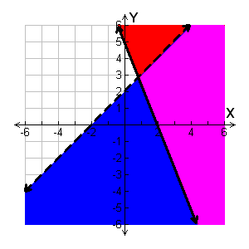
Lesson Quiz: Part I
y < x + 2
1. Graph .
5x + 2y ≥ 10
Give two ordered pairs that are solutions and two that are not solutions.
Possible answer:
solutions: (4, 4), (8, 6);
not solutions: (0, 0), (–2, 3)

Slide 37
Lesson Quiz: Part II
2. Dee has at most $150 to spend on restocking dolls and trains at her toy store. Dolls cost $7.50 and trains cost $5.00. Dee needs no more than 10 trains and she needs at least 8 dolls. Show and describe all possible combinations of dolls and trains that Dee can buy. List two possible combinations.

Slide 38
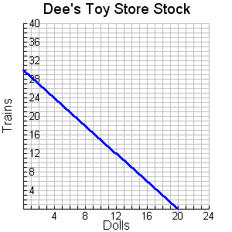
Lesson Quiz: Part II Continued
Reasonable answers must be whole numbers. Possible answer:
(12 dolls, 6 trains) and (16 dolls, 4 trains)
Solutions

