Slide 1

Properties of Parallelograms
Warm Up
Lesson Presentation
Lesson Quiz
Holt McDougal Geometry
Holt Geometry

Slide 2
Warm Up
Find the value of each variable.
1. x 2. y 3. z
2
4
18

Slide 3
Objectives
Prove and apply properties of parallelograms.
Use properties of parallelograms to solve problems.

Slide 4
Vocabulary
parallelogram

Slide 5
Any polygon with four sides is a quadrilateral. However, some quadrilaterals have special properties. These special quadrilaterals are given their own names.

Slide 6
Helpful Hint
Opposite sides of a quadrilateral do not share a vertex. Opposite angles do not share a side.

Slide 7
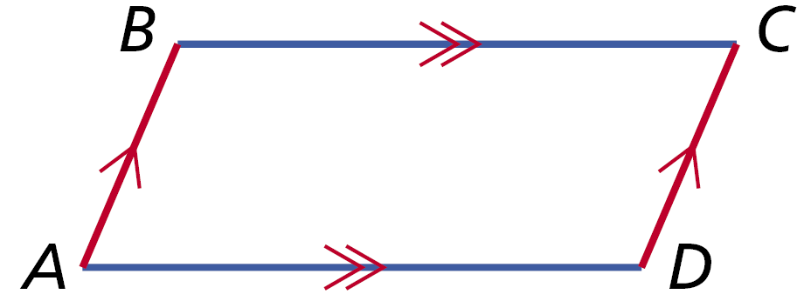
A quadrilateral with two pairs of parallel sides is a parallelogram. To write the name of a parallelogram, you use the symbol .

Slide 8
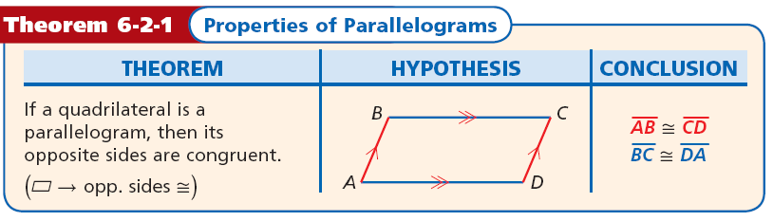

Slide 9
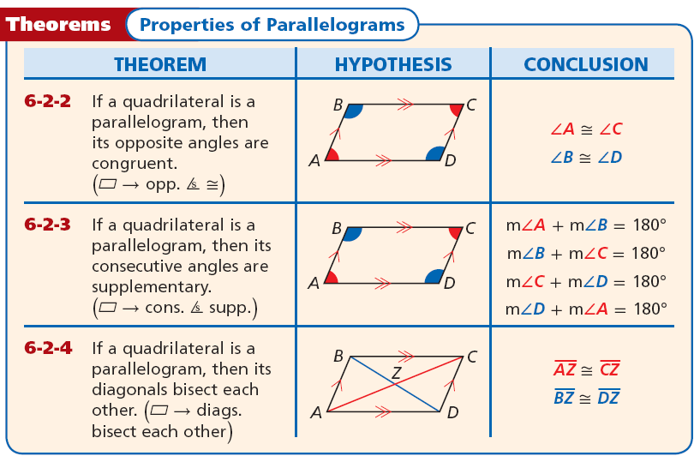

Slide 10

Example 1A: Properties of Parallelograms
In CDEF, DE = 74 mm,
DG = 31 mm, and m∠FCD = 42°. Find CF.
→ opp. sides ≅
CF = DE
Def. of ≅ segs.
CF = 74 mm
Substitute 74 for DE.

Slide 11
Example 1B: Properties of Parallelograms
In CDEF, DE = 74 mm,
DG = 31 mm, and m∠FCD = 42°. Find m∠EFC.
m∠EFC + m∠FCD = 180°
→ cons. ∠s supp.
m∠EFC + 42 = 180
Substitute 42 for m∠FCD.
m∠EFC = 138°
Subtract 42 from both sides.

Slide 12
Example 1C: Properties of Parallelograms
In CDEF, DE = 74 mm,
DG = 31 mm, and m∠FCD = 42°. Find DF.
DF = 2DG
→ diags. bisect each other.
DF = 2(31)
Substitute 31 for DG.
DF = 62
Simplify.

Slide 13

Check It Out! Example 1a
In KLMN, LM = 28 in.,
LN = 26 in., and m∠LKN = 74°. Find KN.
→ opp. sides ≅
LM = KN
Def. of ≅ segs.
LM = 28 in.
Substitute 28 for DE.

Slide 14
Check It Out! Example 1b
In KLMN, LM = 28 in.,
LN = 26 in., and m∠LKN = 74°. Find m∠NML.
∠NML ≅ ∠LKN
→ opp. ∠s ≅
m∠NML = m∠LKN
Def. of ≅ ∠s.
m∠NML = 74°
Substitute 74° for m∠LKN.
Def. of angles.

Slide 15
Check It Out! Example 1c
In KLMN, LM = 28 in.,
LN = 26 in., and m∠LKN = 74°. Find LO.
LN = 2LO
→ diags. bisect each other.
26 = 2LO
Substitute 26 for LN.
LO = 13 in.
Simplify.

Slide 16

Example 2A: Using Properties of Parallelograms to Find Measures
WXYZ is a parallelogram. Find YZ.
→ opp. ∠s ≅
YZ = XW
Def. of ≅ segs.
8a – 4 = 6a + 10
Substitute the given values.
Subtract 6a from both sides and add 4 to both sides.
2a = 14
a = 7
Divide both sides by 2.
YZ = 8a – 4 = 8(7) – 4 = 52

Slide 17
Example 2B: Using Properties of Parallelograms to Find Measures
WXYZ is a parallelogram. Find m∠Z .
m∠Z + m∠W = 180°
→ cons. ∠s supp.
(9b + 2) + (18b – 11) = 180
Substitute the given values.
27b – 9 = 180
Combine like terms.
27b = 189
Add 9 to both sides.
b = 7
Divide by 27.
m∠Z = (9b + 2)° = [9(7) + 2]° = 65°

Slide 18

Check It Out! Example 2a
EFGH is a parallelogram.
Find JG.
→ diags. bisect each other.
EJ = JG
Def. of ≅ segs.
3w = w + 8
Substitute.
2w = 8
Simplify.
w = 4
Divide both sides by 2.
JG = w + 8 = 4 + 8 = 12

Slide 19

Check It Out! Example 2b
EFGH is a parallelogram.
Find FH.
→ diags. bisect each other.
FJ = JH
Def. of ≅ segs.
4z – 9 = 2z
Substitute.
2z = 9
Simplify.
z = 4.5
Divide both sides by 2.
FH = (4z – 9) + (2z) = 4(4.5) – 9 + 2(4.5) = 18

Slide 20
Remember!
When you are drawing a figure in the coordinate plane, the name ABCD gives the order of the vertices.

Slide 21
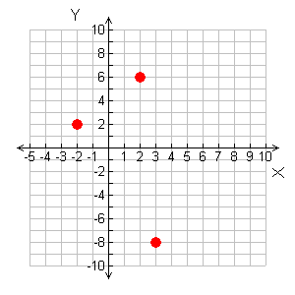
Example 3: Parallelograms in the Coordinate Plane
Three vertices of JKLM are J(3, –8), K(–2, 2), and L(2, 6). Find the coordinates of vertex M.
Since JKLM is a parallelogram, both pairs of opposite sides must be parallel.
Step 1 Graph the given points.
L
K
J

Slide 22

Example 3 Continued
Step 2 Find the slope of by counting the units from K to L.
  The rise from 2 to 6 is 4.
  The run of –2 to 2 is 4.
L
K
Step 3 Start at J and count the
same number of units.
  A rise of 4 from –8 is –4.
  A run of 4 from 3 is 7. Label (7, –4) as vertex M.
M
J

Slide 23



Example 3 Continued
Step 4 Use the slope formula to verify that
L
K
M
J
The coordinates of vertex M are (7, –4).

Slide 24
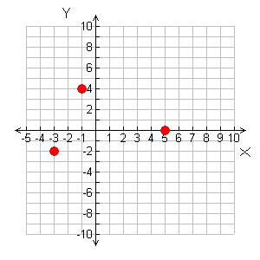
Check It Out! Example 3
Three vertices of PQRS are P(–3, –2), Q(–1, 4), and S(5, 0). Find the coordinates of vertex R.
Since PQRS is a parallelogram, both pairs of opposite sides must be parallel.
Step 1 Graph the given points.
Q
S
P

Slide 25

Check It Out! Example 3 Continued
Step 2 Find the slope of by counting the units from P to Q.
  The rise from –2 to 4 is 6.
  The run of –3 to –1 is 2.
R
Q
S
P
Step 3 Start at S and count the
same number of units.
  A rise of 6 from 0 is 6.
  A run of 2 from 5 is 7. Label (7, 6) as vertex R.

Slide 26



Check It Out! Example 3 Continued
Step 4 Use the slope formula to verify that
R
Q
S
P
The coordinates of vertex R are (7, 6).

Slide 27
Example 4A: Using Properties of Parallelograms in a Proof
Write a two-column proof.
Given: ABCD is a parallelogram.
Prove: ∆AEB ≅ ∆CED

Slide 28



Example 4A Continued
Proof:
Statements | Reasons
1. ABCD is a parallelogram
1. Given
2. → opp. sides ≅
3. → diags. bisect
each other
4. SSS Steps 2, 3

Slide 29
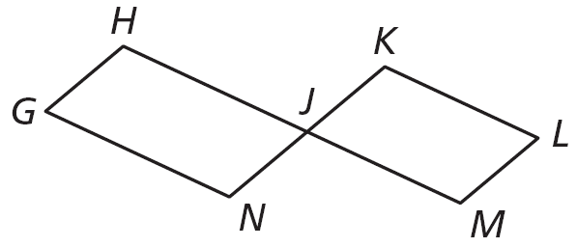
Example 4B: Using Properties of Parallelograms in a Proof
Write a two-column proof.
Given: GHJN and JKLM are parallelograms. H and M are collinear. N and K are collinear.
Prove: ∠H ≅∠M

Slide 30
Example 4B Continued
Proof:
Statements | Reasons
1. GHJN and JKLM are
parallelograms.
1. Given
2. ∠H and ∠HJN are supp.
2. → cons. ∠s supp.
∠M and ∠MJK are supp.
3. ∠HJN ≅ ∠MJK
3. Vert. ∠s Thm.
4. ∠H ≅ ∠M
4. ≅ Supps. Thm.

Slide 31
Check It Out! Example 4
Write a two-column proof.
Given: GHJN and JKLM are parallelograms.
H and M are collinear. N and K are collinear.
Prove: ∠N ≅ ∠K

Slide 32
Check It Out! Example 4 Continued
Proof:
Statements | Reasons
1. GHJN and JKLM
are parallelograms.
1. Given
2. ∠N and ∠HJN are supp.
2. → cons. ∠s supp.
∠K and ∠MJK are supp.
3. ∠HJN ≅ ∠MJK
3. Vert. ∠s Thm.
4. ∠N ≅ ∠K
4. ≅ Supps. Thm.

Slide 33
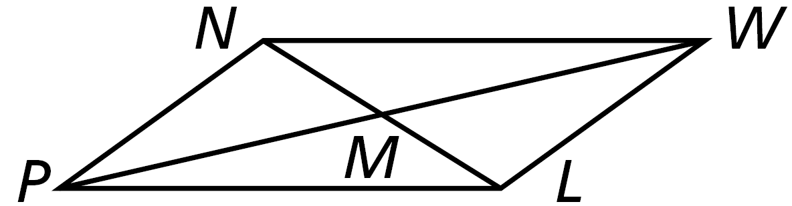
Lesson Quiz: Part I
In PNWL, NW = 12, PM = 9, and
m∠WLP = 144°. Find each measure.
1. PW 2. m∠PNW
18
144°

Slide 34
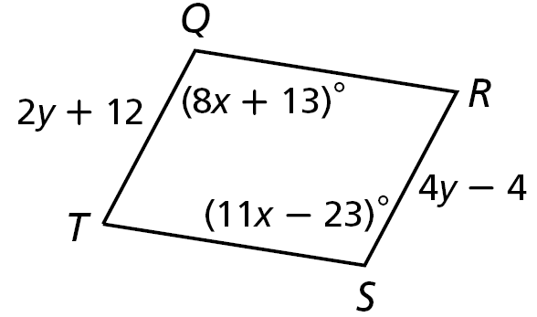
Lesson Quiz: Part II
QRST is a parallelogram. Find each measure.
2. TQ 3. m∠T
28
71°

Slide 35
Lesson Quiz: Part III
5. Three vertices of ABCD are A (2, –6), B (–1, 2), and C(5, 3). Find the coordinates of vertex D.
(8, –5)

Slide 36

Lesson Quiz: Part IV
6. Write a two-column proof.
Given: RSTU is a parallelogram.
Prove: ∆RSU ≅ ∆TUS
Statements | Reasons
1. RSTU is a parallelogram.
1. Given
2. → cons. ∠s ≅
3. ∠R ≅ ∠T
3. → opp. ∠s ≅
4. ∆RSU ≅ ∆TUS
4. SAS

