Slide 1

Relations and Functions
Warm Up
Lesson Presentation
Lesson Quiz
Holt Algebra 1
Holt McDougal Algebra 1

Slide 2
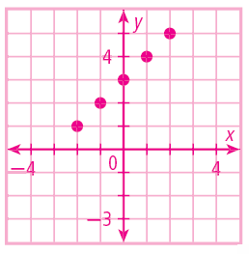
Warm Up
Generate ordered pairs for the function
y = x + 3 for x = –2, –1, 0, 1, and 2. Graph the ordered pairs.
(–2, 1)
(–1, 2)
(0, 3)
(1, 4)
(2, 5)

Slide 3
Objectives
Identify functions.
Find the domain and range of relations and functions.

Slide 4
Vocabulary
relation
domain
range
function

Slide 5
In Lesson 4-1 you saw relationships represented by graphs. Relationships can also be represented by a set of ordered pairs called a relation.
In the scoring systems of some track meets, for first place you get 5 points, for second place you get 3 points, for third place you get 2 points, and for fourth place you get 1 point. This scoring system is a relation, so it can be shown by ordered pairs. {(1, 5), (2, 3), (3, 2) (4, 1)}. You can also show relations in other ways, such as tables, graphs, or mapping diagrams.

Slide 6
Example 1: Showing Multiple Representations of Relations
Express the relation {(2, 3), (4, 7), (6, 8)} as a table, as a graph, and as a mapping diagram.
Table
x y
Write all x-values under “x” and all y-values under “y”.
2
3
4
7
6
8

Slide 7
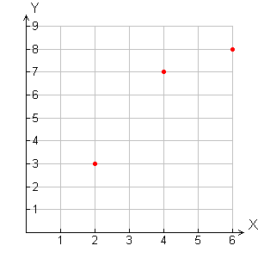
Example 1 Continued
Express the relation {(2, 3), (4, 7), (6, 8)} as a table, as a graph, and as a mapping diagram.
Graph
Use the x- and y-values to plot the ordered pairs.

Slide 8
Example 1 Continued
Express the relation {(2, 3), (4, 7), (6, 8)} as a table, as a graph, and as a mapping diagram.
Mapping Diagram
x
y
Write all x-values under “x” and all y-values under “y”. Draw an arrow from each x-value to its corresponding y-value.
2
3
4
7
6
8

Slide 9
Check It Out! Example 1
Express the relation {(1, 3), (2, 4), (3, 5)} as a table, as a graph, and as a mapping diagram.
Table
x y
Write all x-values under “x” and all y-values under “y”.
1
3
2
4
3
5

Slide 10
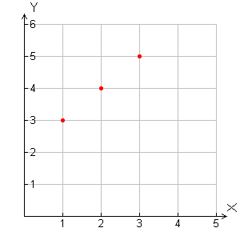
Check It Out! Example 1 Continued
Express the relation {(1, 3), (2, 4), (3, 5)} as a table, as a graph, and as a mapping diagram.
Graph
Use the x- and y-values to plot the ordered pairs.

Slide 11
Check It Out! Example 1 Continued
Express the relation {(1, 3), (2, 4), (3, 5)} as a table, as a graph, and as a mapping diagram.
Mapping Diagram
x
y
1
3
Write all x-values under “x” and all y-values under “y”. Draw an arrow from each x-value to its corresponding y-value.
2
4
3
5

Slide 12
The domain of a relation is the set of first coordinates (or x-values) of the ordered pairs. The range of a relation is the set of second coordinates (or y-values) of the ordered pairs. The domain of the track meet scoring system is {1, 2, 3, 4}. The range is {5, 3, 2, 1}.

Slide 13
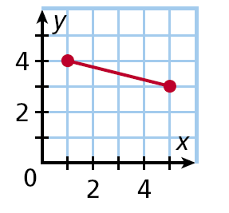
Example 2: Finding the Domain and Range of a
Relation
Give the domain and range of the relation.
The domain value is all x-values from 1 through 5, inclusive.
The range value is all y-values from 3 through 4, inclusive.
Domain: 1 ≤ x ≤ 5
Range: 3 ≤ y ≤ 4

Slide 14
Check It Out! Example 2a
Give the domain and range of the relation.
6
The domain values are all x-values 1, 2, 5 and 6.
–4
5
–1
2
The range values are y-values 0, –1 and –4.
0
1
Domain: {6, 5, 2, 1}
Range: {–4, –1, 0}

Slide 15
Check It Out! Example 2b
Give the domain and range of the relation.
x y
The domain values are all x-values 1, 4, and 8.
1
1
4
4
The range values are y-values 1 and 4.
8
1
Domain: {1, 4, 8}
Range: {1, 4}

Slide 16
A function is a special type of relation that pairs each domain value with exactly one range value.

Slide 17
Example 3A: Identifying Functions
Give the domain and range of the relation. Tell whether the relation is a function. Explain.
{(3, –2), (5, –1), (4, 0), (3, 1)}
D: {3, 5, 4}
Even though 3 is in the domain twice, it is written only once when you are giving the domain.
R: {–2, –1, 0, 1}
The relation is not a function. Each domain value does not have exactly one range value. The domain value 3 is paired with the range values –2 and 1.

Slide 18
Example 3B: Identifying Functions
Give the domain and range of the relation. Tell whether the relation is a function. Explain.
–4
2
Use the arrows to determine which domain values correspond to each range value.
–8
1
4
5
D: {–4, –8, 4, 5}
R: {2, 1}
This relation is a function. Each domain value is paired with exactly one range value.

Slide 19
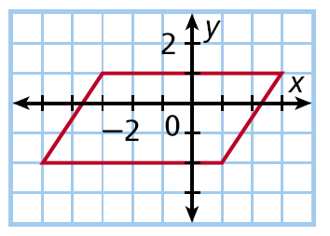
Example 3C: Identifying Functions
Give the domain and range of the relation. Tell whether the relation is a function. Explain.
Draw lines to see the domain and range values.
Range
Domain
D: –5 ≤ x ≤ 3 R: –2 ≤ y ≤ 1
The relation is not a function. Nearly all domain values have more than one range value.

Slide 20
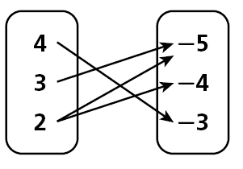
Check It Out! Example 3
Give the domain and range of each relation. Tell whether the relation is a function and explain.
a. {(8, 2), (–4, 1),
(–6, 2),(1, 9)}
b.
D: {–6, –4, 1, 8}
R: {1, 2, 9}
The relation is a function. Each domain value is paired with exactly one range value.
D: {2, 3, 4}
R: {–5, –4, –3}
The relation is not a function. The domain value 2 is paired with both –5 and –4.

Slide 21
Textbook page 197-198 #1-24 Even on pg. 73 in interactive notebook

Slide 22
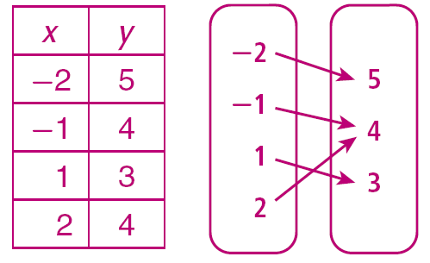
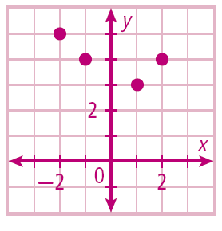
Lesson Quiz: Part I
1. Express the relation {(–2, 5), (–1, 4), (1, 3), (2, 4)} as a table, as a graph, and as a
mapping diagram.

Slide 23
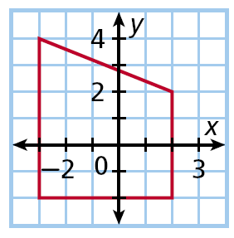
Lesson Quiz: Part II
2. Give the domain and range of the relation.
D: –3 ≤ x ≤ 2: R: –2 ≤ y ≤ 4

Slide 24
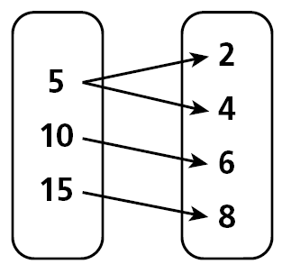
Lesson Quiz: Part III
3. Give the domain and range of the relation. Tell whether the relation is a function. Explain.
D: {5, 10, 15};
R: {2, 4, 6, 8};
The relation is not a function since 5 is paired with 2 and 4.

