Slide 1

Conditions for Parallelograms
Warm Up
Lesson Presentation
Lesson Quiz
Holt McDougal Geometry
Holt Geometry

Slide 2


Warm Up
Justify each statement.
1.
2.
Evaluate each expression for x = 12 and
y = 8.5.
3. 2x + 7
4. 16x – 9
5. (8y + 5)°
Reflex Prop. of ≅
Conv. of Alt. Int. ∠s Thm.
31
183
73°

Slide 3
Objective
Prove that a given quadrilateral is a parallelogram.

Slide 4
You have learned to identify the properties of a parallelogram. Now you will be given the properties of a quadrilateral and will have to tell if the quadrilateral is a parallelogram. To do this, you can
use the definition of a parallelogram or the conditions below.

Slide 5
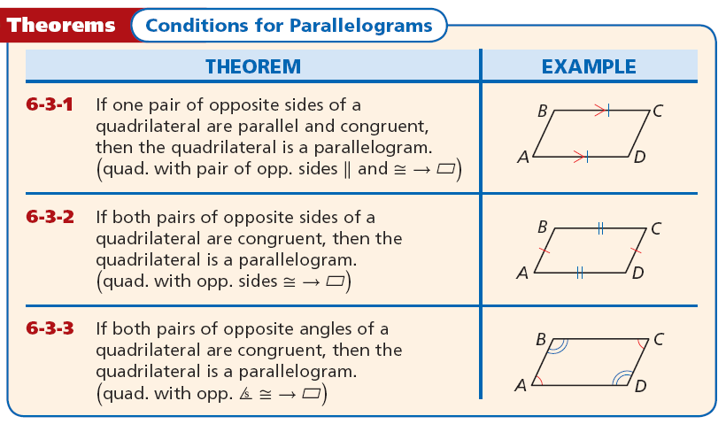

Slide 6
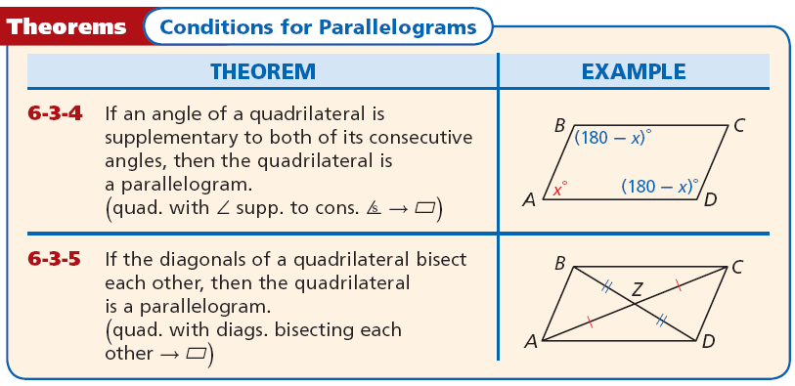
The two theorems below can also be used to show that a given quadrilateral is a parallelogram.

Slide 7
Example 1A: Verifying Figures are Parallelograms
Show that JKLM is
a parallelogram for
a = 3 and b = 9.
Step 1 Find JK and LM.
JK = 15a – 11
Given
LM = 10a + 4
Substitute and simplify.
JK = 15(3) – 11 = 34
LM = 10(3)+ 4 = 34

Slide 8
Example 1A Continued
Step 2 Find KL and JM.
KL = 5b + 6
Given
JM = 8b – 21
Substitute and simplify.
KL = 5(9) + 6 = 51
JM = 8(9) – 21 = 51
Since JK = LM and KL = JM, JKLM is a parallelogram by Theorem 6-3-2.

Slide 9
Example 1B: Verifying Figures are Parallelograms
Show that PQRS is a parallelogram for x = 10 and y = 6.5.
m∠Q = (6y + 7)°
Given
Substitute 6.5 for y and simplify.
m∠Q = [(6(6.5) + 7)]° = 46°
m∠S = (8y – 6)°
Given
m∠S = [(8(6.5) – 6)]° = 46°
Substitute 6.5 for y and simplify.
m∠R = (15x – 16)°
Given
Substitute 10 for x and simplify.
m∠R = [(15(10) – 16)]° = 134°

Slide 10
Example 1B Continued
Since 46° + 134° = 180°, ∠R is supplementary to both ∠Q and ∠S. PQRS is a parallelogram by Theorem 6-3-4.

Slide 11


Check It Out! Example 1
Show that PQRS is a parallelogram for a = 2.4 and b = 9.
PQ = RS = 16.8, so
m∠Q = 74°, and m∠R = 106°, so ∠Q and ∠R are supplementary.
Therefore,
So one pair of opposite sides of PQRS are || and ≅.
By Theorem 6-3-1, PQRS is a parallelogram.

Slide 12
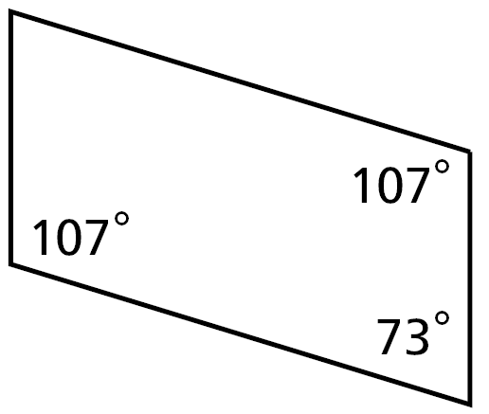
Example 2A: Applying Conditions for Parallelograms
Determine if the quadrilateral must be a parallelogram. Justify your answer.
Yes. The 73° angle is supplementary to both its corresponding angles. By Theorem 6-3-4, the quadrilateral is a parallelogram.

Slide 13
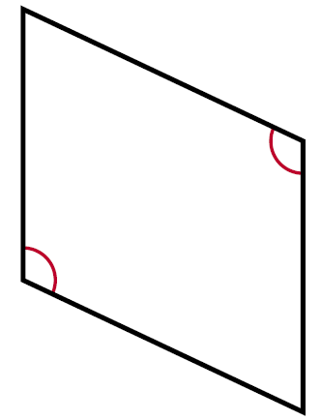
Example 2B: Applying Conditions for Parallelograms
Determine if the quadrilateral must be a parallelogram. Justify your answer.
No. One pair of opposite angles are congruent. The other pair is not. The conditions for a parallelogram are not met.

Slide 14
Check It Out! Example 2a
Determine if the quadrilateral must be a parallelogram. Justify your answer.
Yes
The diagonal of the quadrilateral forms 2 triangles.
Two angles of one triangle are congruent to two angles of the other triangle, so the third pair of angles are congruent by the Third Angles Theorem.
So both pairs of opposite angles of the quadrilateral are congruent .
By Theorem 6-3-3, the quadrilateral is a parallelogram.

Slide 15
Check It Out! Example 2b
Determine if each quadrilateral must be a parallelogram. Justify your answer.
No. Two pairs of consective sides are congruent.
None of the sets of conditions for a parallelogram are met.

Slide 16
Helpful Hint
To say that a quadrilateral is a parallelogram by
definition, you must show that both pairs of opposite sides are parallel.

Slide 17




Example 3A: Proving Parallelograms in the Coordinate Plane
Show that quadrilateral JKLM is a parallelogram by using the definition of parallelogram. J(–1, –6), K(–4, –1), L(4, 5), M(7, 0).
Find the slopes of both pairs of opposite sides.
Since both pairs of opposite sides are parallel, JKLM is a parallelogram by definition.

Slide 18






Example 3B: Proving Parallelograms in the Coordinate Plane
Show that quadrilateral ABCD is a parallelogram by using Theorem 6-3-1. A(2, 3), B(6, 2), C(5, 0), D(1, 1).
Find the slopes and lengths of one pair of opposite sides.
AB and CD have the same slope, so . Since
AB = CD, . So by Theorem 6-3-1, ABCD is a
parallelogram.

Slide 19






Check It Out! Example 3
Use the definition of a parallelogram to show that the quadrilateral with vertices K(–3, 0), L(–5, 7), M(3, 5), and N(5, –2) is a parallelogram.
Both pairs of opposite sides have the same slope so and by definition, KLMN is a parallelogram.

Slide 20
You have learned several ways to determine whether a quadrilateral is a parallelogram. You can use the given information about a figure to decide which condition is best to apply.

Slide 21
Helpful Hint
To show that a quadrilateral is a parallelogram, you only have to show that it satisfies one of these sets of conditions.

Slide 22
Example 4: Application
The legs of a keyboard tray are connected by a bolt at their midpoints, which allows the tray to be raised or lowered. Why is PQRS always a parallelogram?
Since the bolt is at the midpoint of both legs, PE = ER and SE = EQ. So the diagonals of PQRS bisect each other, and by Theorem 6-3-5, PQRS is always a parallelogram.

Slide 23

Check It Out! Example 4
The frame is attached to the tripod at points A and B such that AB = RS and BR = SA. So ABRS is also a parallelogram. How does this ensure that the angle of the binoculars stays the same?
Since ABRS is a parallelogram, it is always true that .
Since AB stays vertical, RS also remains vertical no matter how the frame is adjusted.
Therefore the viewing ∠ never changes.

Slide 24
Lesson Quiz: Part I
1. Show that JKLM is a parallelogram for a = 4 and b = 5.
2. Determine if QWRT must be a parallelogram. Justify your answer.
JN = LN = 22; KN = MN = 10; so JKLM is a parallelogram by Theorem 6-3-5.
No; One pair of consecutive ∠s are ≅, and one pair of opposite sides are ||. The conditions for a parallelogram are not met.

Slide 25


Lesson Quiz: Part II
3. Show that the quadrilateral with vertices E(–1, 5), F(2, 4), G(0, –3), and H(–3, –2) is a parallelogram.
Since one pair of opposite sides are || and ≅, EFGH is a parallelogram by Theorem 6-3-1.

