Slide 1

Properties of Special Parallelograms
Warm Up
Lesson Presentation
Lesson Quiz
Holt McDougal Geometry

Slide 2
Warm Up
Solve for x.
1. 16x – 3 = 12x + 13
2. 2x – 4 = 90
ABCD is a parallelogram. Find each measure.
3. CD 4. m∠C
4
47
14
104°

Slide 3
Objectives
Prove and apply properties of rectangles, rhombuses, and squares.
Use properties of rectangles, rhombuses, and squares to solve problems.

Slide 4
Vocabulary
rectangle
rhombus
square

Slide 5
A second type of special quadrilateral is a rectangle. A rectangle is a quadrilateral with four right angles.

Slide 6
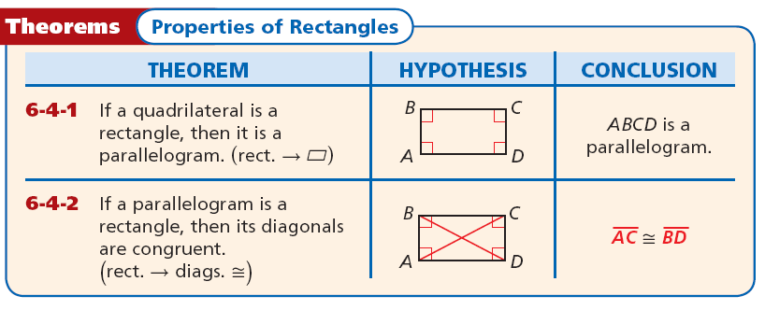
Since a rectangle is a parallelogram by Theorem 6-4-1, a rectangle “inherits” all the properties of parallelograms that you learned in Lesson 6-2.

Slide 7



Example 1: Craft Application
A woodworker constructs a rectangular picture frame so that JK = 50 cm and JL = 86 cm. Find HM.
Rect. → diags. ≅
KM = JL = 86
Def. of ≅ segs.
→ diags. bisect each other
Substitute and simplify.

Slide 8

Check It Out! Example 1a
Carpentry The rectangular gate has diagonal braces.
Find HJ.
Rect. → diags. ≅
HJ = GK = 48
Def. of ≅ segs.

Slide 9


Check It Out! Example 1b
Carpentry The rectangular gate has diagonal braces.
Find HK.
Rect. → diags. ≅
Rect. → diagonals bisect each other
JL = LG
Def. of ≅ segs.
JG = 2JL = 2(30.8) = 61.6
Substitute and simplify.

Slide 10
A rhombus is another special quadrilateral. A rhombus is a quadrilateral with four congruent sides.

Slide 11
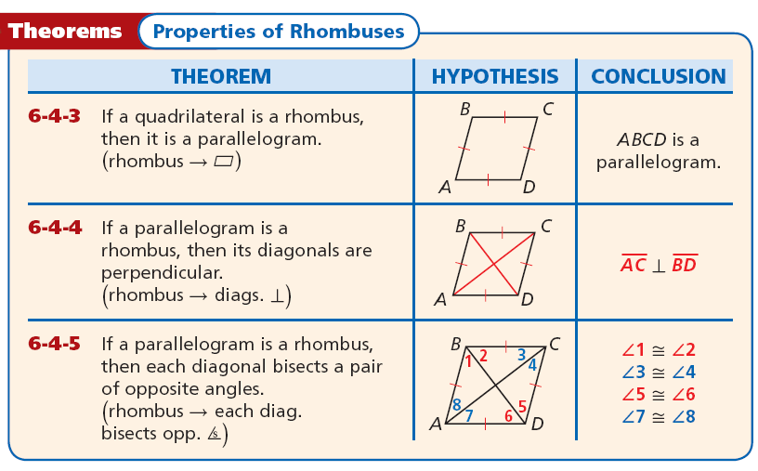

Slide 12
Like a rectangle, a rhombus is a parallelogram. So you can apply the properties of parallelograms to rhombuses.

Slide 13
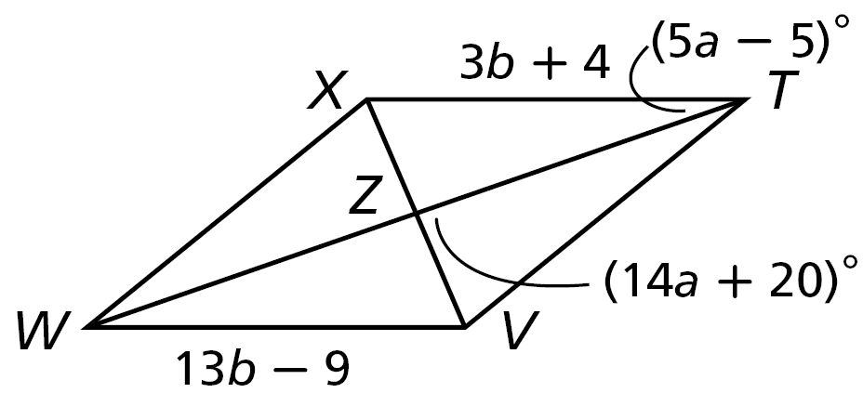
Example 2A: Using Properties of Rhombuses to Find Measures
TVWX is a rhombus. Find TV.
WV = XT
Def. of rhombus
13b – 9 = 3b + 4
Substitute given values.
10b = 13
Subtract 3b from both sides and add 9 to both sides.
b = 1.3
Divide both sides by 10.

Slide 14
Example 2A Continued
TV = XT
Def. of rhombus
TV = 3b + 4
Substitute 3b + 4 for XT.
TV = 3(1.3) + 4 = 7.9
Substitute 1.3 for b and simplify.

Slide 15
Example 2B: Using Properties of Rhombuses to Find Measures
TVWX is a rhombus. Find m∠VTZ.
m∠VZT = 90°
Rhombus → diag. ⊥
14a + 20 = 90°
Substitute 14a + 20 for m∠VTZ.
Subtract 20 from both sides and divide both sides by 14.
a = 5

Slide 16
Example 2B Continued
m∠VTZ = m∠ZTX
Rhombus → each diag. bisects opp. ∠s
m∠VTZ = (5a – 5)°
Substitute 5a – 5 for m∠VTZ.
m∠VTZ = [5(5) – 5)]°
= 20°
Substitute 5 for a and simplify.

Slide 17
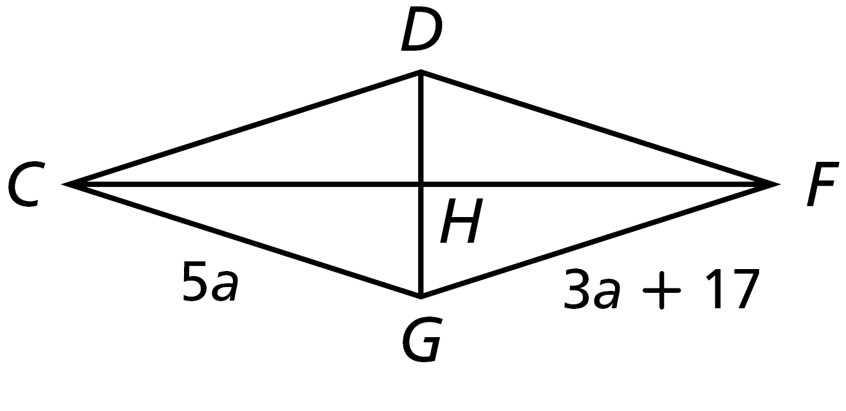
Check It Out! Example 2a
CDFG is a rhombus. Find CD.
CG = GF
Def. of rhombus
5a = 3a + 17
Substitute
a = 8.5
Simplify
GF = 3a + 17 = 42.5
Substitute
CD = GF
Def. of rhombus
CD = 42.5
Substitute

Slide 18
Check It Out! Example 2b
CDFG is a rhombus.
Find the measure.
m∠GCH if m∠GCD = (b + 3)°
and m∠CDF = (6b – 40)°
m∠GCD + m∠CDF = 180°
Def. of rhombus
b + 3 + 6b – 40 = 180°
Substitute.
7b = 217°
Simplify.
b = 31°
Divide both sides by 7.

Slide 19
Check It Out! Example 2b Continued
m∠GCH + m∠HCD = m∠GCD
Rhombus → each diag. bisects opp. ∠s
2m∠GCH = m∠GCD
2m∠GCH = (b + 3)
Substitute.
2m∠GCH = (31 + 3)
Substitute.
m∠GCH = 17°
Simplify and divide both sides by 2.

Slide 20
A square is a quadrilateral with four right angles and four congruent sides. In the exercises, you will show that a square is a parallelogram, a rectangle, and a rhombus. So a square has the properties of all three.

Slide 21
Helpful Hint
Rectangles, rhombuses, and squares are sometimes referred to as special parallelograms.

Slide 22
Example 3: Verifying Properties of Squares
Show that the diagonals of square EFGH are congruent perpendicular bisectors of each other.

Slide 23



Example 3 Continued
Step 1 Show that EG and FH are congruent.
Since EG = FH,

Slide 24




Example 3 Continued
Step 2 Show that EG and FH are perpendicular.
Since ,

Slide 25


Example 3 Continued
Step 3 Show that EG and FH are bisect each other.
Since EG and FH have the same midpoint, they bisect each other.
The diagonals are congruent perpendicular bisectors of each other.

Slide 26
Check It Out! Example 3
The vertices of square STVW are S(–5, –4), T(0, 2), V(6, –3) , and W(1, –9) . Show that the diagonals of square STVW are congruent perpendicular bisectors of each other.
SV = TW = 122 so, SV ≅ TW .
1
slope of SV =
11
slope of TW = –11
SV ⊥ TW

Slide 27



Check It Out! Example 3 Continued
Step 1 Show that SV and TW are congruent.
Since SV = TW,

Slide 28



Check It Out! Example 3 Continued
Step 2 Show that SV and TW are perpendicular.
Since

Slide 29


Check It Out! Example 3 Continued
Step 3 Show that SV and TW bisect each other.
Since SV and TW have the same midpoint, they bisect each other.
The diagonals are congruent perpendicular bisectors of each other.

Slide 30


Example 4: Using Properties of Special Parallelograms in Proofs
Given: ABCD is a rhombus. E is
the midpoint of , and F
is the midpoint of .
Prove: AEFD is a parallelogram.

Slide 31
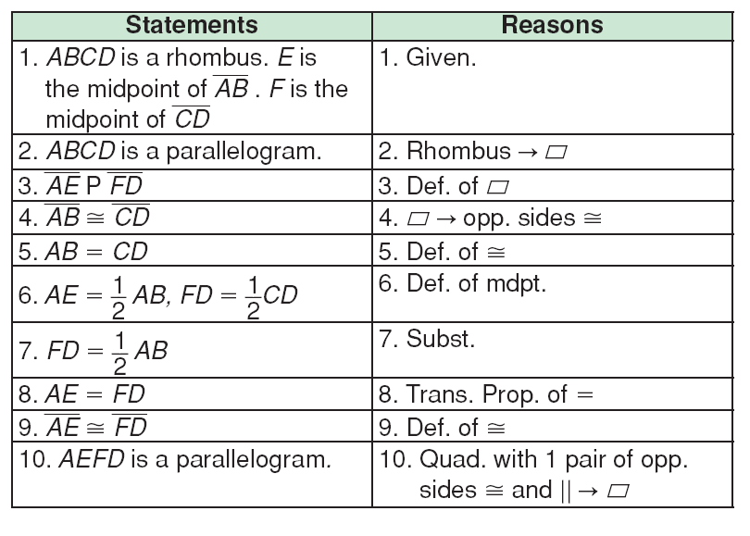
Example 4 Continued
||

Slide 32


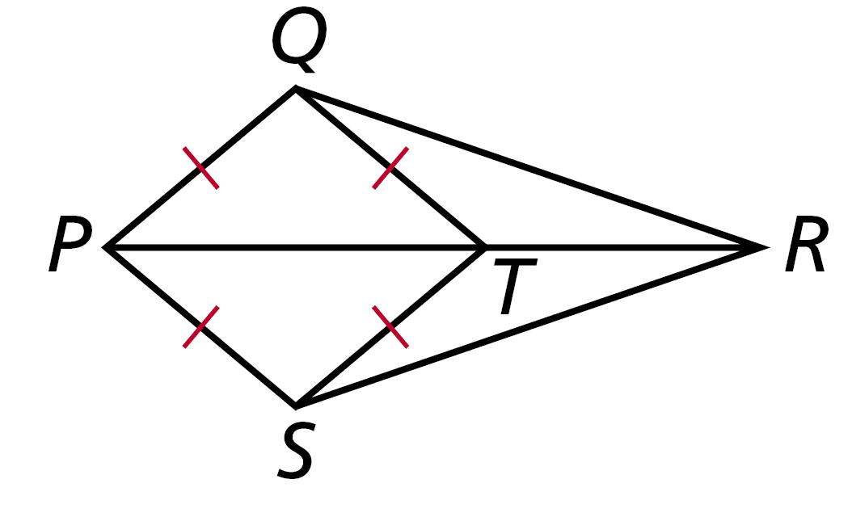
Check It Out! Example 4
Given: PQTS is a rhombus with diagonal
Prove:

Slide 33





Check It Out! Example 4 Continued
Statements | Reasons
1. PQTS is a rhombus.
1. Given.
2. Rhombus → each
diag. bisects opp. ∠s
2.
3. ∠QPR ≅ ∠SPR
3. Def. of ∠ bisector.
4.
4. Def. of rhombus.
5.
5. Reflex. Prop. of ≅
6.
6. SAS
7.
7. CPCTC

Slide 34
Lesson Quiz: Part I
A slab of concrete is poured with diagonal spacers. In rectangle CNRT, CN = 35 ft, and NT = 58 ft. Find each length.
1. TR 2. CE
35 ft
29 ft

Slide 35
Lesson Quiz: Part II
PQRS is a rhombus. Find each measure.
3. QP 4. m∠QRP
42
51°

Slide 36
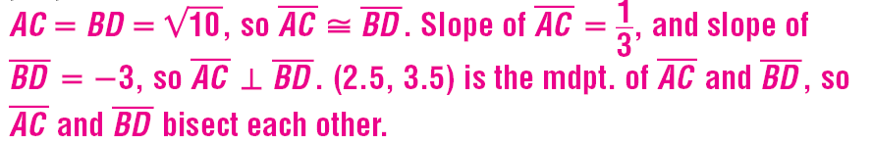
Lesson Quiz: Part III
5. The vertices of square ABCD are A(1, 3), B(3, 2), C(4, 4), and D(2, 5). Show that its diagonals are congruent perpendicular bisectors of each other.

Slide 37

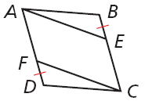
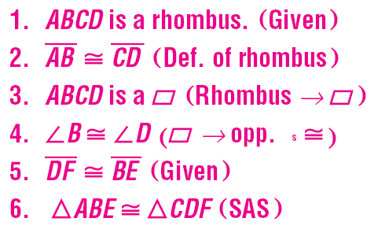
Lesson Quiz: Part IV
6. Given: ABCD is a rhombus.
Prove:
ΔABE≅ΔCDF
∠

