Slide 1

Conditions for Special Parallelograms
Warm Up
Lesson Presentation
Lesson Quiz
Holt McDougal Geometry

Slide 2
Warm Up
1. Find AB for A (–3, 5) and B (1, 2).
2. Find the slope of JK for J(–4, 4) and K(3, –3).
ABCD is a parallelogram. Justify each statement.
3. ∠ABC ≅ ∠CDA
4. ∠AEB ≅ ∠CED
5
–1
→ opp. ∠s ≅
Vert. ∠s Thm.

Slide 3
Objective
Prove that a given quadrilateral is a rectangle, rhombus, or square.

Slide 4
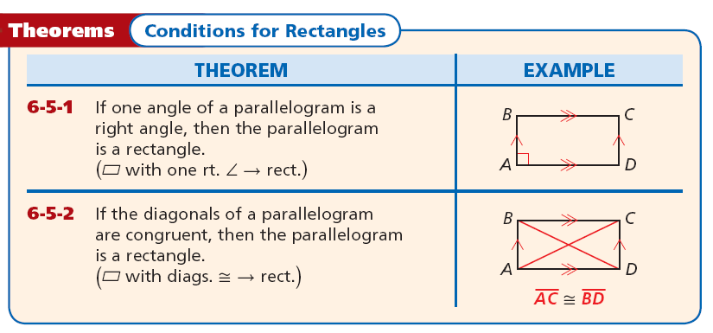
When you are given a parallelogram with certain
properties, you can use the theorems below to determine whether the parallelogram is a rectangle.

Slide 5
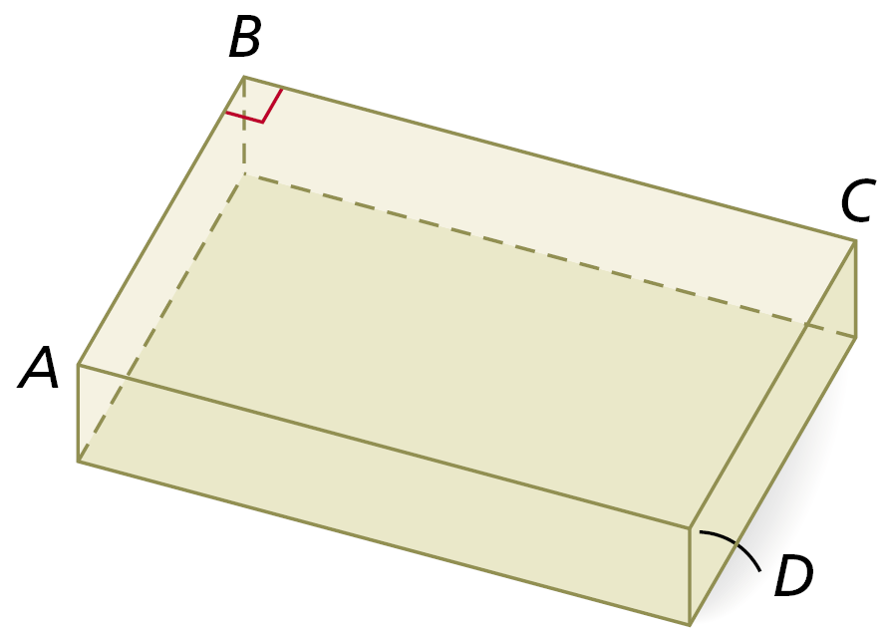


Example 1: Carpentry Application
A manufacture builds a mold for a desktop so that , , and m∠ABC = 90°. Why must ABCD be a rectangle?
Both pairs of opposites sides of ABCD are congruent, so ABCD is a . Since m∠ABC = 90°, one angle ABCD is a right angle. ABCD is a rectangle by Theorem 6-5-1.

Slide 6
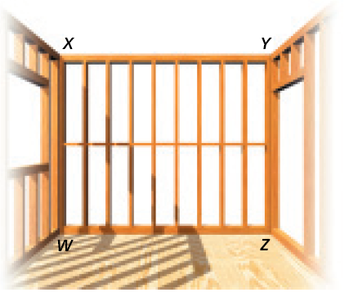
Check It Out! Example 1
A carpenter’s square can be used to test that an angle is a right angle. How could the contractor use a carpenter’s square to check that the frame is a rectangle?
Both pairs of opp. sides of WXYZ are ≅, so WXYZ is a parallelogram. The contractor can use the carpenter’s square to see if one ∠ of WXYZ is a right ∠. If one angle is a right ∠, then by Theorem 6-5-1 the frame is a rectangle.

Slide 7
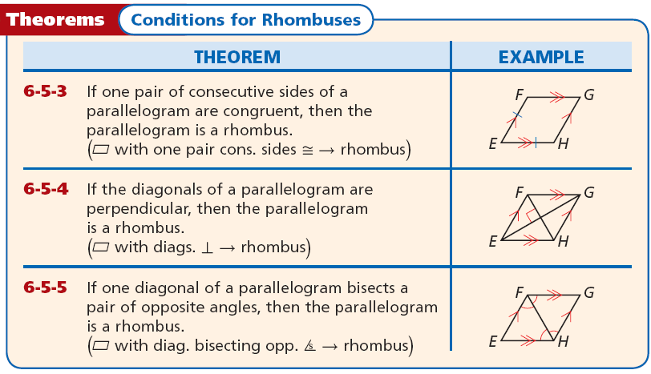
Below are some conditions you can use to determine whether a parallelogram is a rhombus.

Slide 8
Caution
In order to apply Theorems 6-5-1 through 6-5-5, the quadrilateral must be a parallelogram.
To prove that a given quadrilateral is a square, it is sufficient to show that the figure is both a rectangle and a rhombus. You will explain why this is true in Exercise 43.

Slide 9
Remember!
You can also prove that a given quadrilateral is a
rectangle, rhombus, or square by using the definitions of the special quadrilaterals.

Slide 10

Example 2A: Applying Conditions for Special Parallelograms
Determine if the conclusion is valid. If not, tell what additional information is needed to make it valid.
Given:
Conclusion: EFGH is a rhombus.
The conclusion is not valid. By Theorem 6-5-3, if one pair of consecutive sides of a parallelogram are congruent, then the parallelogram is a rhombus. By Theorem 6-5-4, if the diagonals of a parallelogram are perpendicular, then the parallelogram is a rhombus. To apply either theorem, you must first know that ABCD is a parallelogram.

Slide 11

Example 2B: Applying Conditions for Special Parallelograms
Determine if the conclusion is valid.
If not, tell what additional information is needed to make it valid.
Given:
Conclusion: EFGH is a square.
Step 1 Determine if EFGH is a parallelogram.
Given
Quad. with diags. bisecting each other →
EFGH is a parallelogram.

Slide 12



Example 2B Continued
Step 2 Determine if EFGH is a rectangle.
Given.
EFGH is a rectangle.
with diags. ≅ → rect.
Step 3 Determine if EFGH is a rhombus.
with one pair of cons. sides ≅ → rhombus
EFGH is a rhombus.

Slide 13
Example 2B Continued
Step 4 Determine is EFGH is a square.
Since EFGH is a rectangle and a rhombus, it has four right angles and four congruent sides. So EFGH is a square by definition.
The conclusion is valid.

Slide 14
Check It Out! Example 2
Determine if the conclusion is valid. If not, tell what additional information is needed to make it valid.
Given: ∠ABC is a right angle.
Conclusion: ABCD is a rectangle.
The conclusion is not valid. By Theorem 6-5-1, if one angle of a parallelogram is a right angle, then the parallelogram is a rectangle. To apply this theorem, you need to know that ABCD is a parallelogram .

Slide 15
Example 3A: Identifying Special Parallelograms in the Coordinate Plane
Use the diagonals to determine whether a parallelogram with the given vertices is a rectangle, rhombus, or square. Give all the names that apply.
P(–1, 4), Q(2, 6), R(4, 3), S(1, 1)

Slide 16
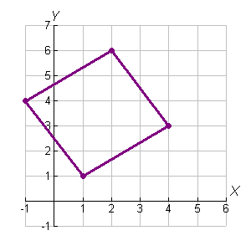
Example 3A Continued
Step 1 Graph PQRS.

Slide 17
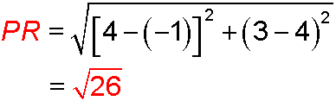
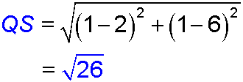

Example 3A Continued
Step 2 Find PR and QS to determine if PQRS is a rectangle.
Since , the diagonals are congruent. PQRS is a rectangle.

Slide 18



Example 3A Continued
Step 3 Determine if PQRS is a rhombus.
Since , PQRS is a rhombus.
Step 4 Determine if PQRS is a square.
Since PQRS is a rectangle and a rhombus, it has four right angles and four congruent sides. So PQRS is a square by definition.

Slide 19
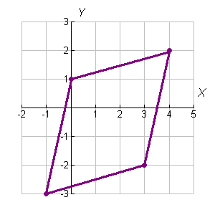
Example 3B: Identifying Special Parallelograms in the Coordinate Plane
Use the diagonals to determine whether a parallelogram with the given vertices is a rectangle, rhombus, or square. Give all the names that apply.
W(0, 1), X(4, 2), Y(3, –2), Z(–1, –3)
Step 1 Graph WXYZ.

Slide 20
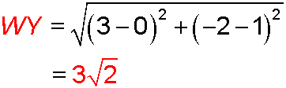
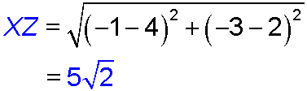

Example 3B Continued
Step 2 Find WY and XZ to determine if WXYZ is a rectangle.
Since , WXYZ is not a rectangle.
Thus WXYZ is not a square.

Slide 21



Example 3B Continued
Step 3 Determine if WXYZ is a rhombus.
Since (–1)(1) = –1, , WXYZ is a rhombus.

Slide 22
Check It Out! Example 3A
Use the diagonals to determine whether a parallelogram with the given vertices is a rectangle, rhombus, or square. Give all the names that apply.
K(–5, –1), L(–2, 4), M(3, 1), N(0, –4)

Slide 23
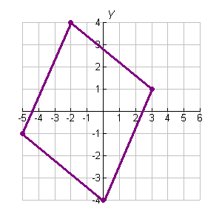
Check It Out! Example 3A Continued
Step 1 Graph KLMN.

Slide 24
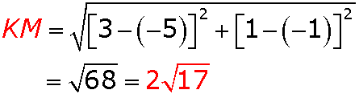
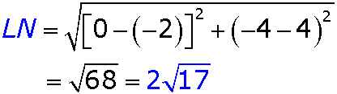

Check It Out! Example 3A Continued
Step 2 Find KM and LN to determine if KLMN is a rectangle.
Since , KMLN is a rectangle.

Slide 25


Check It Out! Example 3A Continued
Step 3 Determine if KLMN is a rhombus.
Since the product of the slopes is –1, the two lines are perpendicular. KLMN is a rhombus.

Slide 26
Check It Out! Example 3A Continued
Step 4 Determine if KLMN is a square.
Since KLMN is a rectangle and a rhombus, it has four right angles and four congruent sides. So KLMN is a square by definition.

Slide 27
Check It Out! Example 3B
Use the diagonals to determine whether a parallelogram with the given vertices is a rectangle, rhombus, or square. Give all the names that apply.
P(–4, 6) , Q(2, 5) , R(3, –1) , S(–3, 0)

Slide 28
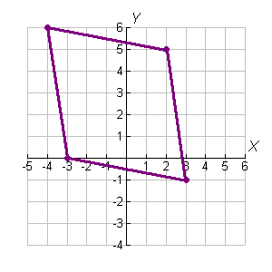
Check It Out! Example 3B Continued
Step 1 Graph PQRS.

Slide 29
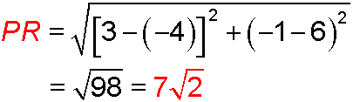
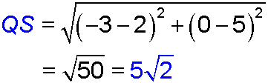

Check It Out! Example 3B Continued
Step 2 Find PR and QS to determine if PQRS is a rectangle.
Since , PQRS is not a rectangle. Thus PQRS is not a square.

Slide 30



Check It Out! Example 3B Continued
Step 3 Determine if PQRS is a rhombus.
Since (–1)(1) = –1, are perpendicular and congruent. PQRS is a rhombus.

Slide 31
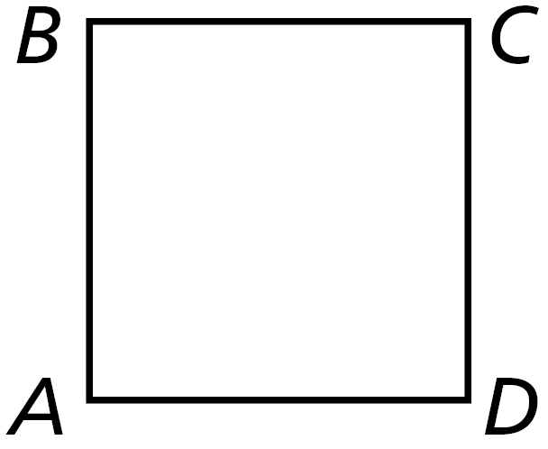

Lesson Quiz: Part I
1. Given that AB = BC = CD = DA, what additional information is needed to conclude that ABCD is a square?

Slide 32

Lesson Quiz: Part II
2. Determine if the conclusion is valid. If not, tell what additional information is needed to make it valid.
Given: PQRS and PQNM are parallelograms.
Conclusion: MNRS is a rhombus.
valid

Slide 33
Exit Ticket 2
1. Use the diagonals to determine whether a parallelogram with vertices A(2, 7), B(7, 9), C(5, 4), and D(0, 2) is a rectangle, rhombus, or square. Give all the names that apply.
AC ≠ BD, so ABCD is not a rect. or a square. The slope of AC = –1, and the slope of BD
= 1, so AC ⊥ BD. ABCD is a rhombus.

