Slide 1

Graphing Functions
Warm Up
Lesson Presentation
Lesson Quiz
Holt McDougal Algebra 1
Holt Algebra 1

Slide 2


Warm Up
Solve each equation for y.
1. 2x + y = 3
2. –x + 3y = –6
3. 4x – 2y = 8
4. Generate ordered pairs for
y = –2x + 3
y = 2x – 4
using x = –4, –2, 0, 2 and 4.
(–4, –1), (–2, 0), (0, 1), (2, 2), (4, 3)

Slide 3
Objectives
Graph functions given a limited domain.
Graph functions given a domain of all real numbers.

Slide 4
Scientists can use a function to make conclusions about the rising sea level.
Sea level is rising at an approximate rate of 2.5 millimeters per year. If this rate continues, the function y = 2.5x can describe how many millimeters y sea level will rise in the next x years.
One way to understand functions such as the one above is to graph them. You can graph a function by finding ordered pairs that satisfy the function.

Slide 5


Example 1A: Graphing Solutions Given a Domain
Graph the function for the given domain.
x – 3y = –6; D: {–3, 0, 3, 6}
Step 1 Solve for y since you are given values of the domain, or x.
x – 3y = –6
–x
–x
Subtract x from both sides.
–3y = –x – 6
Since y is multiplied by –3, divide both sides by –3.
Simplify.

Slide 6





Example 1A Continued
Graph the function for the given domain.
Step 2 Substitute the given value of the domain for x and find values of y.
x
(x, y)
–3
(–3, 1)
0
(0, 2)
3
(3, 3)
6
(6, 4)

Slide 7
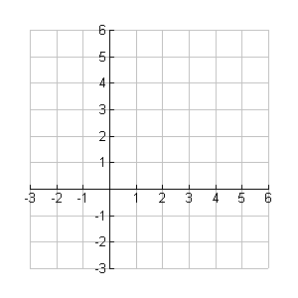
Example 1A Continued
Graph the function for the given domain.
Step 3 Graph the ordered pairs.
y
•
•
•
•
x

Slide 8
Example 1B: Graphing Solutions Given a Domain
Graph the function for the given domain.
f(x) = x² – 3; D: {–2, –1, 0, 1, 2}
Step 1 Use the given values of the domain to find values of f(x).
x
f(x) = x² – 3
(x, f(x))
–2
f(x) = (–2)² – 3 = 1
(–2, 1)
–1
f(x) = (–1)² – 3 = –2
(–1, –2)
0
f(x) = 0² – 3 = –3
(0, –3)
1
f(x) = 1² – 3 = –2
(1, –2)
2
f(x) = 2² – 3 = 1
(2, 1)

Slide 9
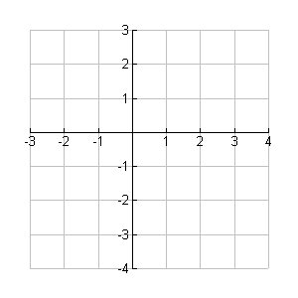
Example 1B Continued
Graph the function for the given domain.
f(x) = x² – 3; D: {–2, –1, 0, 1, 2}
Step 2 Graph the ordered pairs.
y
•
•
x
•
•
•

Slide 10
Check It Out! Example 1a
Graph the function for the given domain.
–2x + y = 3; D: {–5, –3, 1, 4}
Step 1 Solve for y since you are given values of the domain, or x.
–2x + y = 3
+2x +2x
Add 2x to both sides.
y = 2x + 3

Slide 11
Check It Out! Example 1a Continued
Graph the function for the given domain.
–2x + y = 3; D: {–5, –3, 1, 4}
Step 2 Substitute the given values of the domain for x and find values of y.
x
y = 2x + 3
(x, y)
–5
y = 2(–5) + 3 = –7
(–5, –7)
–3
y = 2(–3) + 3 = –3
(–3, –3)
1
y = 2(1) + 3 = 5
(1, 5)
4
y = 2(4) + 3 = 11
(4, 11)

Slide 12
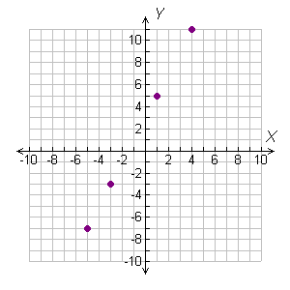
Check It Out! Example 1a Continued
Graph the function for the given domain.
–2x + y = 3; D: {–5, –3, 1, 4}
Step 3 Graph the ordered pairs.

Slide 13
Check It Out! Example 1b
Graph the function for the given domain.
f(x) = x² + 2; D: {–3, –1, 0, 1, 3}
Step 1 Use the given values of the domain to find the values of f(x).
x
f(x) = x² + 2
(x, f(x))
–3
f(x) = (–3²) + 2= 11
(–3, 11)
–1
f(x) = (–1² ) + 2= 3
(–1, 3)
0
f(x) = 0² + 2= 2
(0, 2)
1
f(x) = 1² + 2=3
(1, 3)
3
f(x) = 3² + 2=11
(3, 11)

Slide 14
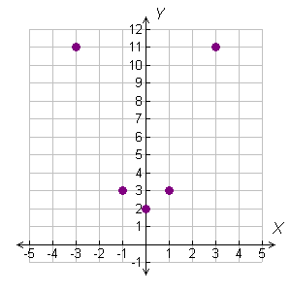
Check It Out! Example 1b
Graph the function for the given domain.
f(x) = x² + 2; D: {–3, –1, 0, 1, 3}
Step 2 Graph the ordered pairs.

Slide 15
If the domain of a function is all real numbers, any number can be used as an input value. This process will produce an infinite number of ordered pairs that satisfy the function. Therefore, arrowheads are drawn at both “ends” of a smooth line or curve to represent the infinite number of ordered pairs. If a domain is not given, assume that the domain is all real numbers.

Slide 16
Graphing Functions Using a Domain of All Real Numbers
Use the function to generate ordered pairs by choosing several values for x.
Step 1
Plot enough points to see a pattern for the graph.
Step 2
Connect the points with a line or smooth curve.
Step 3

Slide 17
Example 2A: Graphing Functions
Graph the function –3x + 2 = y.
Step 1 Choose several values of x and generate ordered pairs.
x | –3x + 2 = y | (x, y)
–2
–3(–2) + 2 = 8
(–2, 8)
–1
–3(–1) + 2 = 5
(–1, 5)
0
–3(0) + 2 = 2
(0, 2)
1
–3(1) + 2 = –1
(1, –1)
2
–3(2) + 2 = –4
(2, –4)
3
–3(3) + 2 = –7
(3, –7)

Slide 18
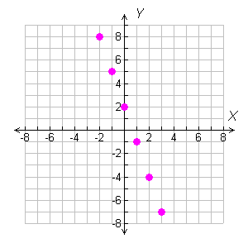
Example 2A Continued
Graph the function –3x + 2 = y.
Step 2 Plot enough points to see a pattern.

Slide 19
Example 2A Continued
Graph the function –3x + 2 = y.
Step 3 The ordered pairs appear to form a line. Draw a line through all the points to show all the ordered pairs that satisfy the function. Draw arrowheads on both “ends” of the line.

Slide 20
Example 2B: Graphing Functions
Graph the function g(x) = |x| + 2.
Step 1 Choose several values of x and generate ordered pairs.
x | g(x) = |x| + 2 | (x, g(x))
–2
g(x) = |–2| + 2= 4
(–2, 4)
–1
g(x) = |–1| + 2= 3
(–1, 3)
0
g(x) = |0| + 2= 2
(0, 2)
1
g(x) = |1| + 2= 3
(1, 3)
2
g(x) = |2| + 2= 4
(2, 4)
3
g(x) = |3| + 2= 5
(3, 5)

Slide 21
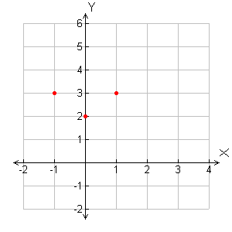
Example 2B Continued
Graph the function g(x) = |x| + 2.
Step 2 Plot enough points to see a pattern.

Slide 22
Example 2B Continued
Graph the function g(x) = |x| + 2.
Step 3 The ordered pairs appear to form a v-shaped graph. Draw lines through all the points to show all the ordered pairs that satisfy the function. Draw arrowheads on the “ends” of the “V”.

Slide 23
Example 2B Continued
Graph the function g(x) = |x| + 2.
Check If the graph is correct, any point on it will satisfy the function. Choose an ordered pair on the graph that was not in your table. (4, 6) is on the graph. Check whether it satisfies g(x)= |x| + 2.
g(x) = |x| + 2
6 |4| + 2
Substitute the values for x and y into the function. Simplify.
6 4 + 2
6 6
✓
The ordered pair (4, 6) satisfies the function.

Slide 24
Check It Out! Example 2a
Graph the function f(x) = 3x – 2.
Step 1 Choose several values of x and generate ordered pairs.
x | f(x) = 3x – 2 | (x, f(x))
–2
f(x) = 3(–2) – 2 = –8
(–2, –8)
–1
f(x) = 3(–1) – 2 = –5
(–1, –5)
0
f(x) = 3(0) – 2 = –2
(0, –2)
1
f(x) = 3(1) – 2 = 1
(1, 1)
2
f(x) = 3(2) – 2 = 4
(2, 4)
3
f(x) = 3(3) – 2 = 7
(3, 7)

Slide 25
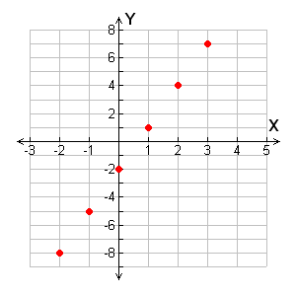
Check It Out! Example 2a Continued
Graph the function f(x) = 3x – 2.
Step 2 Plot enough points to see a pattern.

Slide 26
Check It Out! Example 2a Continued
Graph the function f(x) = 3x – 2.
Step 3 The ordered pairs appear to form a line. Draw a line through all the points to show all the ordered pairs that satisfy the function. Draw arrowheads on both “ends” of the line.

Slide 27
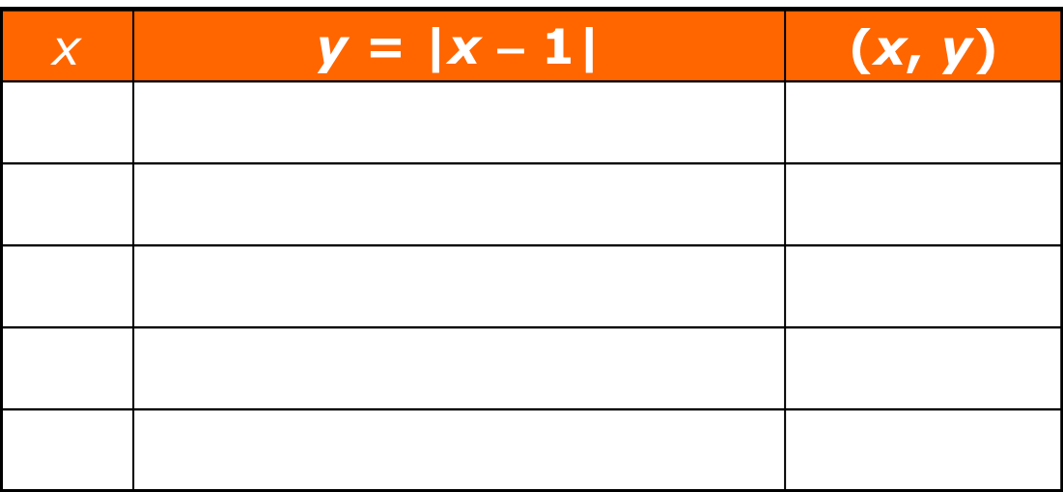
Check It Out! Example 2b
Graph the function y = |x – 1|.
Step 1 Choose several values of x and generate ordered pairs.
–2
y = |–2 – 1| = 3
(–2, 3)
–1
y = |–1 – 1| = 2
(–1, 2)
0
y = |0 – 1| = 1
(0, 1)
1
y = |1 – 1| = 0
(1, 0)
2
y = |2 – 1| = 1
(2, 1)

Slide 28
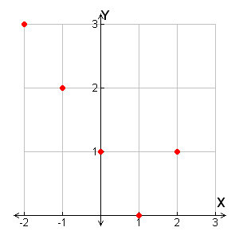
Check It Out! Example 2b Continued
Graph the function y = |x – 1|.
Step 2 Plot enough points to see a pattern.

Slide 29
Check It Out! Example 2b Continued
Graph the function y = |x – 1|.
Step 3 The ordered pairs appear to form a v-shaped graph. Draw lines through the points to show all the ordered pairs that satisfy the function. Draw arrowheads on both “ends” of the “V”.

Slide 30
Check It Out! Example 2b Continued
Graph the function y = |x – 1|.
Check If the graph is correct, any point on the graph will satisfy the function. Choose an ordered pair on the graph that is not in your table. (3, 2) is on the graph. Check whether it satisfies y = |x – 1|.
y = |x – 1|
2 |3 – 1|
Substitute the values for x and y into the function. Simplify.
2 |2|
2 2
✓
The ordered pair (3, 2) satisfies the function.

Slide 31

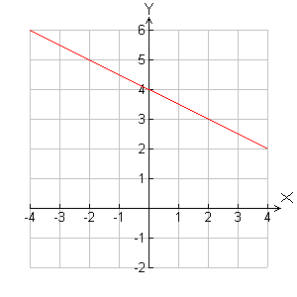
Example 3: Finding Values Using Graphs
Use a graph of the function to find the value of f(x) when x = –4. Check your answer.
Locate –4 on the x-axis. Move up to the graph of the function. Then move right to the y-axis to find the corresponding value of y.
f(–4) = 6

Slide 32


Example 3 Continued
Use a graph of the function to find the value of f(x) when x = –4. Check your answer.
f(–4) = 6
Check Use substitution.
6
Substitute the values for x and y into the function.
6
2 + 4
Simplify.
6
6
✓
The ordered pair (–4, 6) satisfies the function.

Slide 33

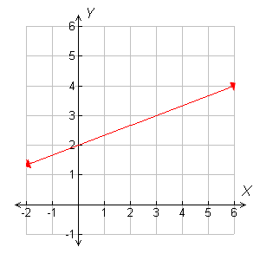
Check It Out! Example 3
Use the graph of to find the value of x when f(x) = 3. Check your answer.
Locate 3 on the y-axis. Move right to the graph of the function. Then move down to the x-axis to find the corresponding value of x.
f(3) = 3

Slide 34


Check It Out! Example 3 Continued
Use the graph of to find the value of x when f(x) = 3. Check your answer.
f(3) = 3
Check Use substitution.
Substitute the values for x and y into the function.
3
3
1 + 2
Simplify.
3
3
✓
The ordered pair (3, 3) satisfies the function.

Slide 35
Recall that in real-world situations you may have to limit the domain to make answers reasonable. For example, quantities such as time, distance, and number of people can be represented using only nonnegative values. When both the domain and the range are limited to nonnegative values, the function is graphed only in Quadrant I.

Slide 36

Example 4: Problem-Solving Application
A mouse can run 3.5 meters per second. The function y = 3.5x describes the distance in meters the mouse can run in x seconds. Graph the function. Use the graph to estimate how many meters a mouse can run in 2.5 seconds.

Slide 37

Example 4 Continued
1
Understand the Problem
The answer is a graph that can be used to find the value of y when x is 2.5.
List the important information:
• The function y = 3.5x describes how many meters the mouse can run.

Slide 38

Example 4 Continued
2
Make a Plan
Think: What values should I use to graph this function? Both the number of seconds the mouse runs and the distance the mouse runs cannot be negative. Use only nonnegative values for both the domain and the range. The function will be graphed in Quadrant I.

Slide 39

Example 4 Continued
3
Solve
Choose several nonnegative values of x to find values of y.
x
y = 3.5x
(x, y)
0
y = 3.5(0) = 0
(0, 0)
1
y = 3.5(1) = 3.5
(1, 3.5)
2
y = 3.5(2) = 7
(2, 7)
3
y = 3.5(3) = 10.5
(3, 10.5)

Slide 40
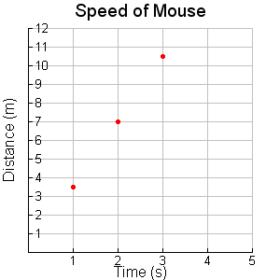
Example 4 Continued
3
Solve
Graph the ordered pairs.
Draw a line through the points to show all the ordered pairs that satisfy this function.
Use the graph to estimate the y-value when x is 2.5.
A mouse can run about 8.75 meters in 2.5 seconds.

Slide 41

Example 4 Continued
4
Look Back
As time increases, the distance traveled also increases, so the graph is reasonable. When x is between 2 and 3, y is between 7 and 10.5. Since 2.5 is between 2 and 3, it is reasonable to estimate y to be 8.75 when x is 2.5.

Slide 42
Check It Out! Example 4
The fastest recorded Hawaiian lava flow moved at an average speed of 6 miles per hour. The function y = 6x describes the distance y the lava moved on average in x hours. Graph the function. Use the graph to estimate how many miles the lava moved after 5.5 hours.

Slide 43
Check It Out! Example 4 Continued
1
Understand the Problem
The answer is a graph that can be used to find the value of y when x is 5.5.
List the important information:
• The function y = 6x describes how many miles the lava can flow.

Slide 44
Check It Out! Example 4 Continued
2
Make a Plan
Think: What values should I use to graph this function? Both the speed of the lava and the number of hours it flows cannot be negative. Use only nonnegative values for both the domain and the range. The function will be graphed in Quadrant I.

Slide 45
Check It Out! Example 4 Continued
3
Solve
Choose several nonnegative values of x to find values of y.
x
y = 6x
(x, y)
1
y = 6(1) = 6
(1, 6)
3
y = 6(3) = 18
(3, 18)
5
y = 6(5) = 30
(5, 30)

Slide 46
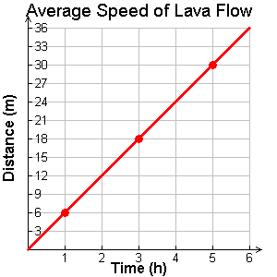
Check It Out! Example 4 Continued
3
Solve
Graph the ordered pairs.
Draw a line through the points to show all the ordered pairs that satisfy this function.
Use the graph to estimate the y-value when x is 5.5.
The lava will travel about 32.5 meters in 5.5 seconds.

Slide 47
Check It Out! Example 4 Continued
4
Look Back
As the amount of time increases, the distance traveled by the lava also increases, so the graph is reasonable. When x is between 5 and 6, y is between 30 and 36. Since 5.5 is between 5 and 6, it is reasonable to estimate y to be 32.5 when x is 5.5.

Slide 48
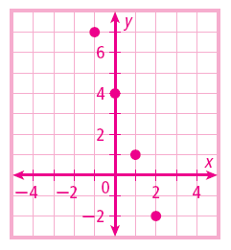
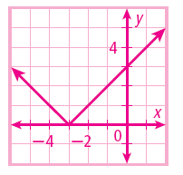
Lesson Quiz: Part I
1. Graph the function for the given domain.
3x + y = 4
D: {–1, 0, 1, 2}
2. Graph the function y = |x + 3|.

Slide 49
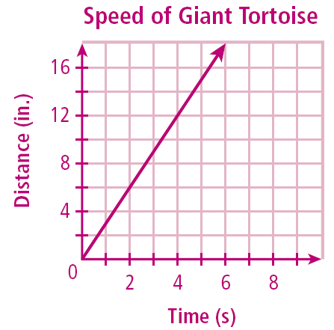
Lesson Quiz: Part II
3. The function y = 3x describes the distance (in inches) a giant tortoise walks in x seconds. Graph the function. Use the graph to estimate how many inches the tortoise will walk in 5.5 seconds.
About 16.5 in.

