Slide 1

Ratios in Similar Polygons
Warm Up
Lesson Presentation
Lesson Quiz
Holt McDougal Geometry
Holt Geometry

Slide 2


Warm Up
1. If ∆QRS ≅ ∆ZYX, identify the pairs of congruent angles and the pairs of congruent sides.
Solve each proportion.
2. 3.
∠Q ≅ ∠Z; ∠R ≅ ∠Y; ∠S ≅ ∠X; QR ≅ ZY; RS ≅ YX; QS ≅ ZX
x = 9
x = 18

Slide 3
Objectives
Identify similar polygons.
Apply properties of similar polygons to solve problems.

Slide 4
Vocabulary
similar
similar polygons
similarity ratio

Slide 5
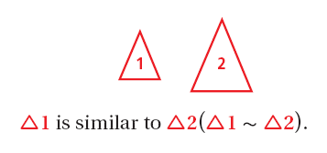
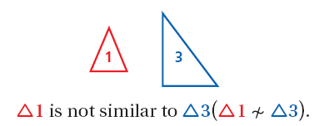
Figures that are similar (~) have the same shape but not necessarily the same size.

Slide 6
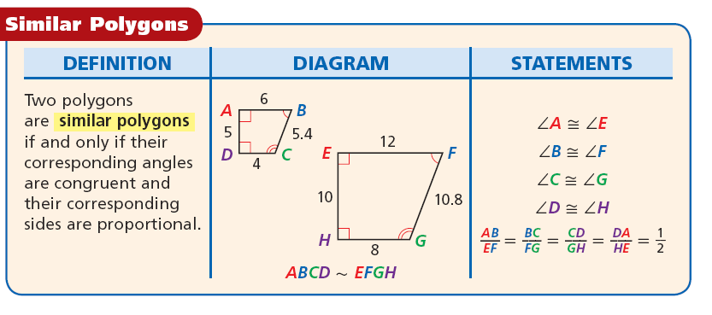
Two polygons are similar polygons if and only if their corresponding angles are congruent and their corresponding side lengths are proportional.

Slide 7
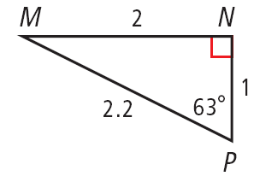
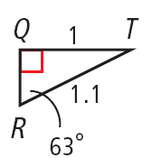

Example 1: Describing Similar Polygons
Identify the pairs of congruent angles and corresponding sides.
0.5
∠N ≅ ∠Q and ∠P ≅ ∠R.
By the Third Angles Theorem, ∠M ≅ ∠T.

Slide 8

Check It Out! Example 1
Identify the pairs of congruent angles and corresponding sides.
∠B ≅ ∠G and ∠C ≅ ∠H.
By the Third Angles Theorem, ∠A ≅ ∠J.

Slide 9
A similarity ratio is the ratio of the lengths of
the corresponding sides of two similar polygons.
The similarity ratio of ∆ABC to ∆DEF is , or .
The similarity ratio of ∆DEF to ∆ABC is , or 2.

Slide 10
Writing Math
Writing a similarity statement is like writing a congruence statement—be sure to list corresponding vertices in the same order.

Slide 11
Example 2A: Identifying Similar Polygons
Determine whether the polygons are similar. If so, write the similarity ratio and a similarity statement.
rectangles ABCD and EFGH

Slide 12
Example 2A Continued
Step 1 Identify pairs of congruent angles.
∠A ≅ ∠E, ∠B ≅ ∠F,
∠C ≅ ∠G, and ∠D ≅ ∠H.
All ∠s of a rect. are rt. ∠s and are ≅.
Step 2 Compare corresponding sides.
Thus the similarity ratio is , and rect. ABCD ~ rect. EFGH.

Slide 13
Example 2B: Identifying Similar Polygons
Determine whether the polygons are similar. If so, write the similarity ratio and a similarity statement.
∆ABCD and ∆EFGH

Slide 14

Example 2B Continued
Step 1 Identify pairs of congruent angles.
∠P ≅ ∠R and ∠S ≅ ∠W
isos. ∆
Step 2 Compare corresponding angles.
m∠W = m∠S = 62°
m∠T = 180° – 2(62°) = 56°
Since no pairs of angles are congruent, the triangles are not similar.

Slide 15
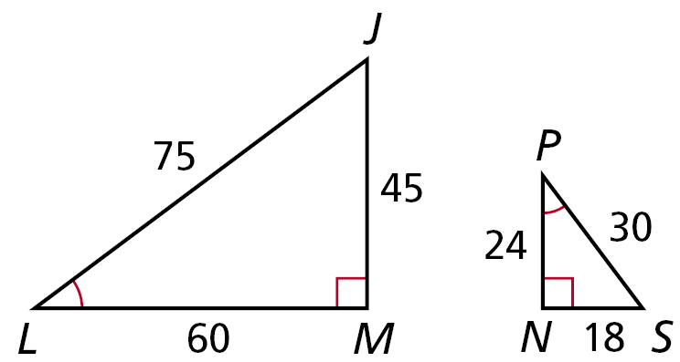
Check It Out! Example 2
Determine if ∆JLM ~ ∆NPS. If so, write the similarity ratio and a similarity statement.
Step 1 Identify pairs of congruent angles.
∠N ≅ ∠M, ∠L ≅ ∠P, ∠S ≅ ∠J

Slide 16

Check It Out! Example 2 Continued
Step 2 Compare corresponding sides.
Thus the similarity ratio is , and ∆LMJ ~ ∆PNS.

Slide 17
Helpful Hint
When you work with proportions, be sure the ratios compare corresponding measures.

Slide 18
Example 3: Hobby Application
Find the length of the model to the nearest tenth of a centimeter.
Let x be the length of the model in centimeters. The rectangular model of the racing car is similar to the rectangular racing car, so the corresponding lengths are proportional.

Slide 19


Example 3 Continued
5(6.3) = x(1.8)
Cross Products Prop.
31.5 = 1.8x
Simplify.
17.5 = x
Divide both sides by 1.8.
The length of the model is 17.5 centimeters.

Slide 20


Check It Out! Example 3
A boxcar has the dimensions shown.
A model of the boxcar is 1.25 in. wide. Find the length of the model to the nearest inch.

Slide 21
Check It Out! Example 3 Continued
1.25(36.25) = x(9)
Cross Products Prop.
45.3 = 9x
Simplify.
5 ≈ x
Divide both sides by 9.
The length of the model is approximately 5 inches.

Slide 22
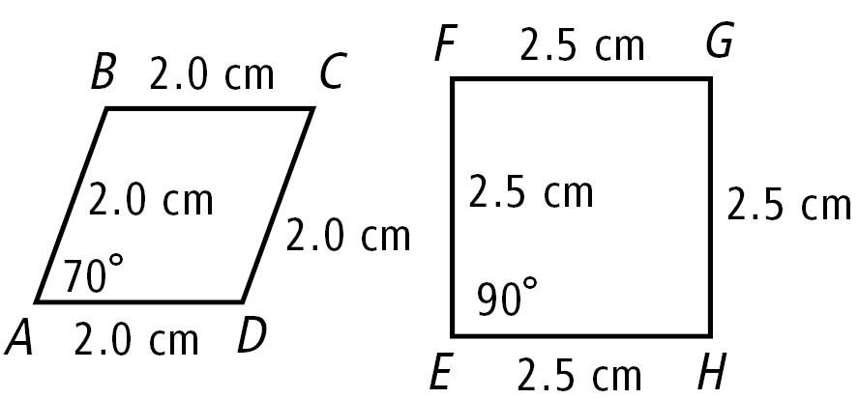

Lesson Quiz: Part I
1. Determine whether the polygons are similar. If so, write the similarity ratio and a similarity statement.
2. The ratio of a model sailboat’s dimensions to the actual boat’s dimensions is . If the length of the model is 10 inches, what is the length of the actual sailboat in feet?
no
25 ft

Slide 23
Lesson Quiz: Part II
3. Tell whether the following statement is sometimes, always, or never true. Two equilateral triangles are similar.
Always

